Slide 1
Get the Most Out of Tecplot 360 EX with Overset Grids Best Practices and Upcoming Features
Scott Fowler, Product Manager
Scott Imlay PhD, Chief Technology Officer

Slide 2
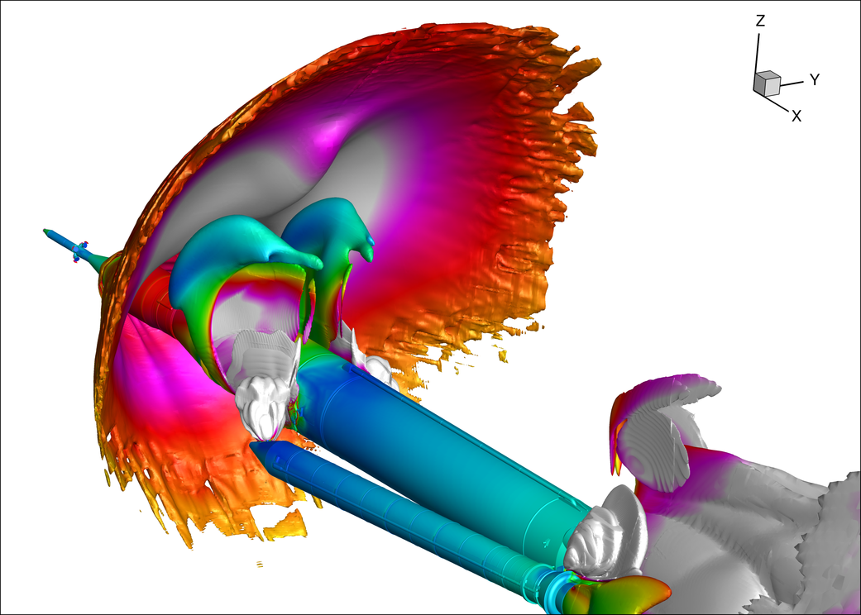
35 Years of Helping Engineers SEE
We believe visual data analysis is the key to unlocking information hidden in complex data leading to world changing discoveries and innovation.

Slide 3
CSI buys businesses and leaves them to continue their Exceptional operations.
Significant opportunities come with new resources:
New technologies and features
Ability to solve more parts of your workflow
Industry-leading technical support
Staying power!
Notes:
CSI buys Exceptional businesses that represent a lifetime of effort and talent, and CSI buys from owners who desire to have their businesses continue to operate in accordance with the history and values that made them Exceptional in the first place. Following an acquisition, CSI leaves them to continue their Exceptional operations as they have in the past.

Slide 4
What is Tecplot 360 EX
Tecplot 360 EX is our most significant update since 2003
New GUI technology
Faster load and processing speeds
Focus on ease of use
New interface on Mac and Linux

Slide 5
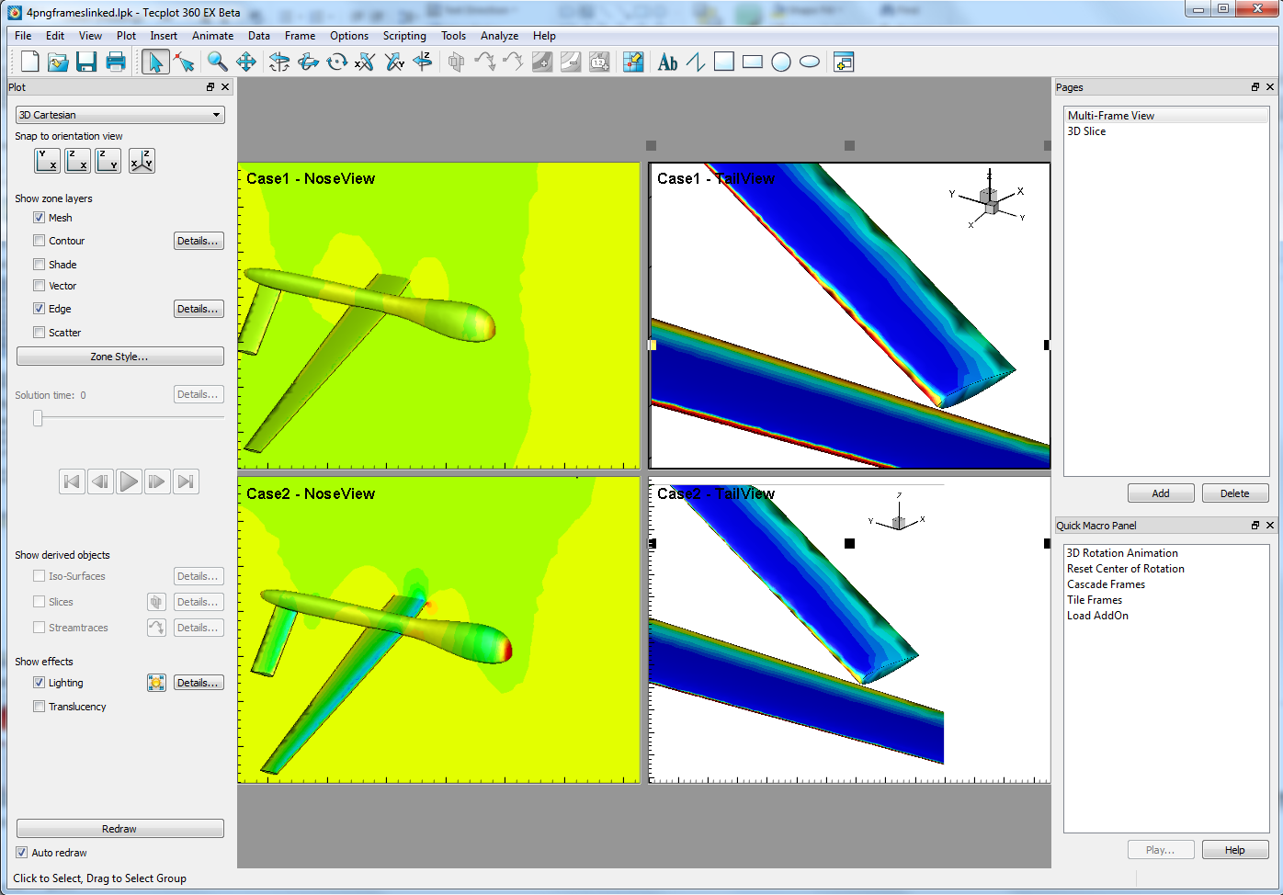
New Interface
Dockable side and tool bars
Pages and Macro Panels
Right-click context menus

Slide 6
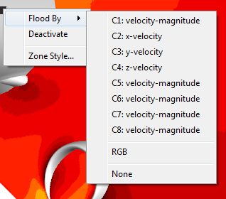
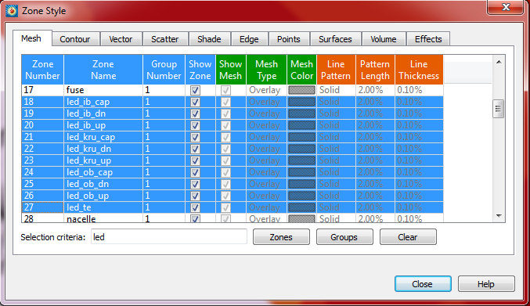
Controlling Plot Style in 360 EX
Context Menu
Onscreen Context Menus
Zone Style Dialog improvements
Zone Style

Slide 7
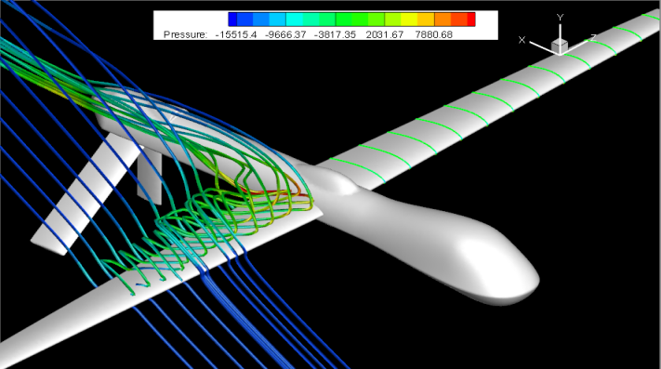
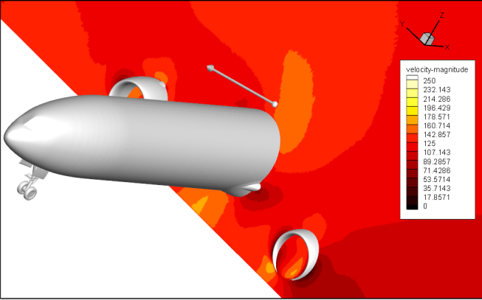
Slicing Design in Tecplot 360 EX
Surface Slices
Slices
Volume slices
Surface slices
Surfaces of Volumes
Arbitrary Slices
Extraction via right-click
Arbitrary Slices

Slide 8
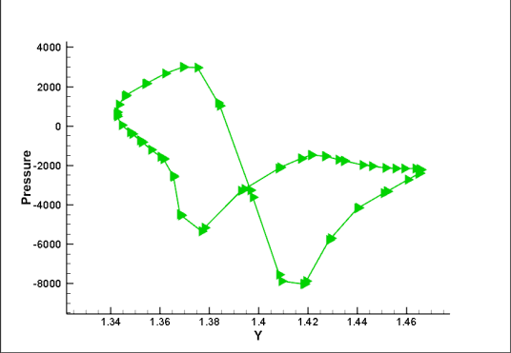
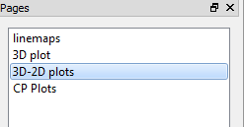
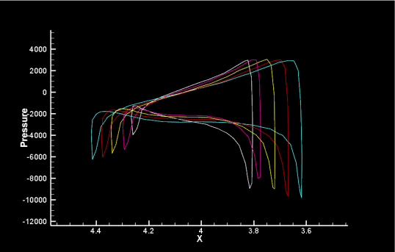
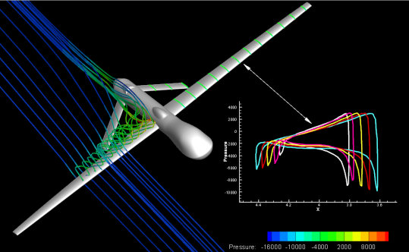
Using Pages in 360 EX
Pages are like Slides
Can be used to create reports and presentations

Slide 9
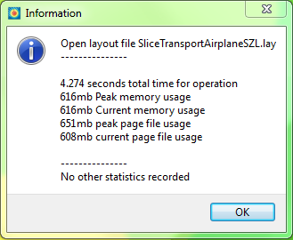
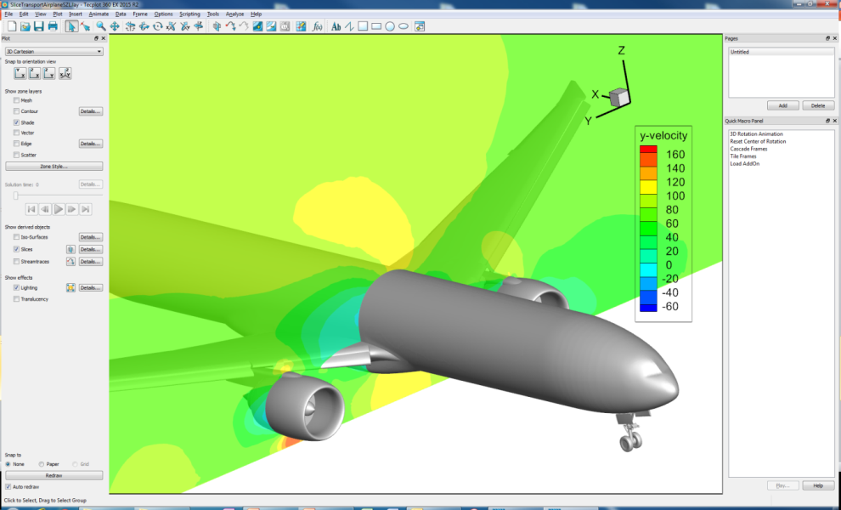
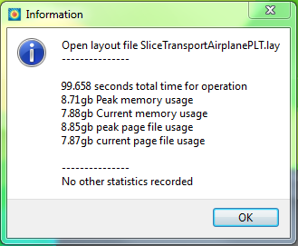
New Subzone Load-on-Demand PLT Format
183M Cell CFD++ Solution
*.szplt
23X Faster!
93% Less RAM
40% File compression
*.plt
Dell Precision Laptop Quad Core 16GB RAM

Slide 10
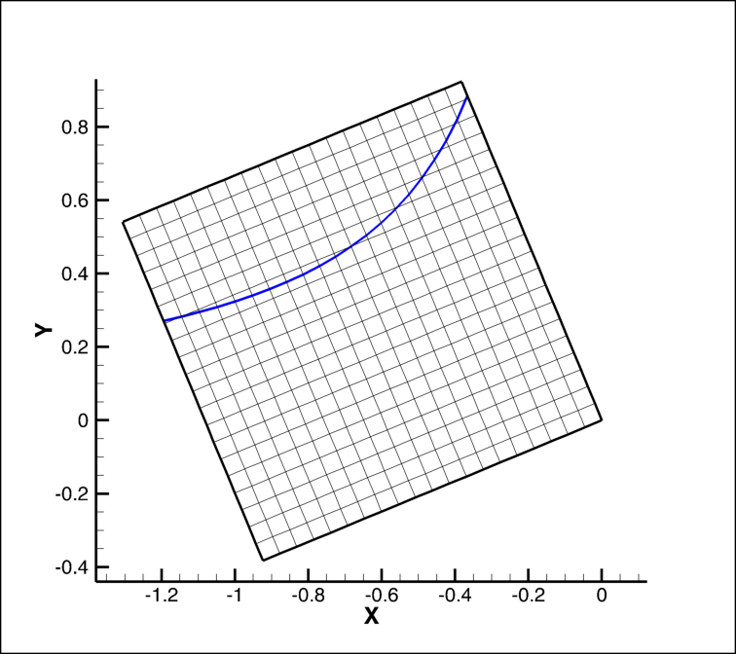
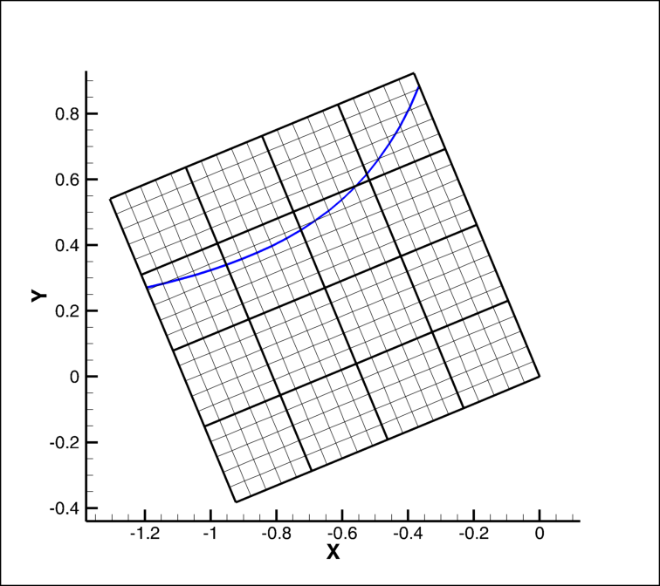
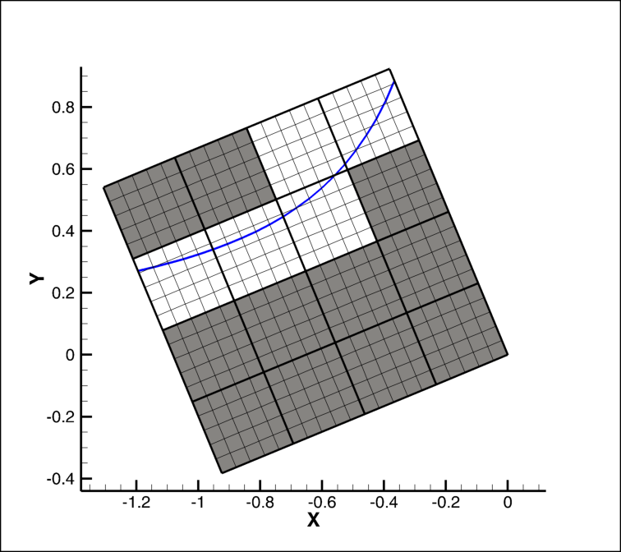
How Does SZL Work?
Example 2D Contour Line
Current Methodologies require loading data for zone
For Large data loading can be time intensive
Domain can be indexed
Decomposition of domain into smaller subdomains
These subdomains can be indexed
Data Required for Line 5/16 of total data
Loading time reduced
Memory requirements reduced

Slide 11
Tips & Tricks

Slide 12
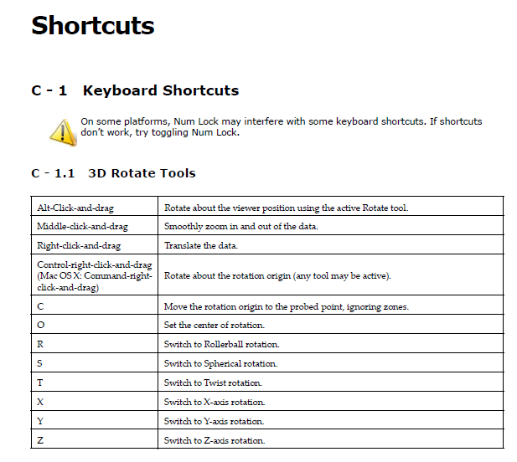
Tips & Tricks
Mouse Shortcuts
‘O’ key to reset the center of rotation
Middle mouse click to redraw
Rotate with Ctrl+Right mouse
Translate with Right mouse
Zoom with Middle mouse
Use a 3D Mouse! (Windows only)

Slide 13
Tips & Tricks
Use the PLT or SZL file formats to:
Reduce File Size
Reduce memory footprint
Decrease time to load & render data
For a 263 million element dataset, rendering a slice:
File type | File size | RAM | Time | Conversion Time (m:ss)
Plot3D | 21.9Gb | 3,500 Mb | 8.6s | N/A
SZL | 13.4Gb | 324Mb | 5.4s | 6:54
PLT | 13.1Gb | 725Mb | 5.9s | 2:32

Slide 14
Tips & Tricks
Update to the latest release for improved performance
Q-Criterion calculation is over 3x faster
Iso-surface rendering is 10% faster
Plot3D loader now handles 64-bit data files*
Product | Data File Type | Size | Max RAM (Gb) | Max CPU | Time to Calculate Q-Criterion | Time to render iso-surface @ Q = 0 | Total Time
Tecplot 360 EX | Plot3D | 50,000,000 | 28 | 100% | 01:35.9 | 00:39.2 | 02:15.1
Tecplot 360 2013 | Tecplot Binary (PLT) | 50,000,000 | 22 | 25% | 04:08.9 | 00:44.9 | 04:53.8
*Support for Plot3D continuation markers available early 2017.

Slide 15
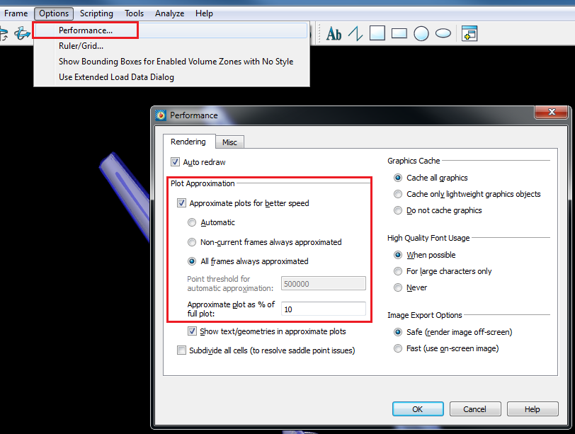
Use Plot Approximations to Improve Interactive Performance
Tips & Tricks

Slide 16
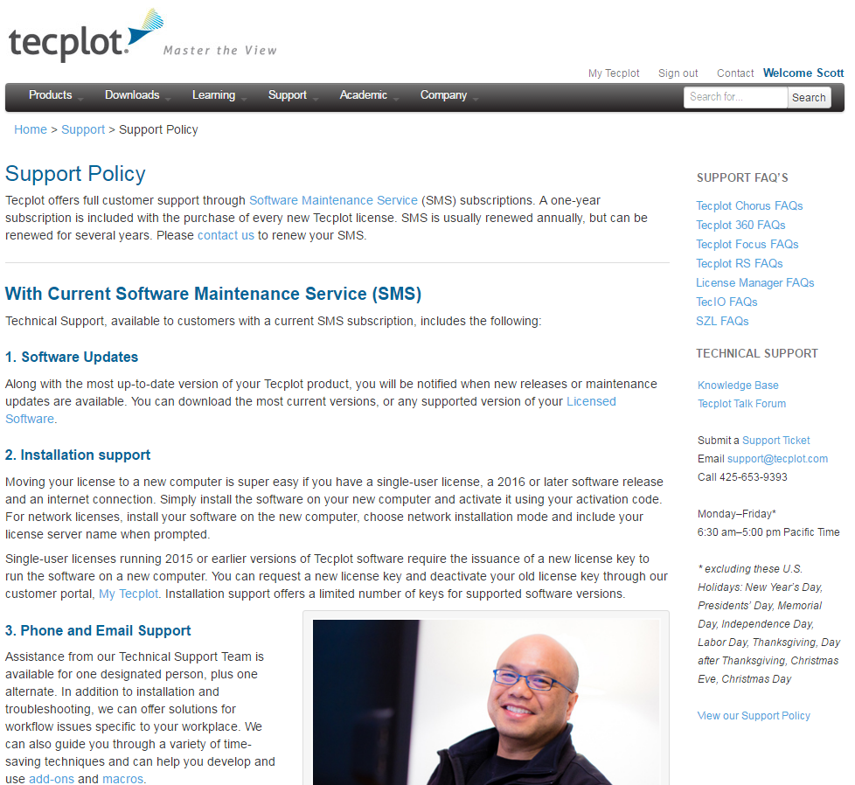
Tips & Tricks
Call Technical Support!

Slide 17
Overset Specific Tips

Slide 18
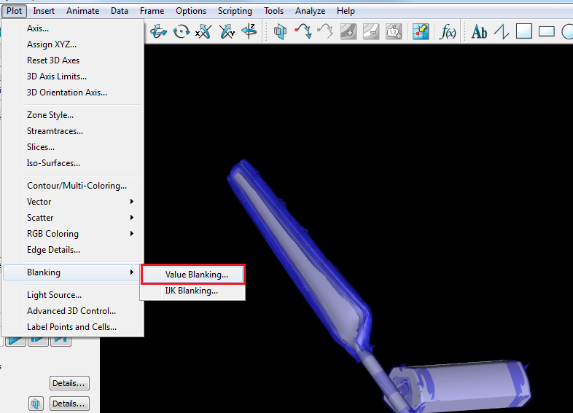
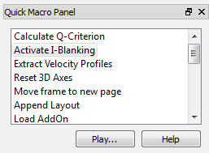
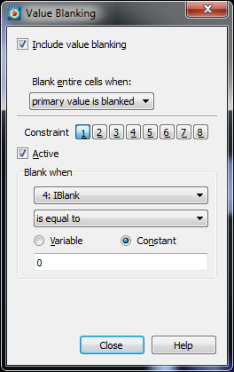
Use Value Blanking
Use the Quick Macro Panel for common settings

Slide 19
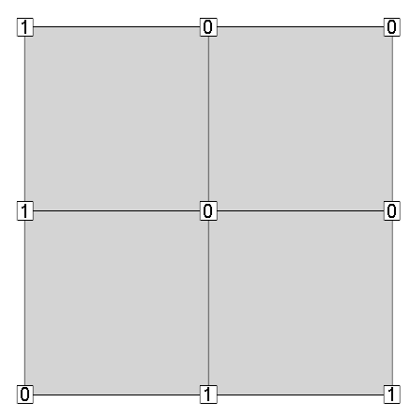
Use Value Blanking
Know the Blanking types
Primary Value
All corners
Any corner

Slide 20
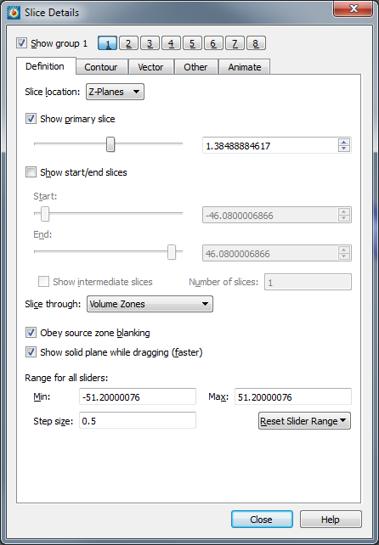
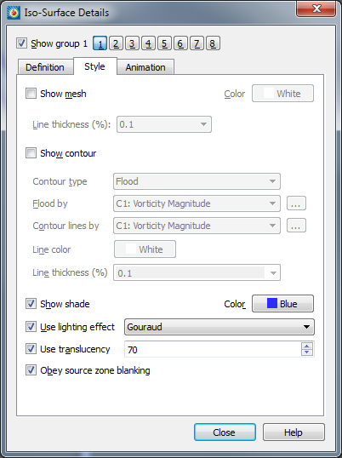
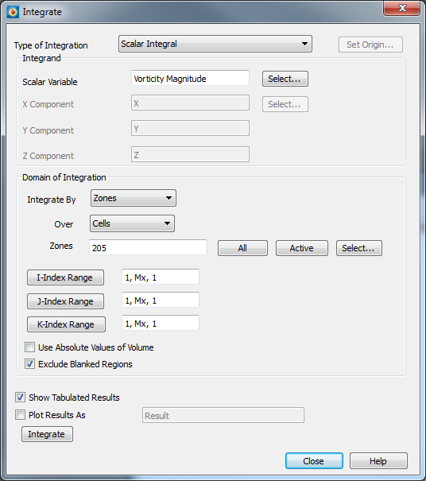
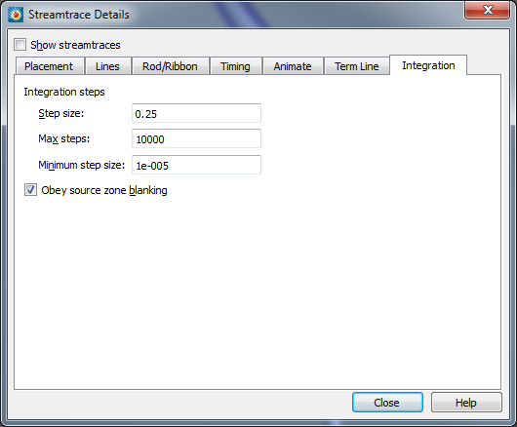
Use Value Blanking

Slide 21
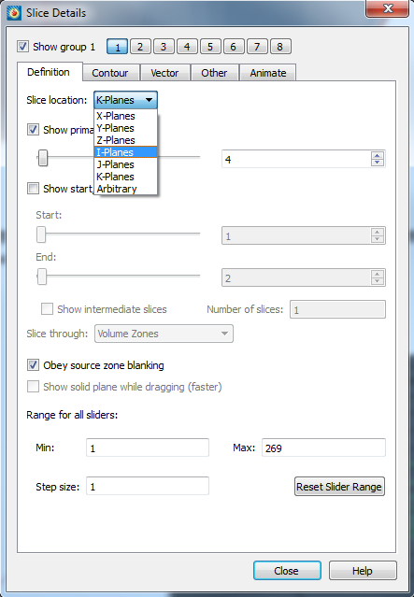
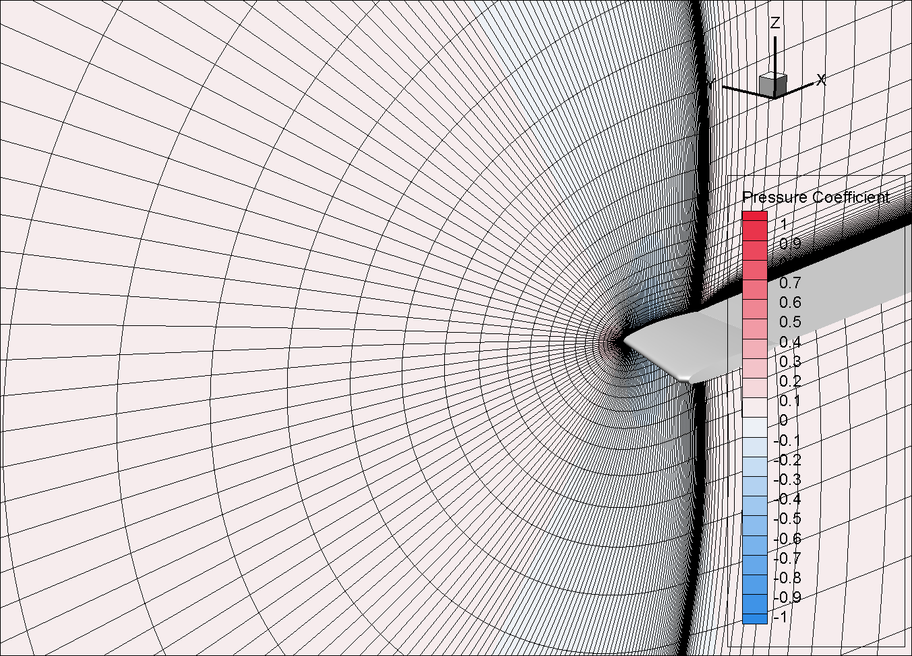
Easily Step Through IJK-Planes using Slices

Slide 22
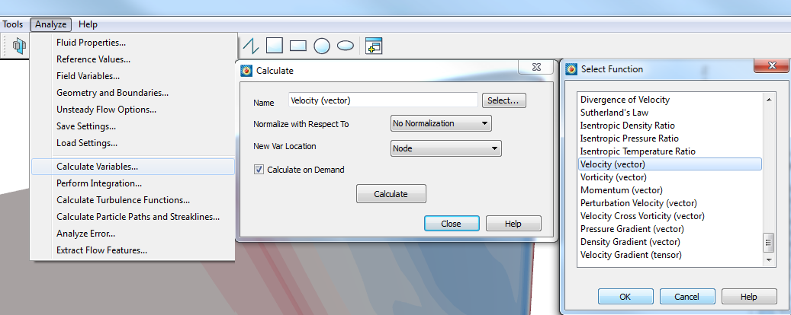
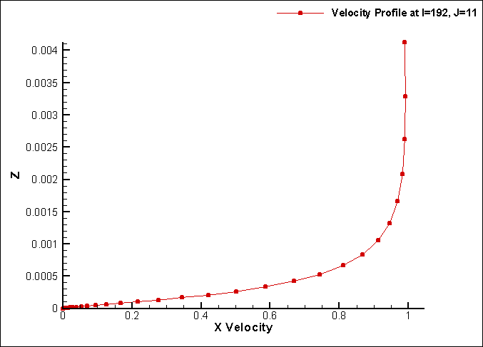
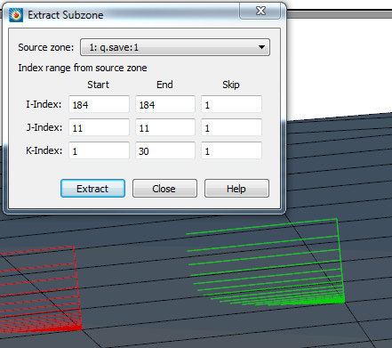
Extract a Velocity Profile
Calculate the velocity vectors
Extract Subzone to extract values within the boundary layer
Plot results in XY Line Plot

Slide 23
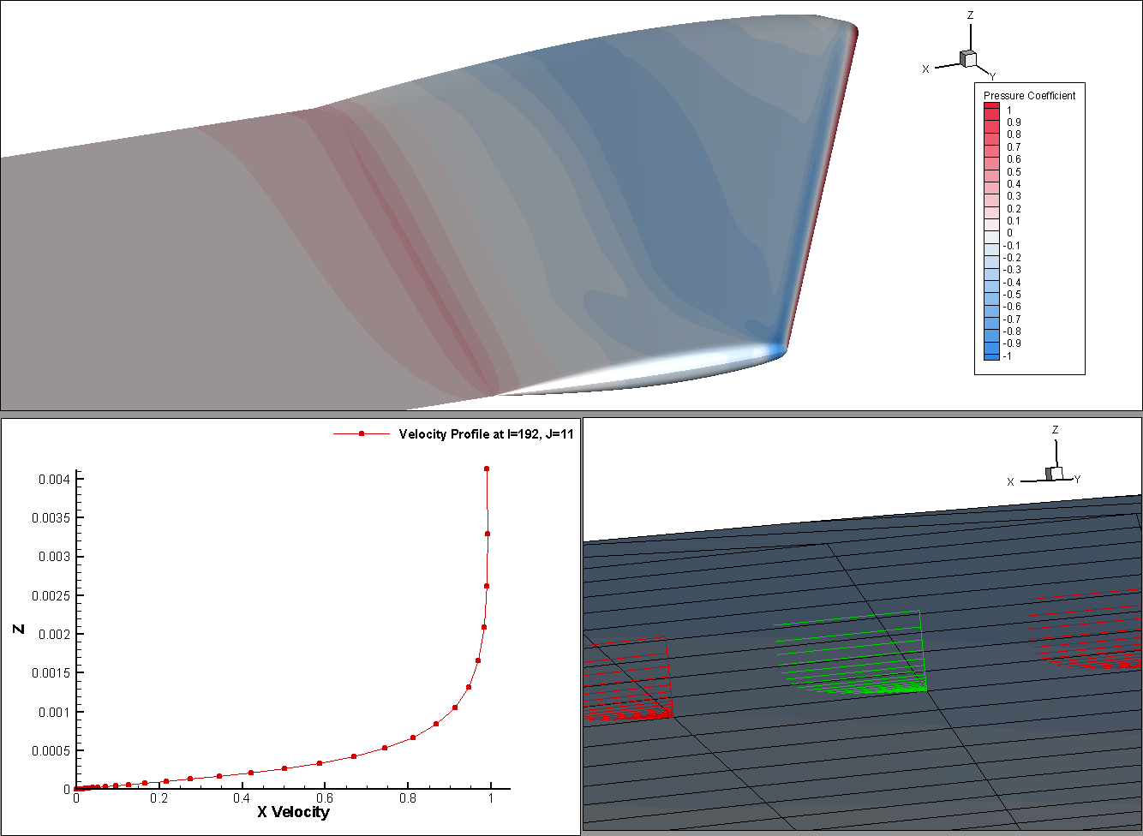
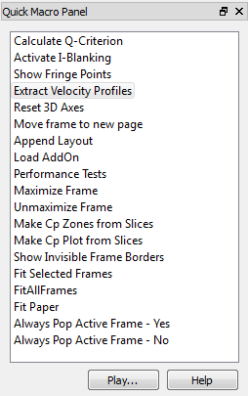
The Power of Quick Macros
Quick Access to common tasks
Reduce click-fatigue
Accomplish work not possible in the user interface

Slide 24
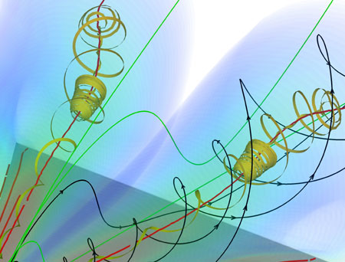
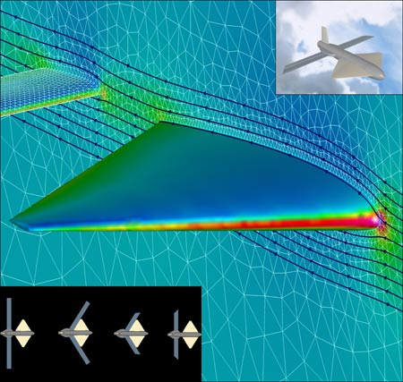
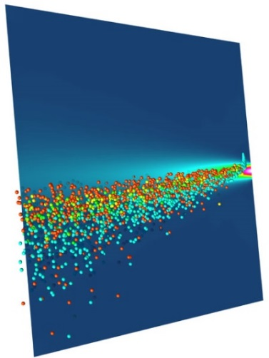
What’s coming in 2017:
Python API
SZL Server
In-situ SZL
TecIO reading .szplt files

Slide 25
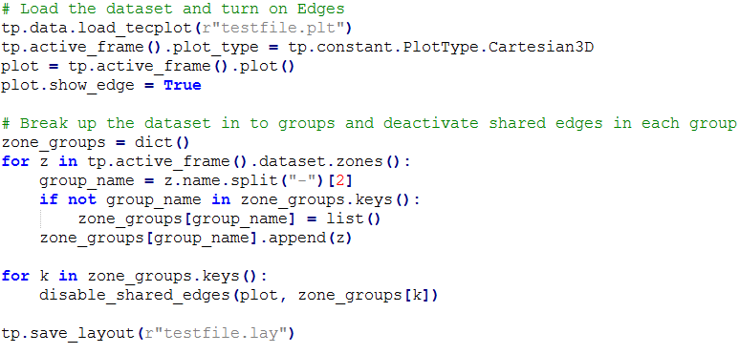
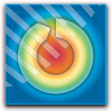
Python API
Accelerate your scripting
Available early 2017

Slide 26
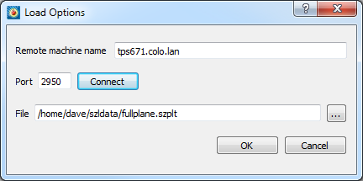
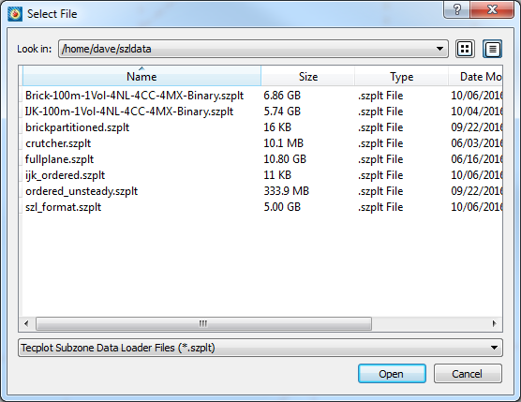
SZL Server
Load SZL format data files from a remote machine
In Beta right now
Available early 2017

Slide 27
In-situ SZL
Use TECIO to write out a fraction of the volume data
Reduces the impact of the I/O bottleneck
Unique in that it writes out volume cells
Learn more on Thursday

Slide 28
Read binary data files
TECIO (reads SZL files only)
Python API
Tecplot Add-On Developer’s Kit (C and FORTRAN)

Slide 29
Tecplot Chorus
Tecplot Chorus is for engineers who need to analyze results of multiple simulations
Design space exploration
Trade studies
Comparative analysis

Slide 30
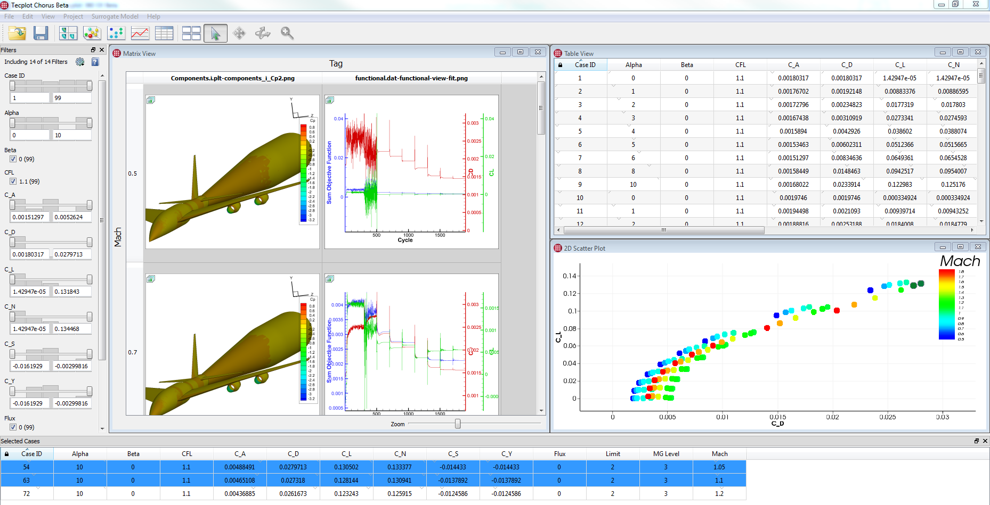
Tecplot Chorus

Slide 31
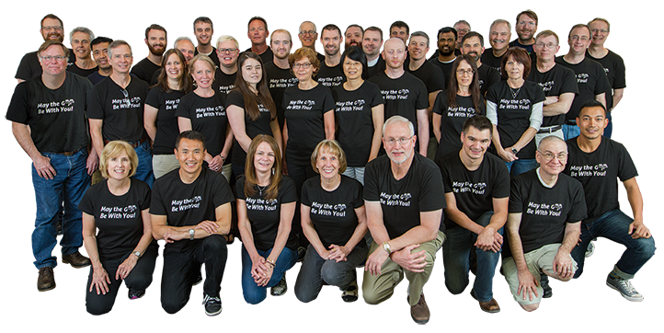
We love helping engineers and have fun while doing it!

