Slide 1





Approved for Public Release, Distribution Statement A
Presented to:
Overset Grid Symposium
2017
Assessment of OVERFLOW solver Langtry-Menter Transition Modeling of the S809 airfoil for developing best practices
Distribution A: Approved for Public Release, unlimited distribution
Presented by:
Zach Hall
Aerospace Engineer
U.S. Army Aviation and Missile Research, Development, and Engineering Center
10/19/2016
Approved for Public Release, Distribution Statement A

Slide 2
Bottom Line Up Front
Assessed Langtry-Menter (LM) transition model in OVERFLOW
  Leveraged s809 airfoil LM’s test case, & OVERFLOW test case
Motivation: Develop best practices for transition model grid requirements
  Based on discussions with CFD SMEs, they currently don’t exist
Conducted in-depth grid refinement studies in streamwise & viscous spacing
  Used turbulent grid generation best practices as baseline
  Capturing transition requires a lot more streamwise points
Grid refinement critical to capture boundary layer transition

Slide 3
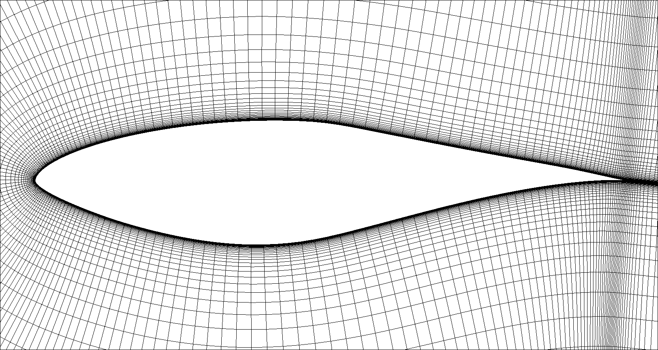
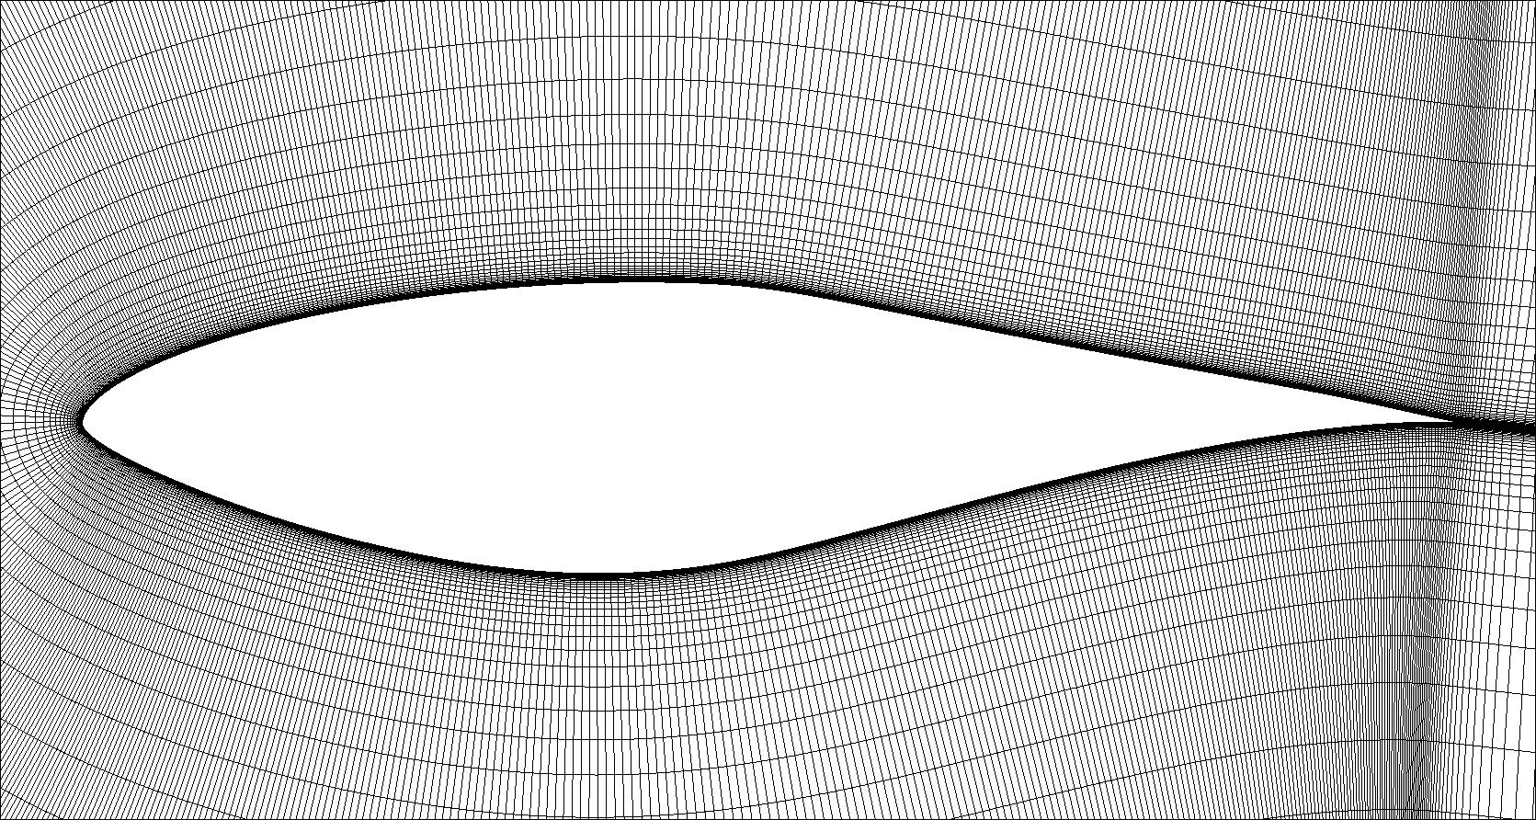
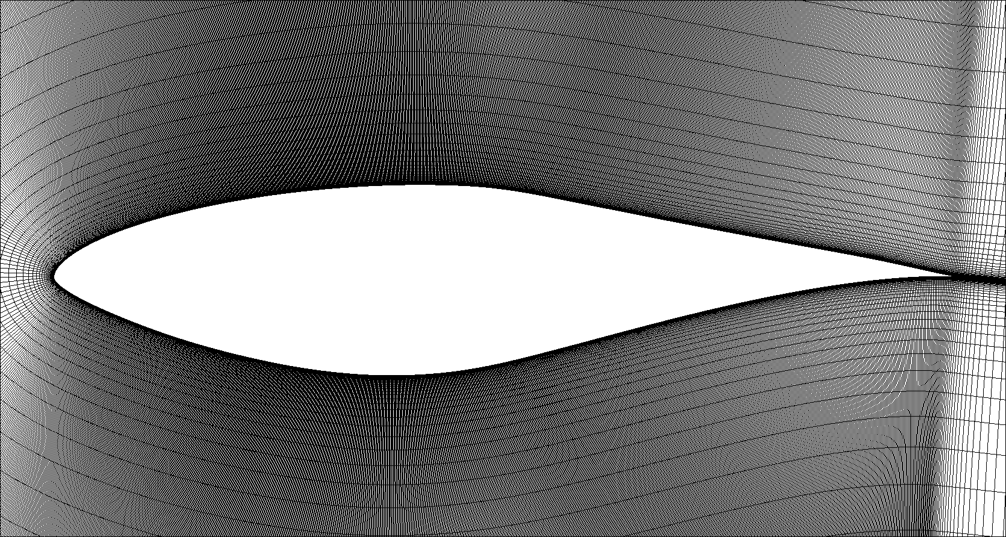
S809 Wind Turbine Airfoil
OVERFLOW Test Case
OVERFLOW Test Case: S809 airfoil, designed by Dan Somers (Airfoils Inc.)
  21% thick wind turbine airfoil, considered to a staple in transition modeling
  Wind Tunnel testing conducted by Dan Somers at Delft in 1997
    Somers, D. “Design and Experimental Results for the s809 Airfoil” MREL/SR-440-918, Jan 1997
  Used as validation case for Langtry-Menter Transition Model
    Langtry, R., Menter, F. “ Correlation-Based Transition Modeling for Unstructured Parallelized Computational Fluid Dynamics Codes” AIAA Journal Vol.47, No.12, Dec. 2009
3 Grids of interest:
  Turbulent Best Practices (TBP): Based on Chan et. al. (AIAA 2001-3191)
  OVERFLOW Test Case Grid: Developed by Pieter Buning
  Streamwise refinement
  Note: These grids used initial spacing of 2E-5, with 1.2 stretching ratio
Turbulent Best Practices (TBP) Grid
OVERFLOW Test Case Grid
Streamwise Refined Grid
0.020M points / slice
0.048M points / slice
0.152M points / slice

Slide 4
Historical Grids
OVERFLOW Test Case Grid
s809 OVERFLOW test case:
  C-mesh, 300 points upper surface, 300 pts lower surface
  49 points in the wake
  Farfield at 50 chords, 69 pts normal to surface, max y+ of 2.5
  Initial spacing = 0.00002 chords
  Stretching Ratio 1.23
  0.1% chord LE spacing, 0.2% chord TE spacing
Issues found by Pieter Buning, noted in test case readme file:
  Laminar separation bubble followed by transition, predicted more forward than experimental data
  Overshoot ahead of the Cp drop
  “I am hoping someone can find the problem” – Buning
    This is what prompted me to dig into this further
Langtry-Menter Grid “Predicting 2D airfoil and 3D wind Turbine Rotor”, AIAA 2006-395:
  C-mesh, 300 points upper surface, 300 pts lower surface
  Farfield at 10 chords, 100 pts normal to surface, maximum y+ of 1
0.048M points / slice

Slide 5
OVERFLOW
Solver Settings
Leveraged OVERFLOW s809 test case flow solver settings:
  Solutions ran time-accurate
  Mach = 0.1
  Reynolds # = 2,000,000
  Freestream Turbulent Kinetic Energy, XKINF= 6E-6
  Freestream Turbulence Level, MUTINF= 10.0
  HLLC Upwind Scheme, RHS Scheme (IRHS=5)
  SSOR LHS Scheme (ILHS = 6)
  Constant time-stap, no scaling (ITIME=0)
  Turbulence model time step = flow solver time step (CFLT=1)
  No rotational/curvature correction for turbulence model (IRC=0)

Slide 6
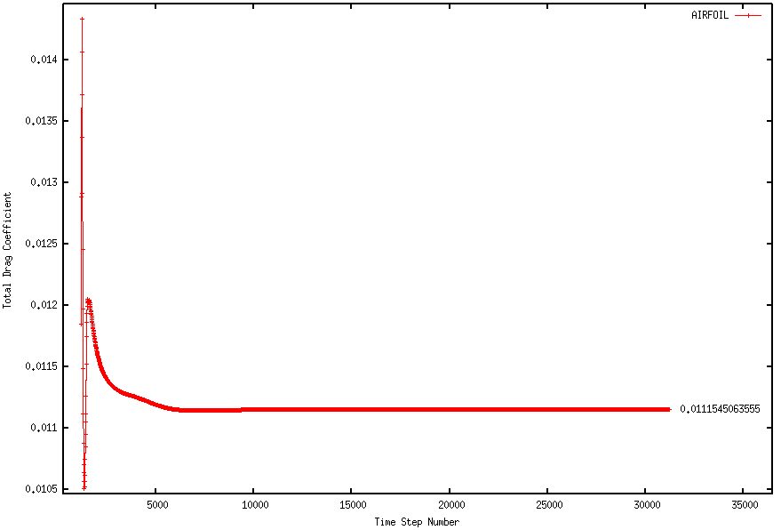
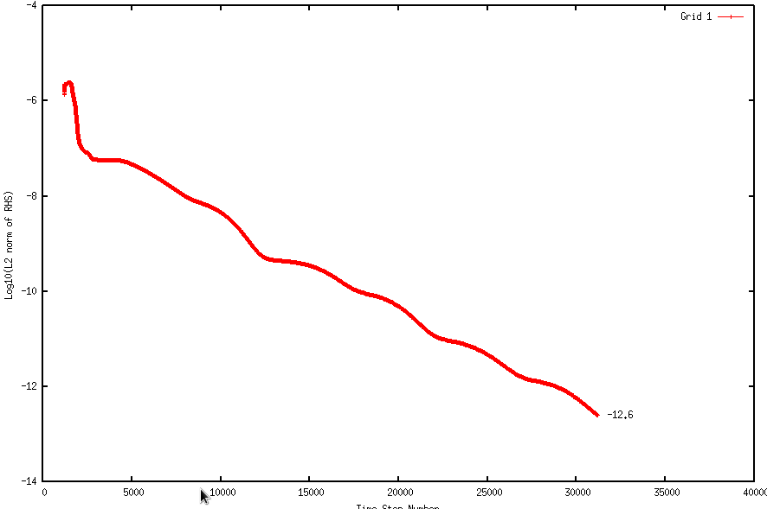
Solution Convergence
OVERFLOW test case ran for 4,200 iterations total
  Drag still varying with iteration
All solutions presented here ran for 31,200 iterations
  To be 100% certain of converged solutions (2D test case ran quickly)
Drag Coefficient Convergence
Residual, L2 norm of RHS
2 order drop in L2 norm by 10,000 steps
Good converged by 10,000 steps
AoA=5°

Slide 7
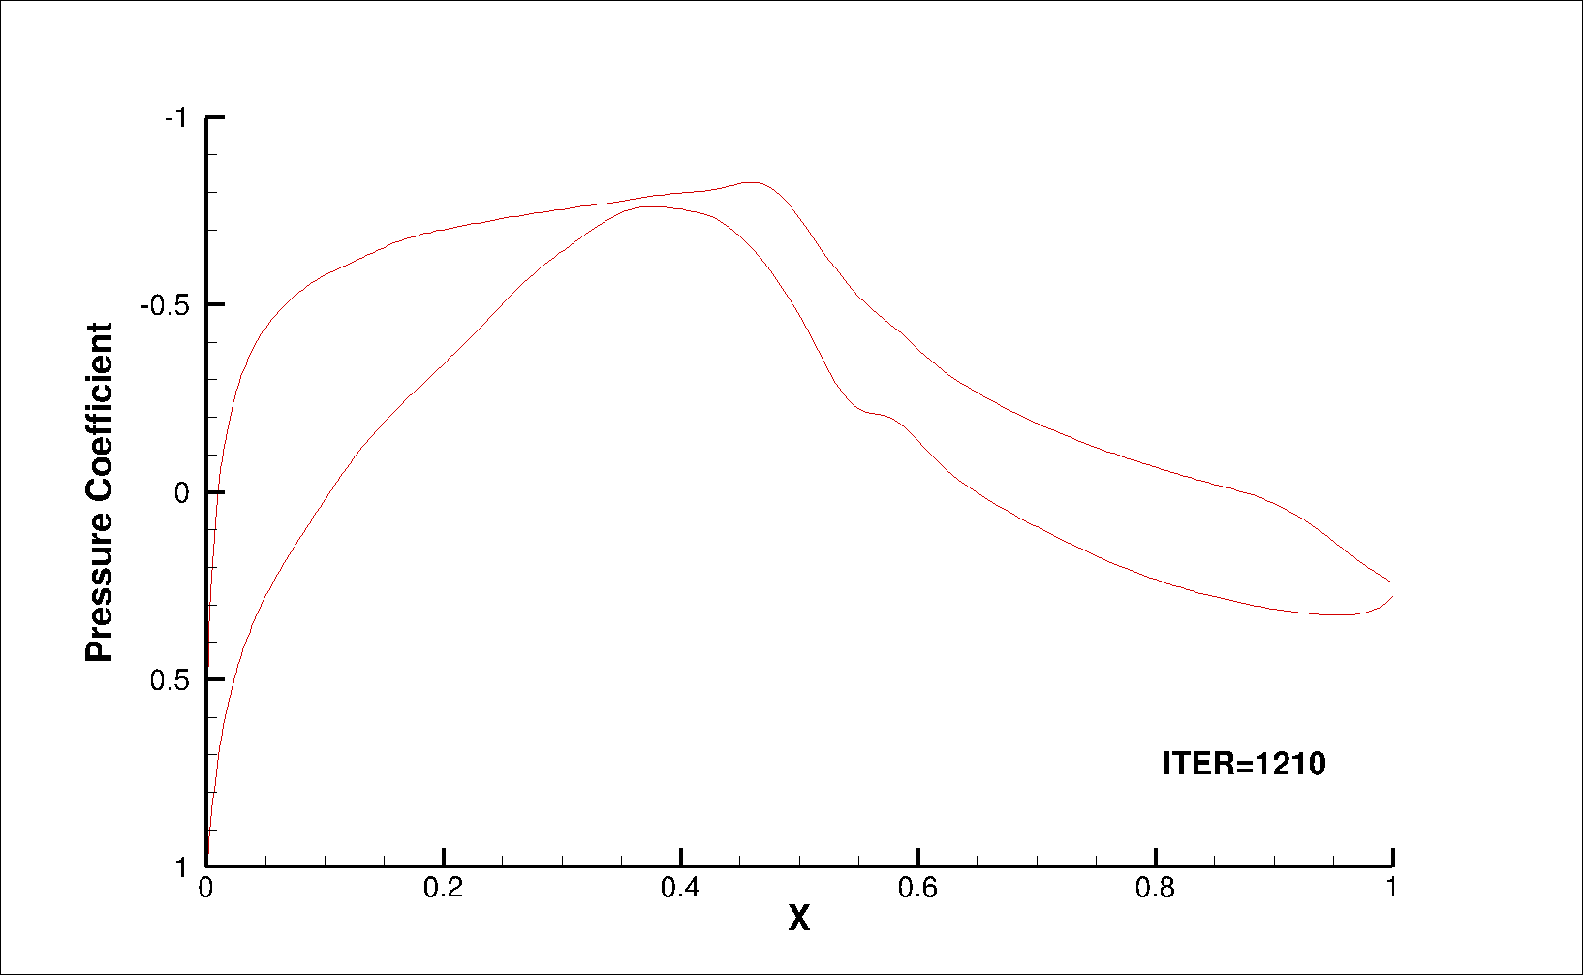



AoA=1°, Impact on Cp:
# of Streamwise pts in 0.5-0.6 X/C
21 pts
54 pts
Cp overshoot
OVERFLOW Test Case Grid
Oscillatory behavior
Cp drop briefly predicted but breaks down, but does not bomb
92 pts
113 pts
Upper & lower surfaces “lock in” but lower surface breaks down, but does not bomb
Upper & lower surfaces lock in to Cp drop

Slide 8
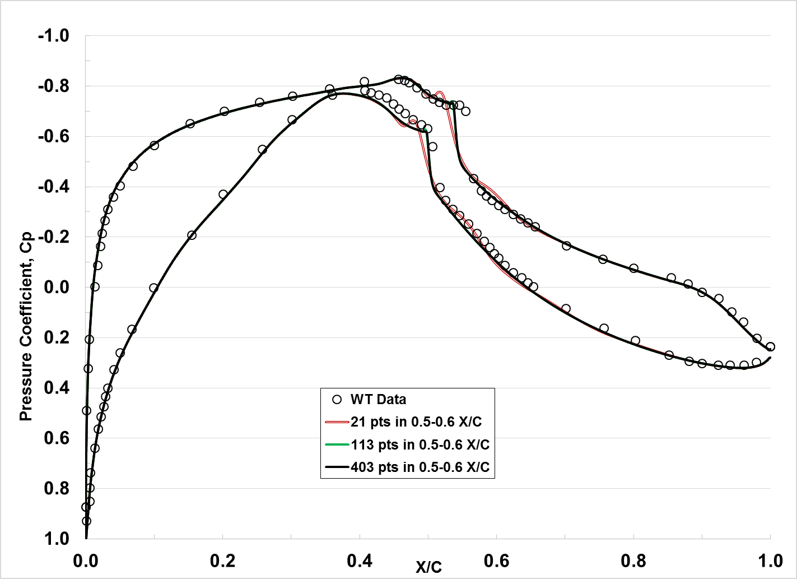
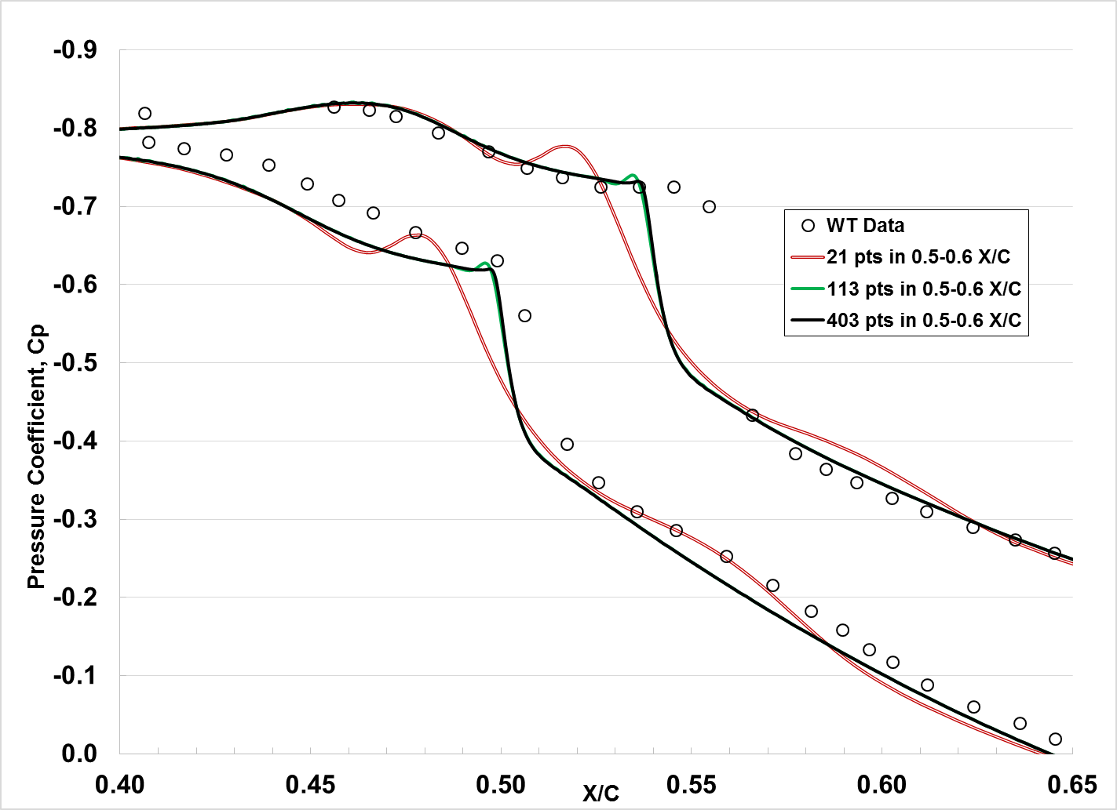
Surface Pressure Comparison
Wind Tunnel vs. CFD
CFD predictions compare well against WT measurements outside of 0.4 – 0.6 X/C
  Negligible differences between varying levels of grid refinement outside of 0.4 – 0.6 X/C
Dr. Buning commented on the overshoot in test case notes as well as CP drop before WT
  Refinement reduces the CP overshoot before the drop, but not the early drop vs. WT
  With enough refinement, overshoot reduces down to a sharp corner

Slide 9
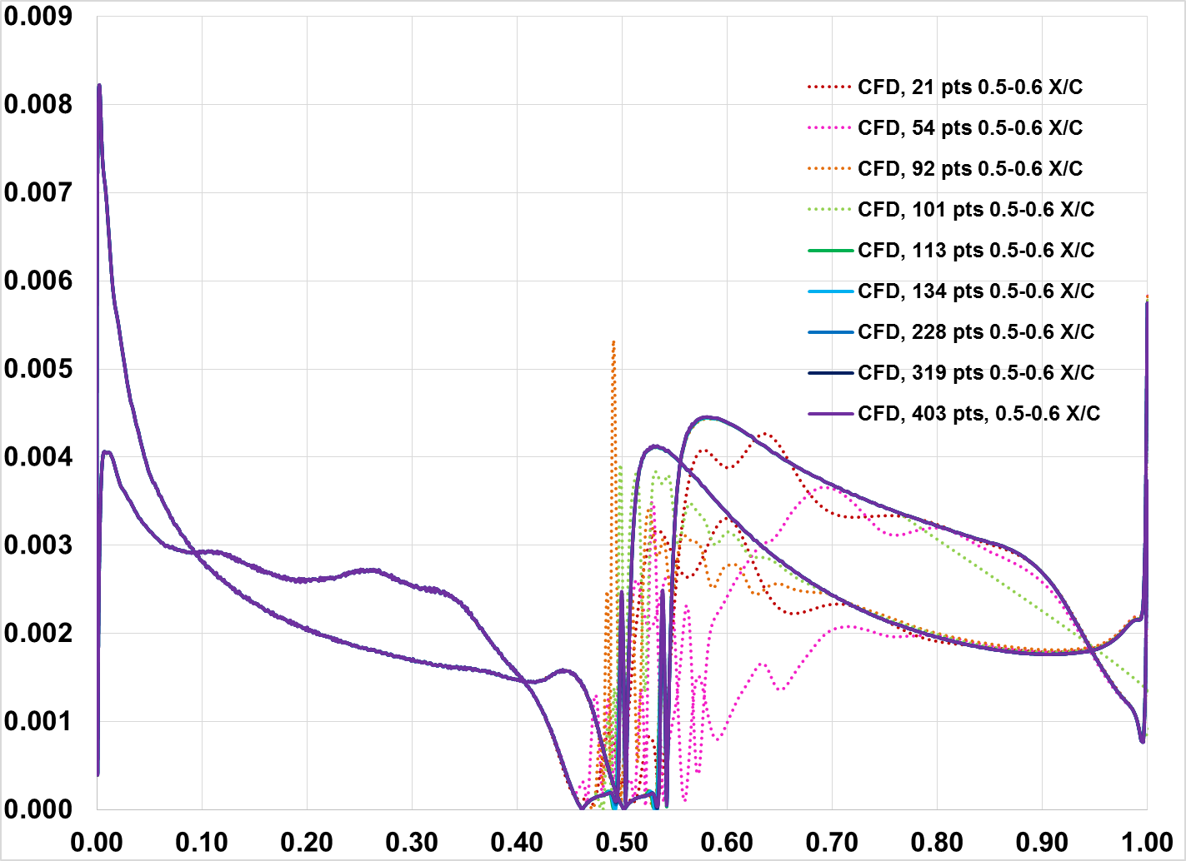
AoA=1°, Impact on Cf:
# of Streamwise pts in 0.5-0.6 X/C
Baseline viscous spacing resulted in max y+ much greater than one
AoA=1°
Max y+
2.5598
Oscillating Solutions
Skin Friction Coefficient, Cf
Area of Interest
Streamwise location, X/C

Slide 10
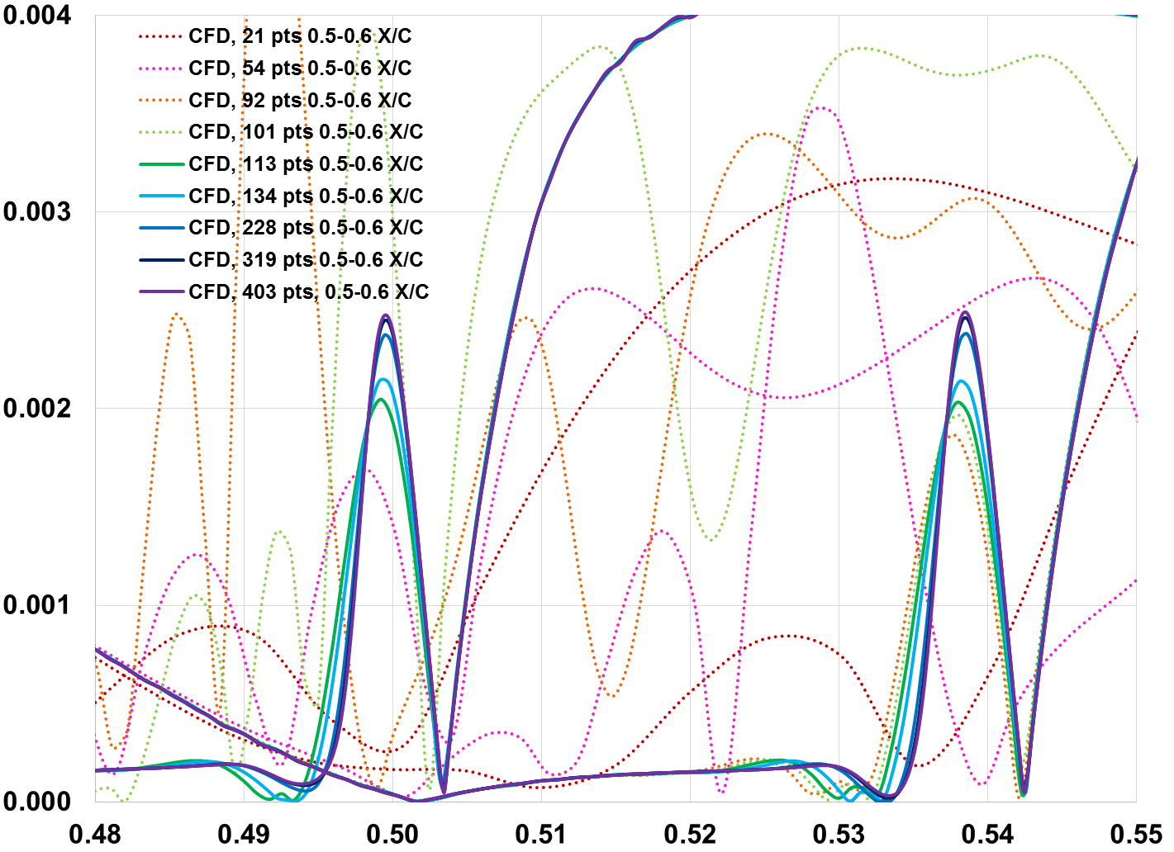
AoA=1°, Impact on Cf:
# of Streamwise pts in 0.5-0.6 X/C
(Zoomed in View)
AoA=1°
Oscillating Solutions
Skin Friction Coefficient, Cf
Streamwise location, X/C

Slide 11
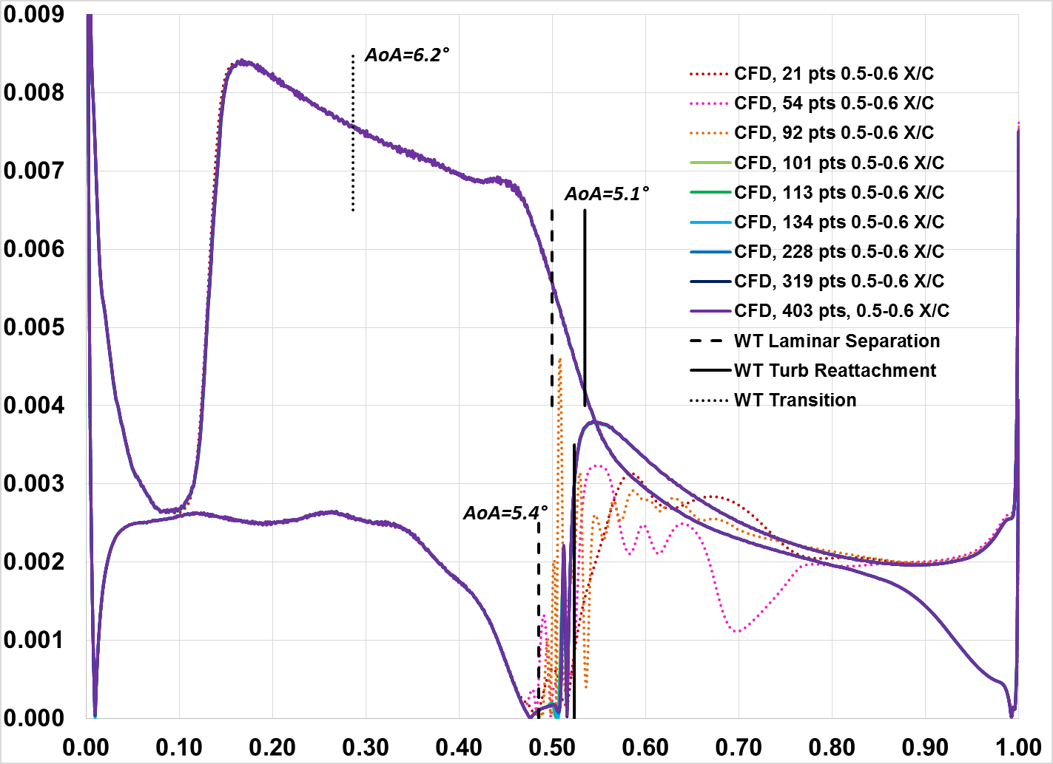
AoA=5°, Impact on Cf:
# of Streamwise pts in 0.5-0.6 X/C
CFWF used to obtain Cf data
AoA=5°
Max y+
4.1392
Oscillating Solutions
Upper surface predicted transition
No focused refinement in this region
Skin Friction Coefficient, Cf
Area of Interest
Streamwise location, X/C

Slide 12
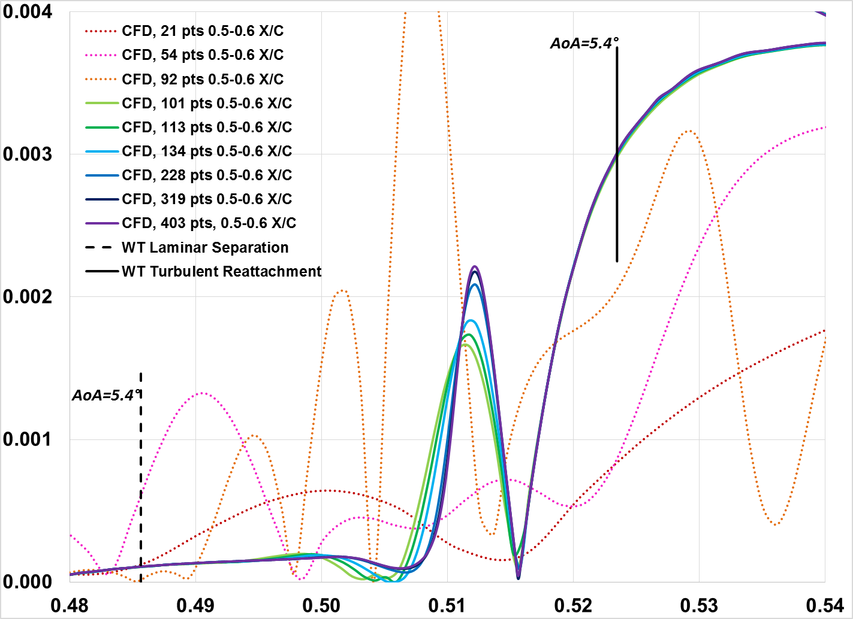
AoA=5°, Impact on Cf:
# of Streamwise pts in 0.5-0.6 X/C
(Zoomed in View)
Oscillating Solutions
Skin Friction Coefficient, Cf
Streamwise location, X/C

Slide 13
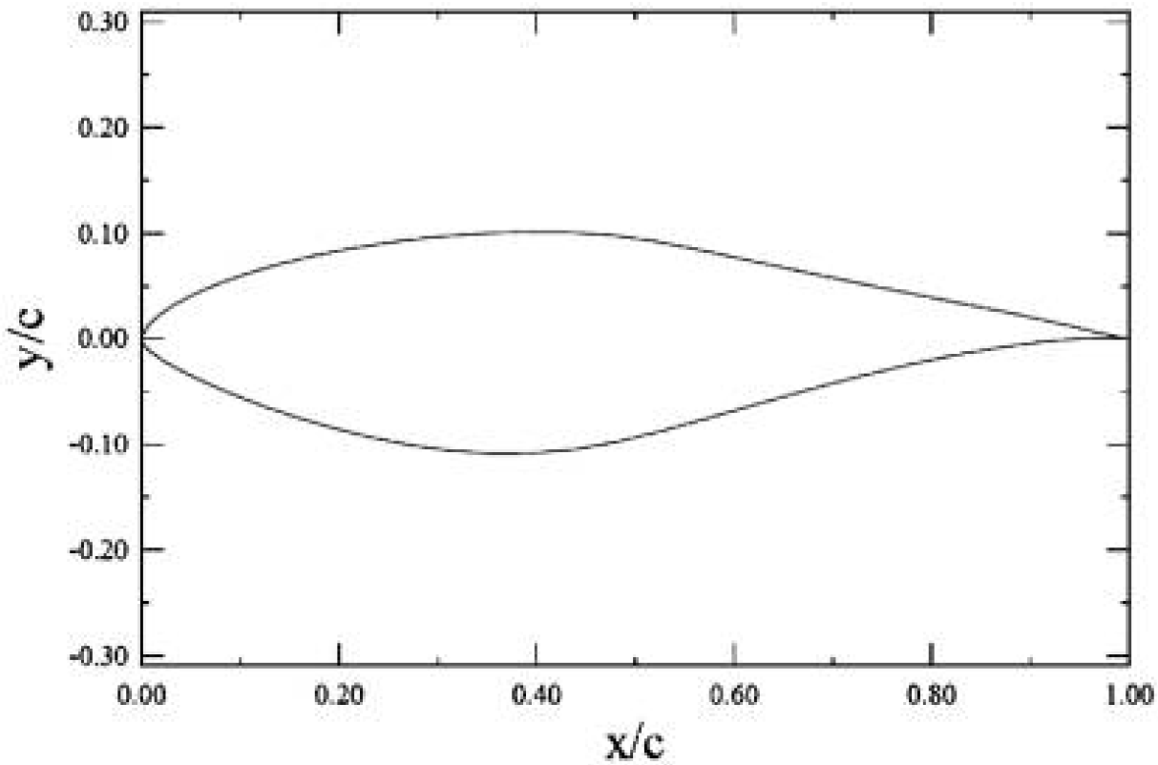
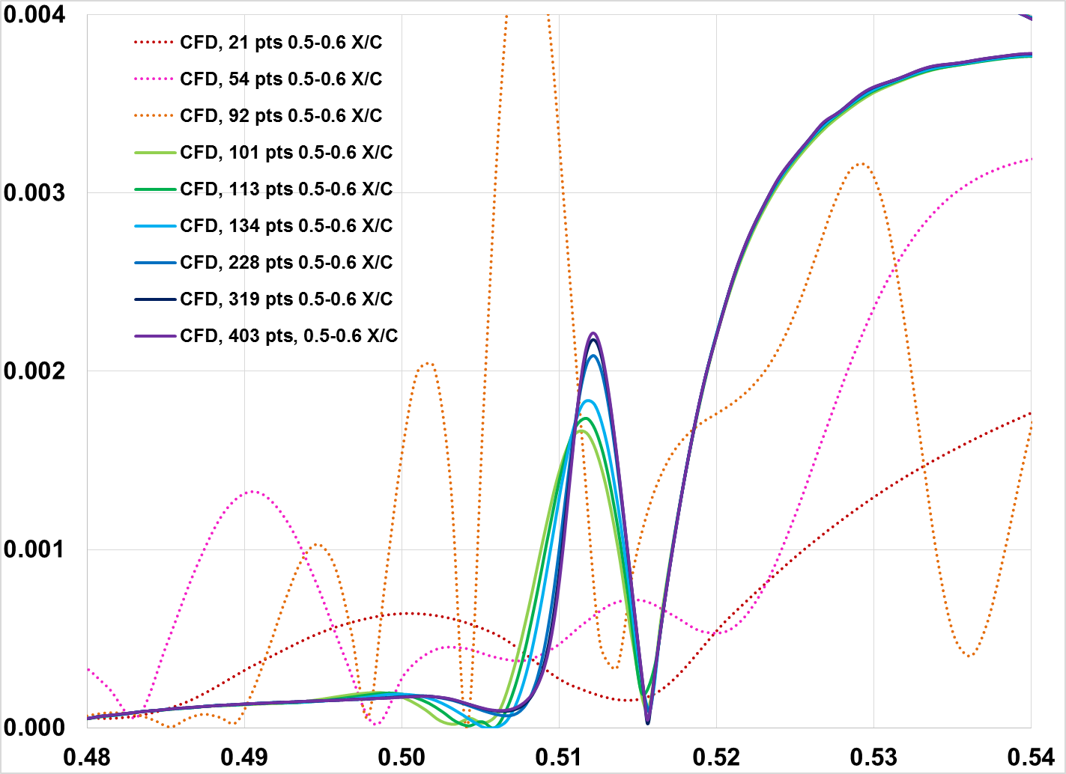
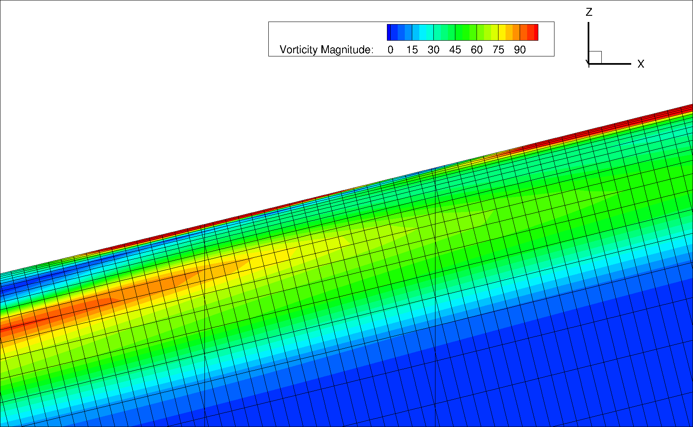
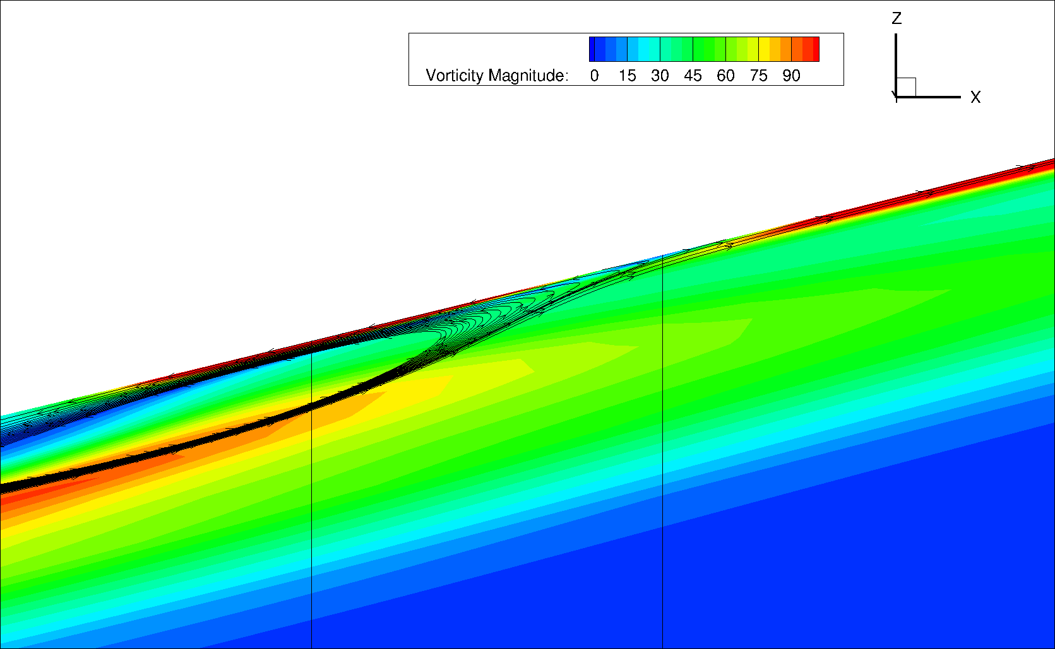
Cf Peak & Valley
Flow Visualizations, AoA=5°
Cfwf outputs abs. value Cf data
Cf with direction relative to up/down stream could be useful
Shear stress pointed downstream
Shear stress pointed upstream
Finest grid
Finest grid
403 pts between 0.5-0.6 X/C
403 pts between 0.5-0.6 X/C
CF Valley
CF Valley
CF Spike
CF Spike
Same solution, one with grid shown, other with streamtraces shown

Slide 14
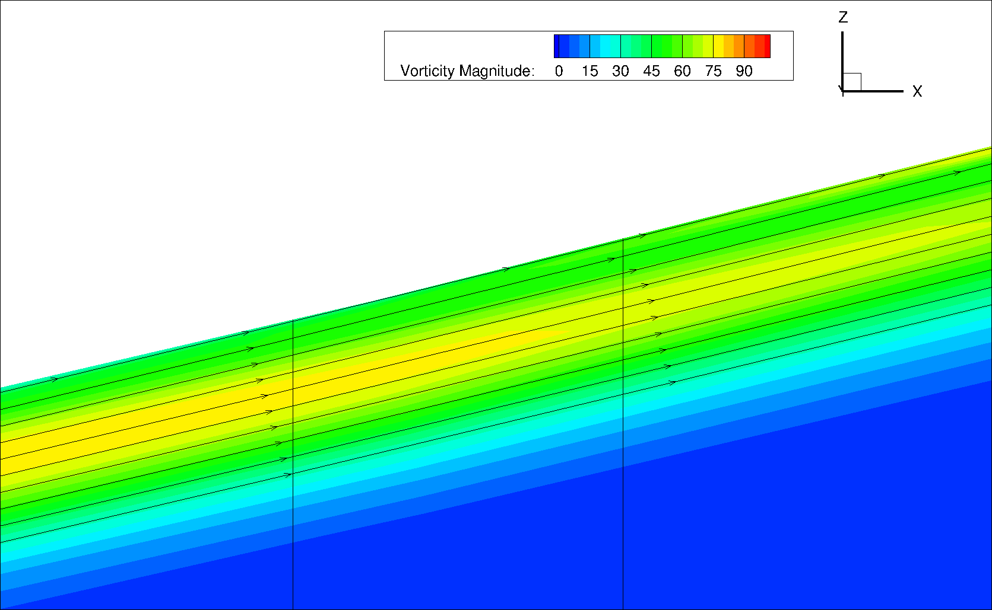
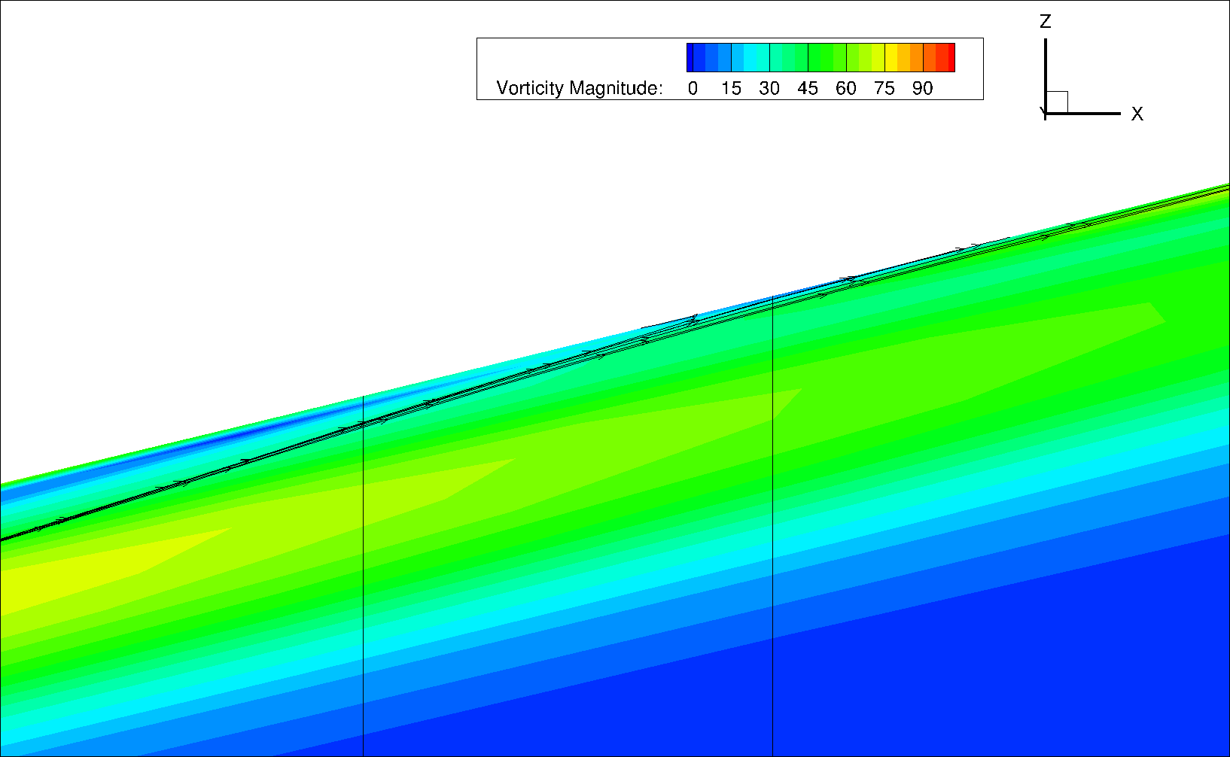
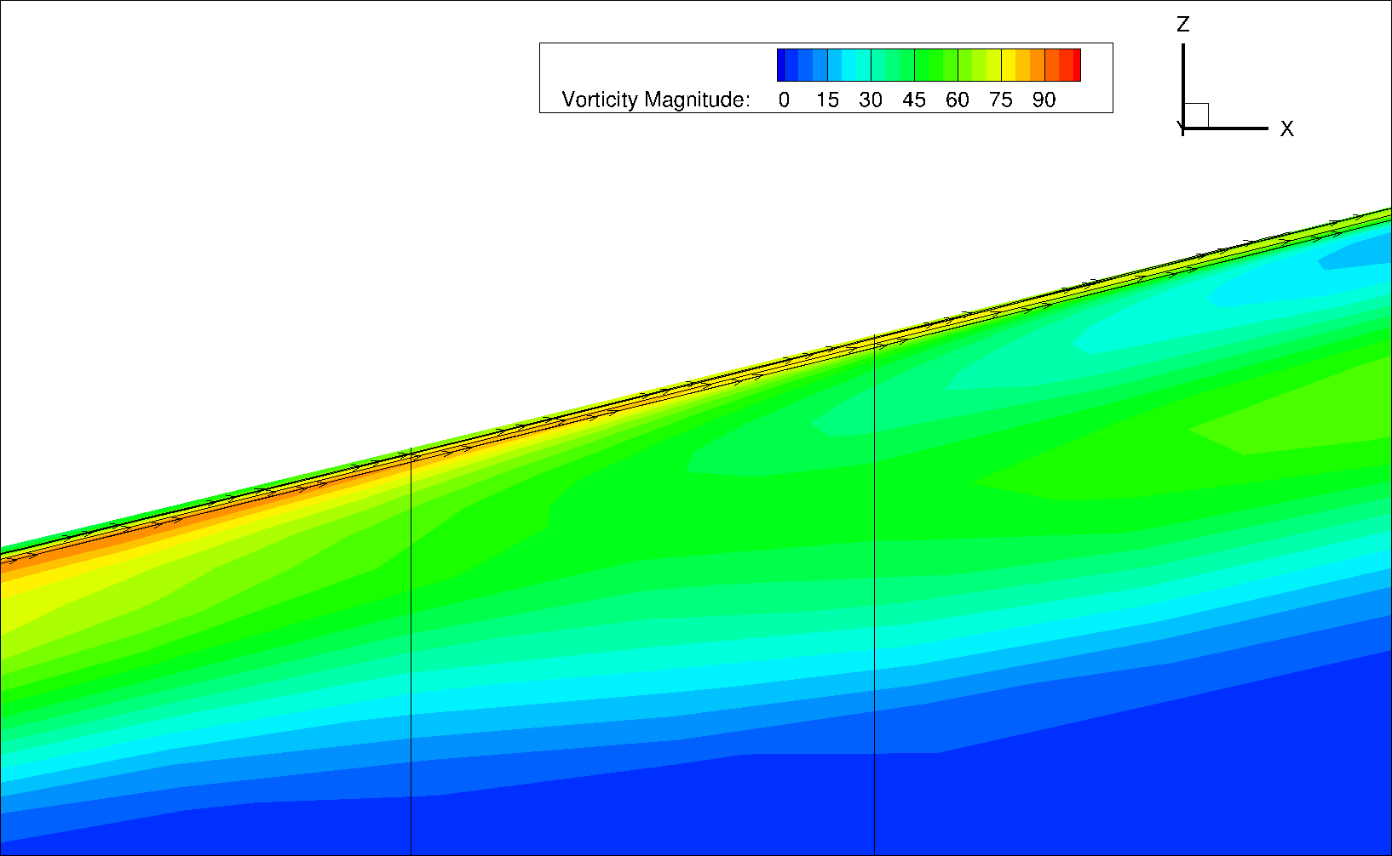
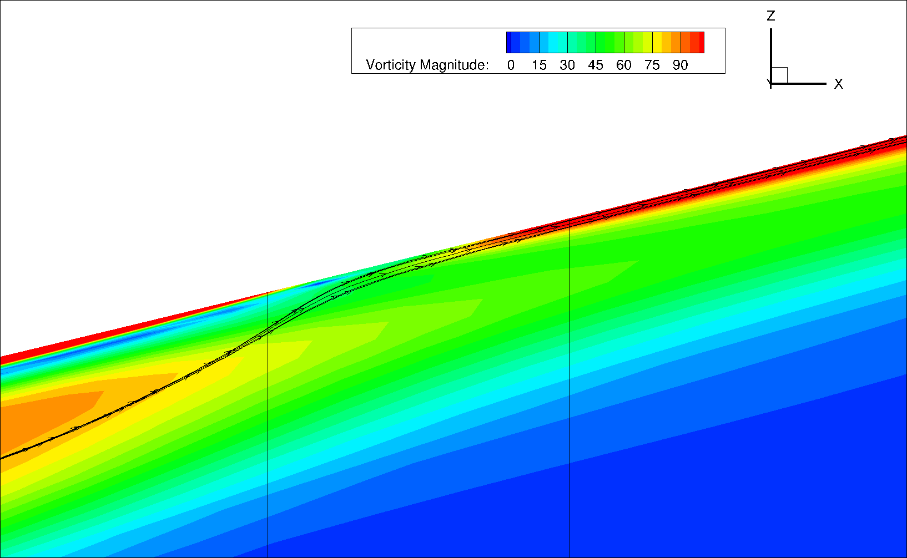
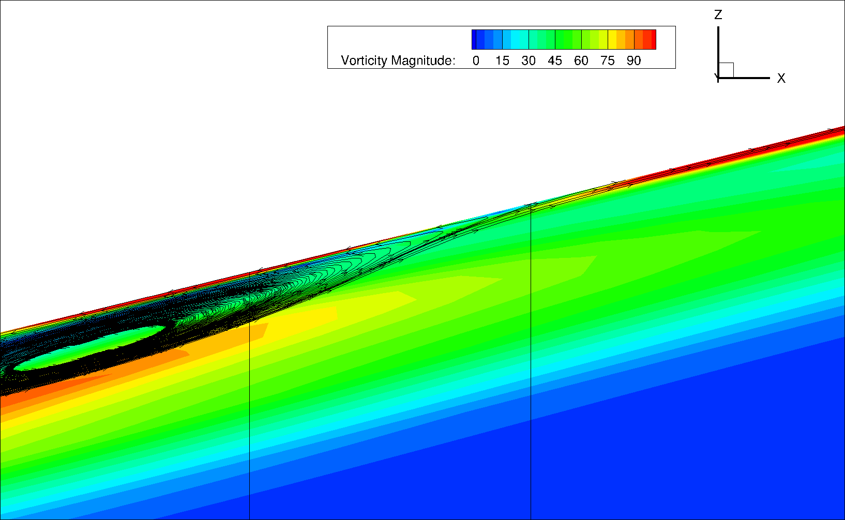
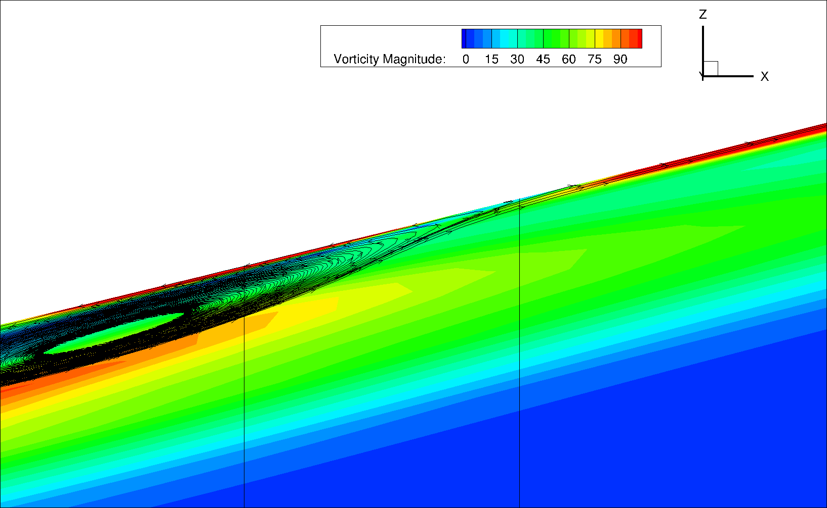
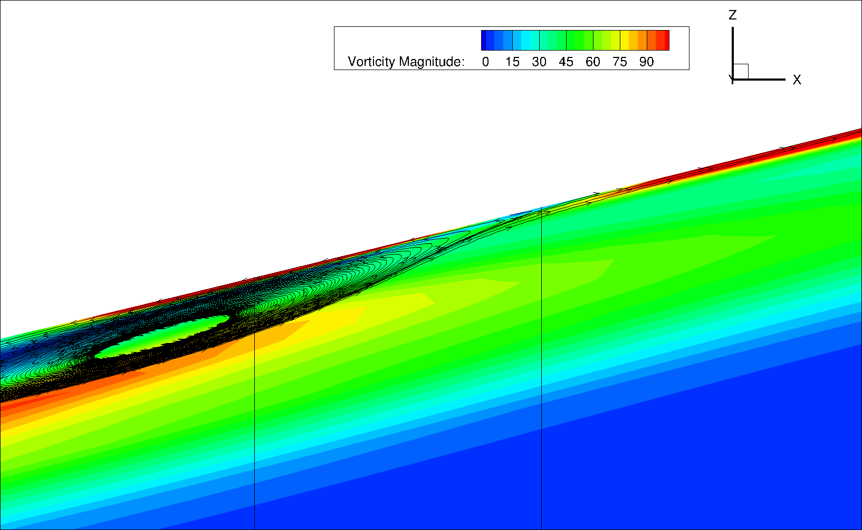
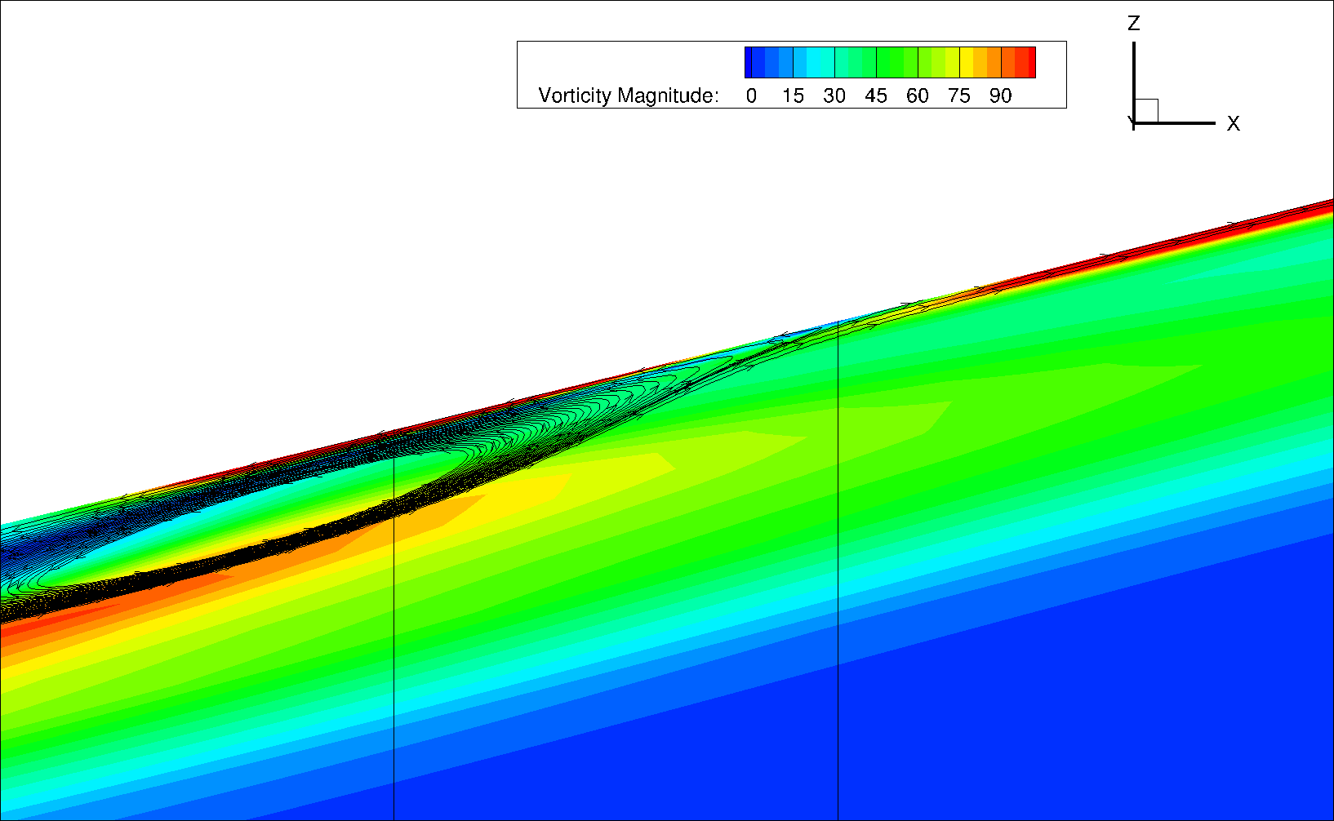
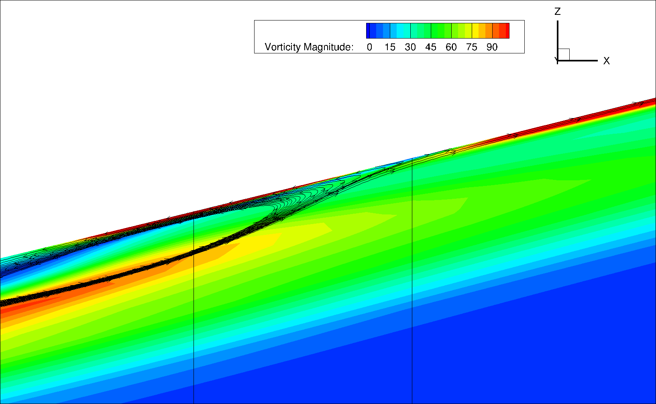
Vorticity Magnitude
& Streamtraces, AoA=5°
5 pts between 0.5-0.6 X/C
21 pts between 0.5-0.6 X/C
54 pts between 0.5-0.6 X/C
No recirculation predicted
92 pts between 0.5-0.6 X/C
113 pts between 0.5-0.6 X/C
134 pts between 0.5-0.6 X/C
Recirculation predicted
228 pts between 0.5-0.6 X/C
319 pts between 0.5-0.6 X/C
403 pts between 0.5-0.6 X/C
CF Valley
CF Spike

Slide 15
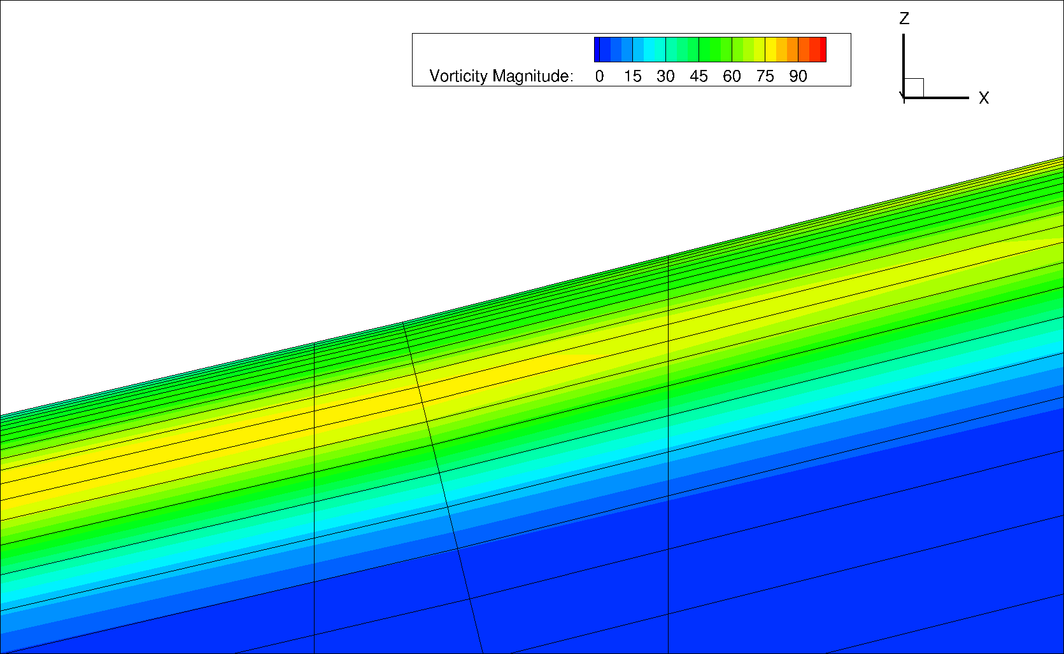
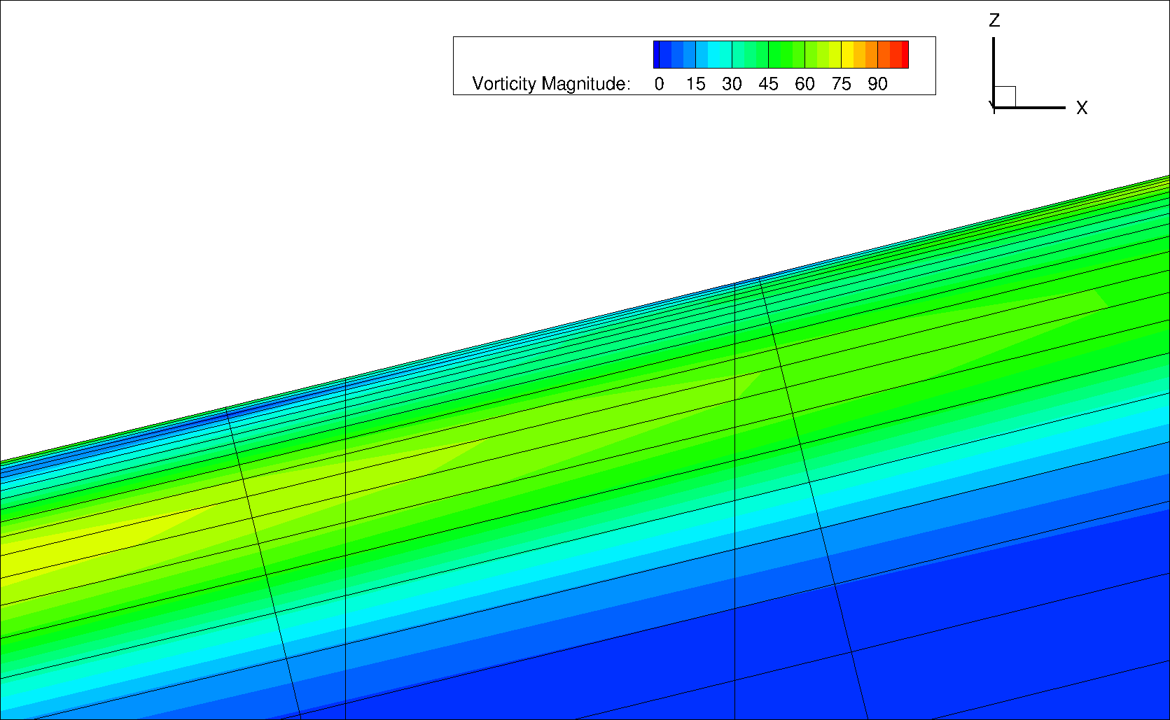
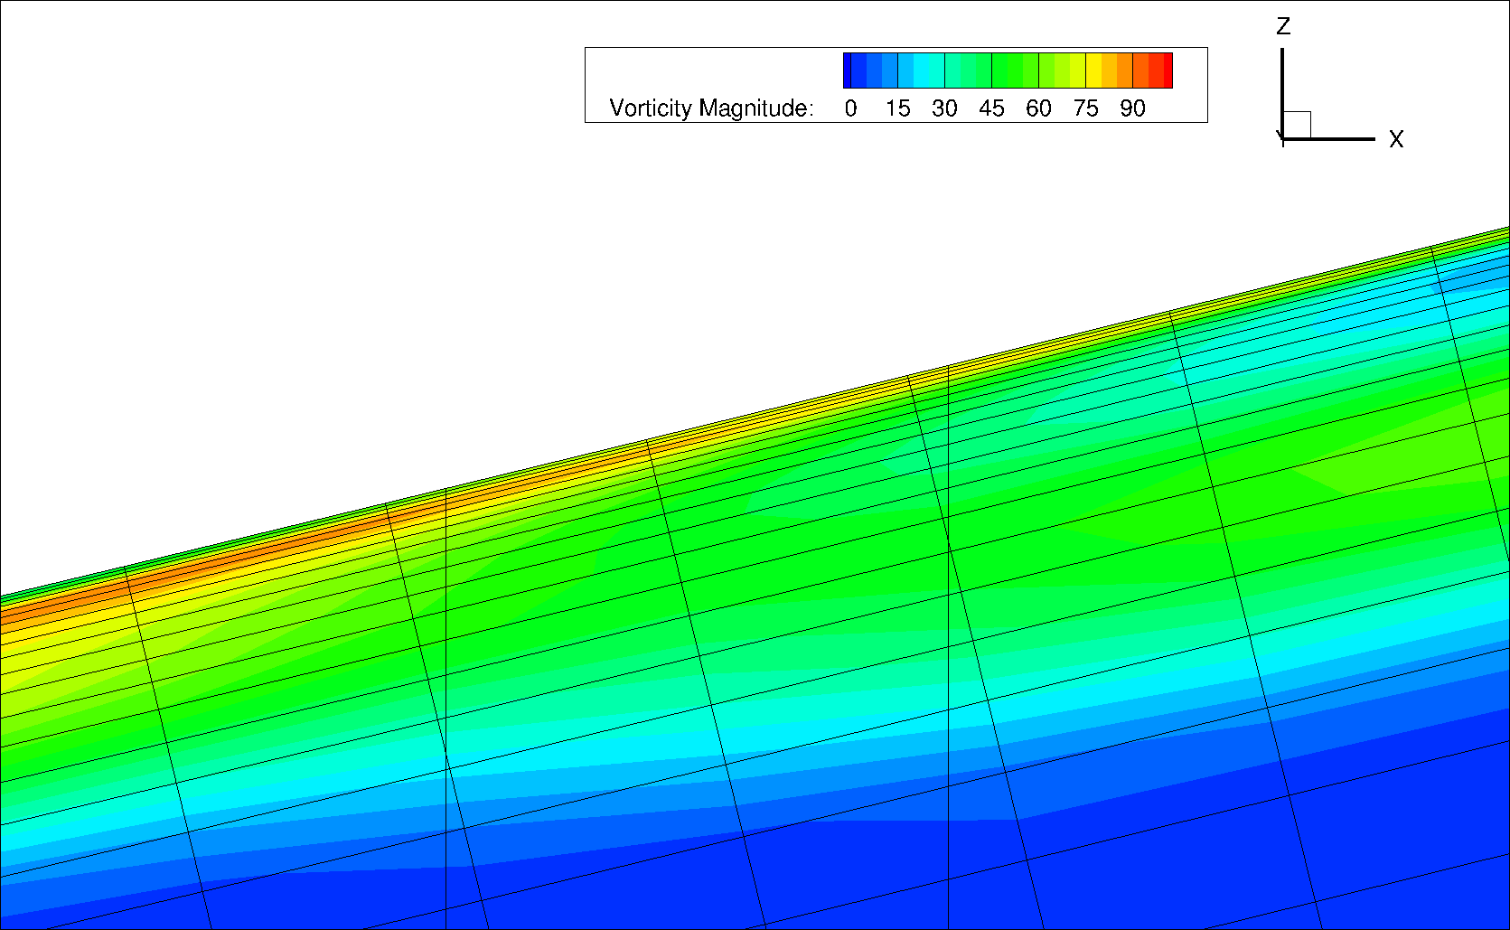
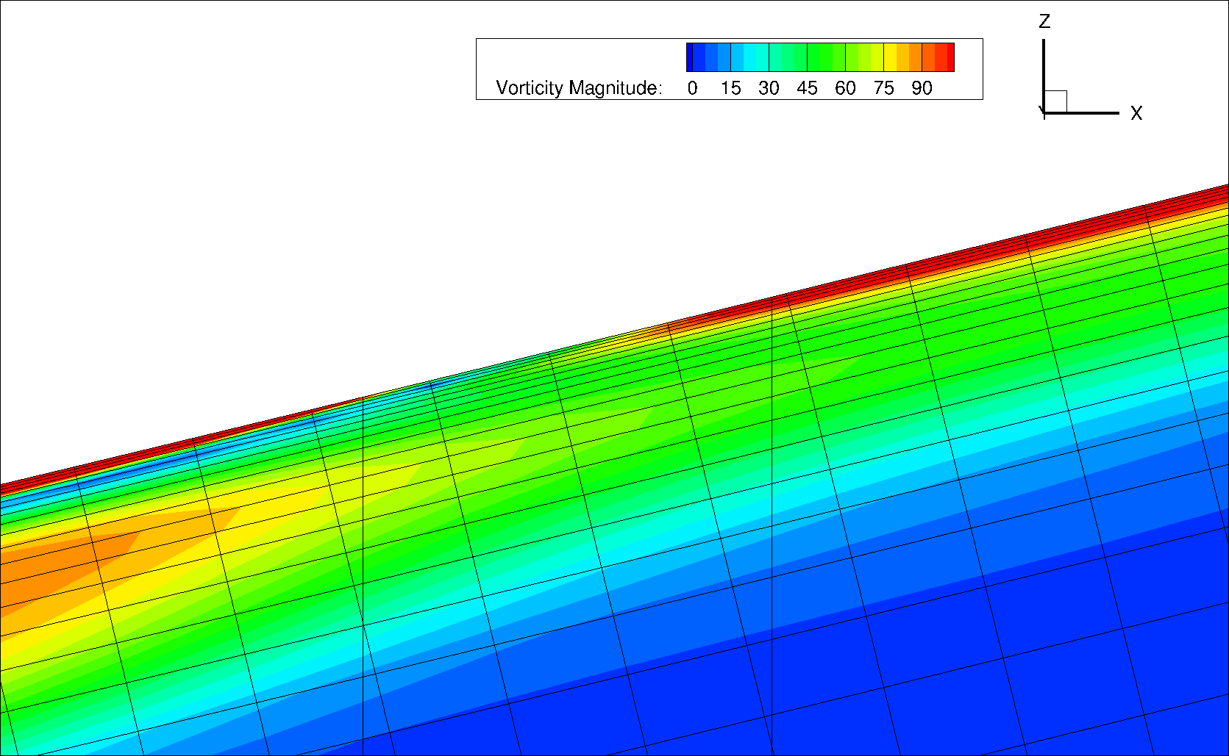
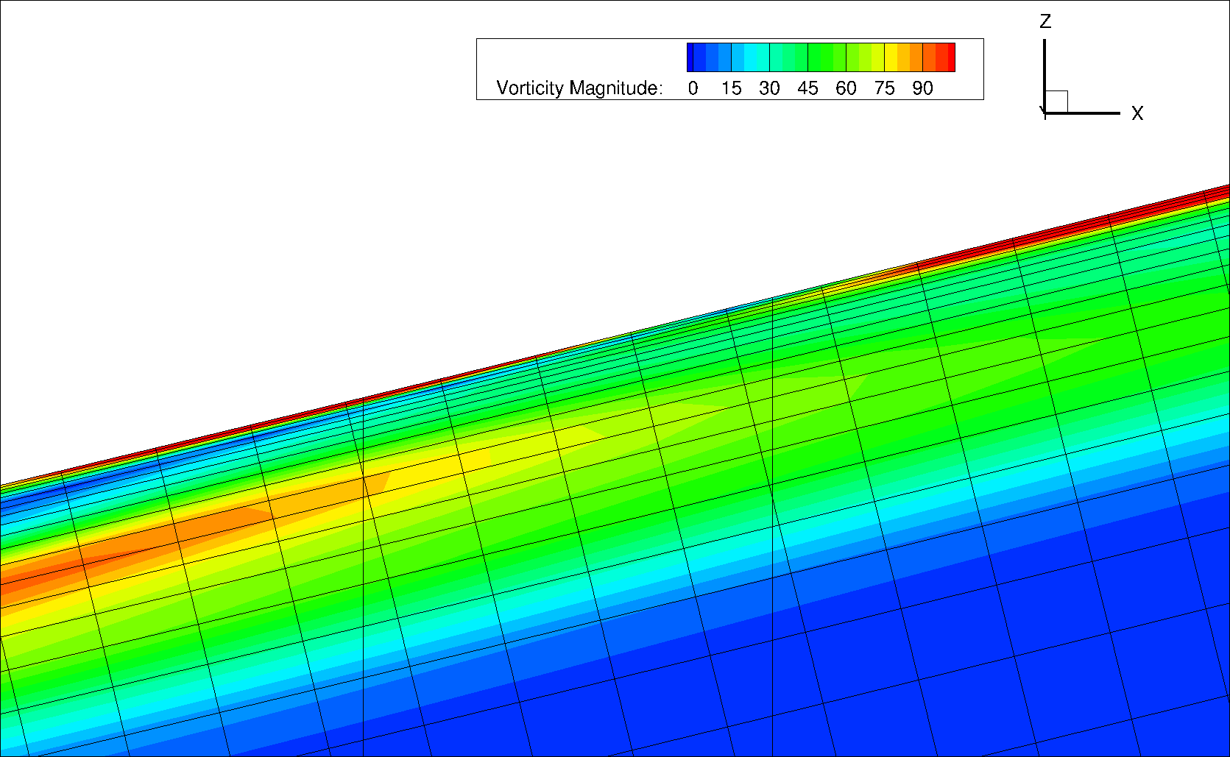
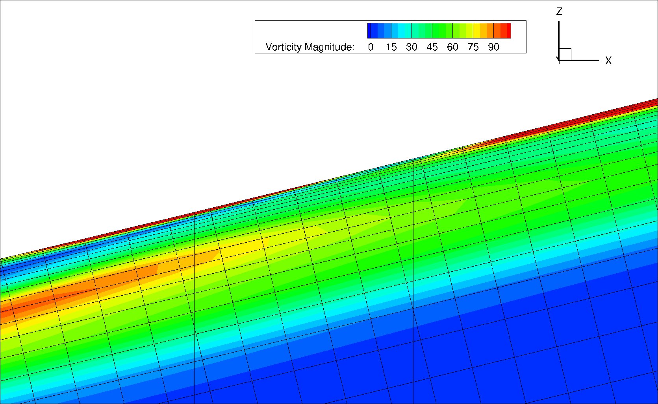



Vorticity Magnitude
& Grid Slice, AoA=5°
5 pts between 0.5-0.6 X/C
21 pts between 0.5-0.6 X/C
54 pts between 0.5-0.6 X/C
No recirculation predicted
92 pts between 0.5-0.6 X/C
113 pts between 0.5-0.6 X/C
134 pts between 0.5-0.6 X/C
Recirculation predicted
228 pts between 0.5-0.6 X/C
319 pts between 0.5-0.6 X/C
403 pts between 0.5-0.6 X/C
CF Valley
CF Spike

Slide 16
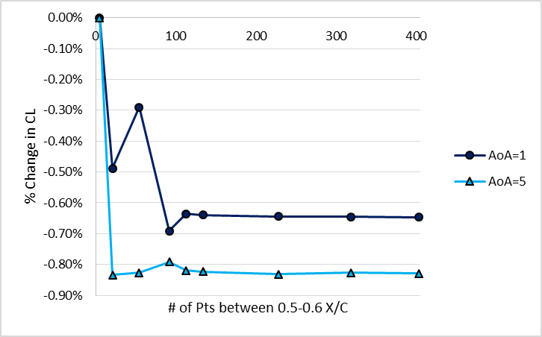
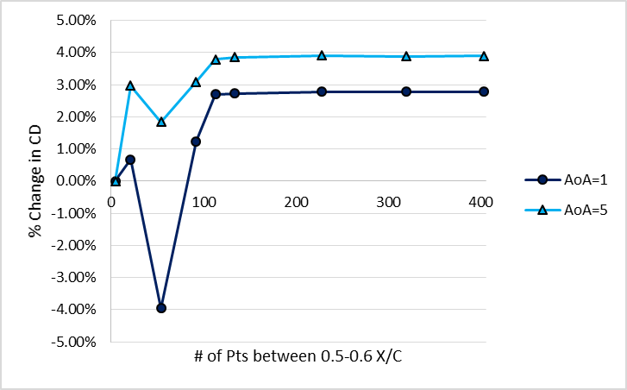
Impact of Streamwise Refinement on Lift and Drag Predictions
Determined needed 110+ points to “lock in” in Cp plots
Quantitative comparisons of % change in CL & CD result in same conclusion
  Solutions non-dimensionalized by the coarsest grid
  Coarsest grid had 101 points on upper and lower surface (each)
Concluded 110+ points needed for converged force and moment predictions
  Made an error in further investigations and used 101 points
  Impacts predictions primarily at AoA=1°, with minimal impact at 5°

Slide 17
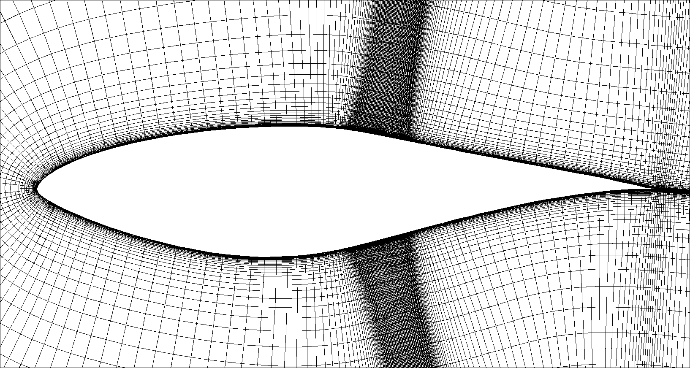
Convergence Criteria
How do you definitively say the grid is converged?
SME’s calibrated eyeball on where the “knee in the curve” exists?
Solution changing less than X% with the addition of X streamwise pts
  <0.05% change in solution per surface point added
  <0.01% change in solution per surface point added
Note: This method assumes user will stop refining once convergence found
  Numerous examples that this can result in only local minima/maxima
Y+2 Grid Image
1
2
3
50 pts
101 pts
40 pts
40 pts
50 pts
101 pts
4
5
6

Slide 18
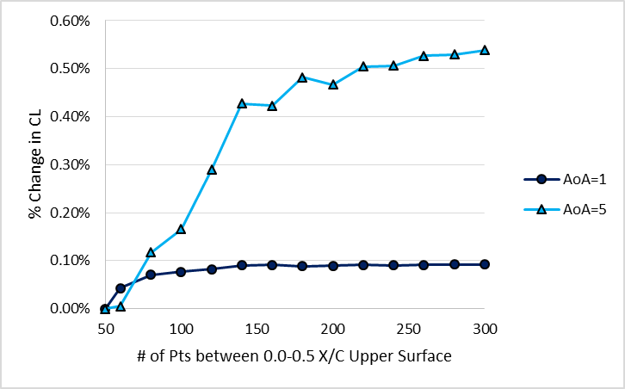
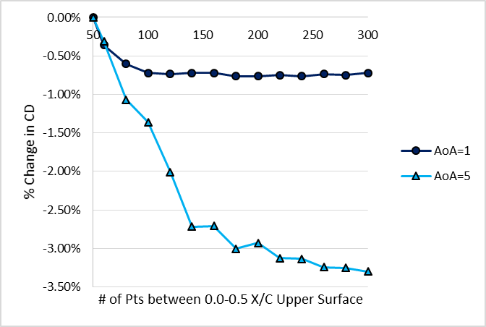
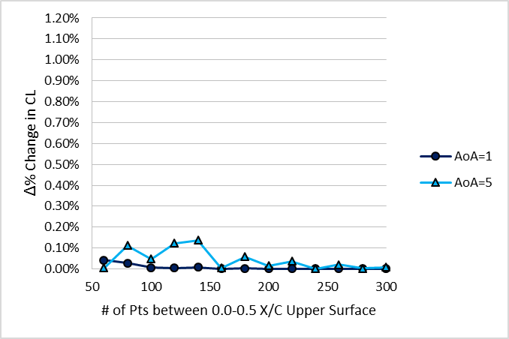
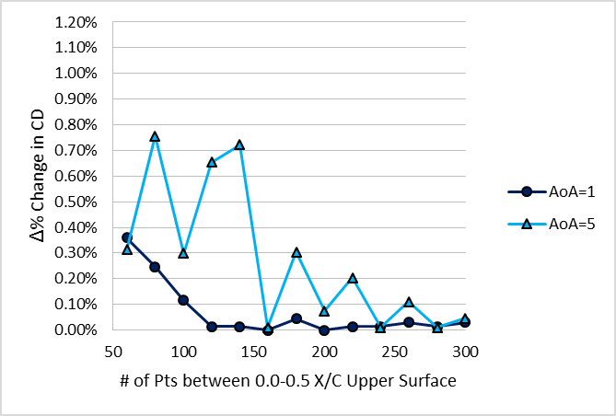
Upper Front Region
Coarse BL Spacing
1
2
3
4
5
6
Initial Spacing:
2E-5 inches
(0 layers constant initial spacing)
Max y+:
2.63 at AoA=1°
4.62 at AoA=5°
% Change
Each solution non-dimensionalized by coarsest solution
=(CL_{x} – CL₅₀) / CL₅₀
Δ% Change
Difference between solution and preceding, less refined solution
=(CL_{B} - CL_{A}) / CL_{A}
Engineering Judgement
1.0% Convergence Criteria
1.0% Convergence Criteria
0.2% Convergence Criteria
0.2% Convergence Criteria

Slide 19
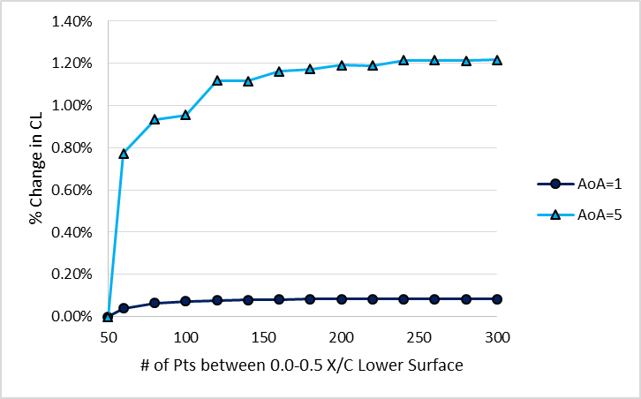
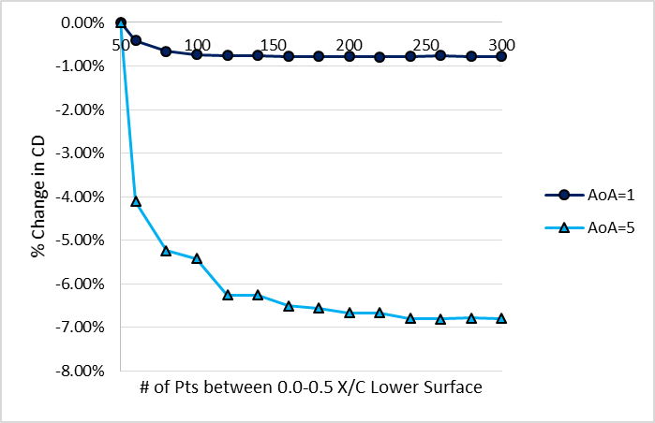
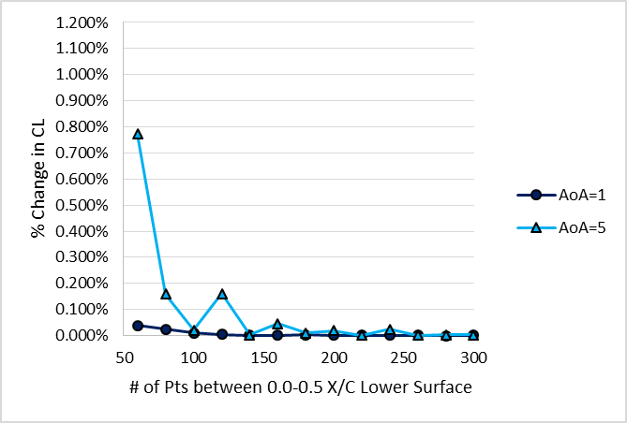
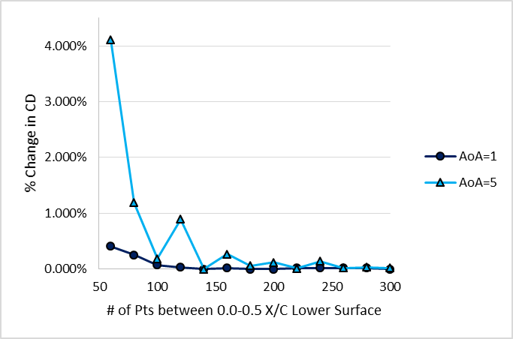
Upper Front Region
Fine BL Spacing
1
2
3
4
5
6
Initial Spacing:
5E-6 inches
(5 layers constant initial spacing)
Max y+:
0.7 at AoA=1°
1.2 at AoA=5°
% Change
Each solution non-dimensionalized by coarsest solution
=(CL_{x} – CL₅₀) / CL₅₀
Δ% Change
Difference between solution and preceding, less refined solution
=(CL_{B} - CL_{A}) / CL_{A}
Engineering Judgement
1.0% Convergence Criteria
0.2% Convergence Criteria
1.0% Convergence Criteria

Slide 20
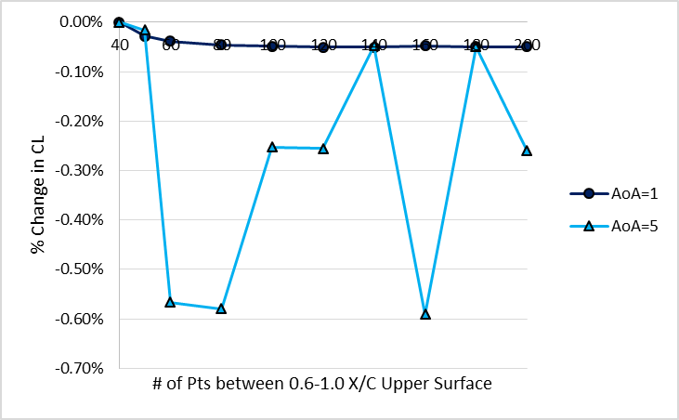
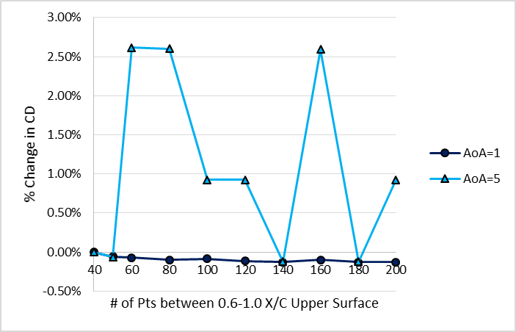
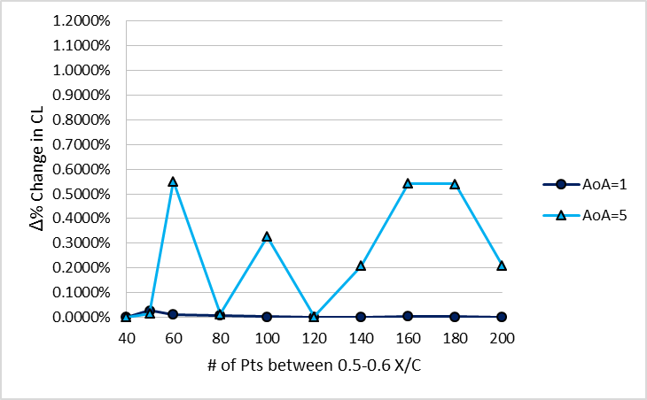
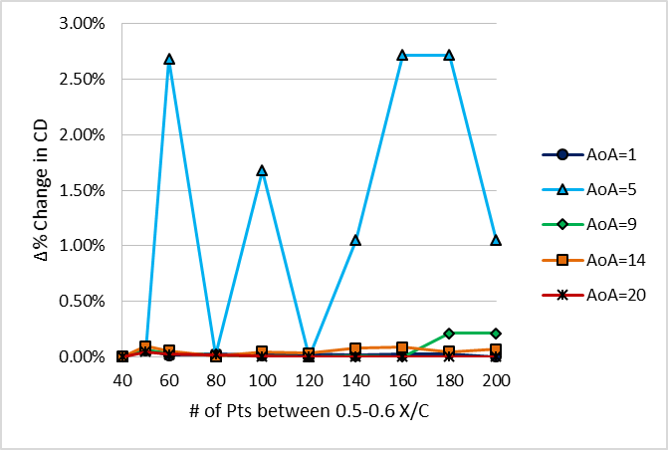
Upper Aft Region
Coarse BL Spacing
1
2
3
4
5
6
Initial Spacing:
2E-5 inches
(0 layers constant initial spacing)
% Change
Each solution non-dimensionalized by coarsest solution
=(CL_{x} – CL₅₀) / CL₅₀
Δ% Change
% Difference between solution and preceding, less refined solution
=(CL_{B} - CL_{A}) / CL_{A}
1.0% Convergence Criteria
1.0% Convergence Criteria
0.2% Convergence Criteria
Behavior occurs for all initial spacings investigated, both upper and lower aft regions

Slide 21
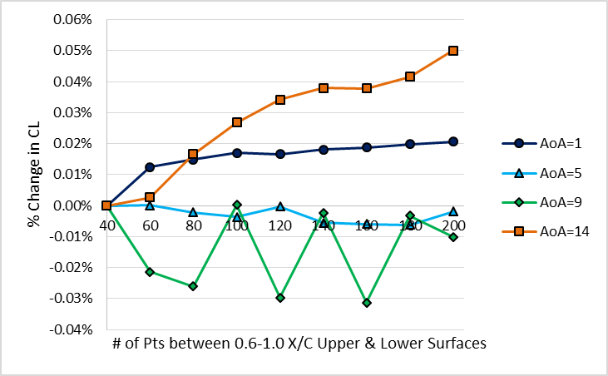
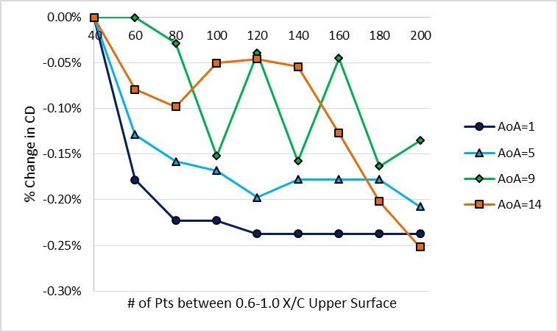
Converged Transition Model
(CTM) Grid
2
3
Leading Edge Region Selected # of Pts for Convergence
  Zone 1, Upper Surface 0.0 – 0.5 X/C: 220 pts
  Zone 4, Lower Surface 0.0 – 0.5 X/C: 200 pts
Poor resolution upstream hypothesized to cause the aft region non-convergence
  Ran leading edge regions with refinement with 40-200 pts aft refinement
  Selected 80 pts as converged grid based on y+=0.5, 5 layer predictions
Converged Transition Model Grid (CTM):
  220/200 pts in the 0.0-0.5 X/C, upper/lower surface each
  101 pts in 0.5-0.6 X/C, upper & lower surface eachh
  80 pts in 0.6-1.0 X/C, upper & lower surface each
1
4
5
6

Slide 22
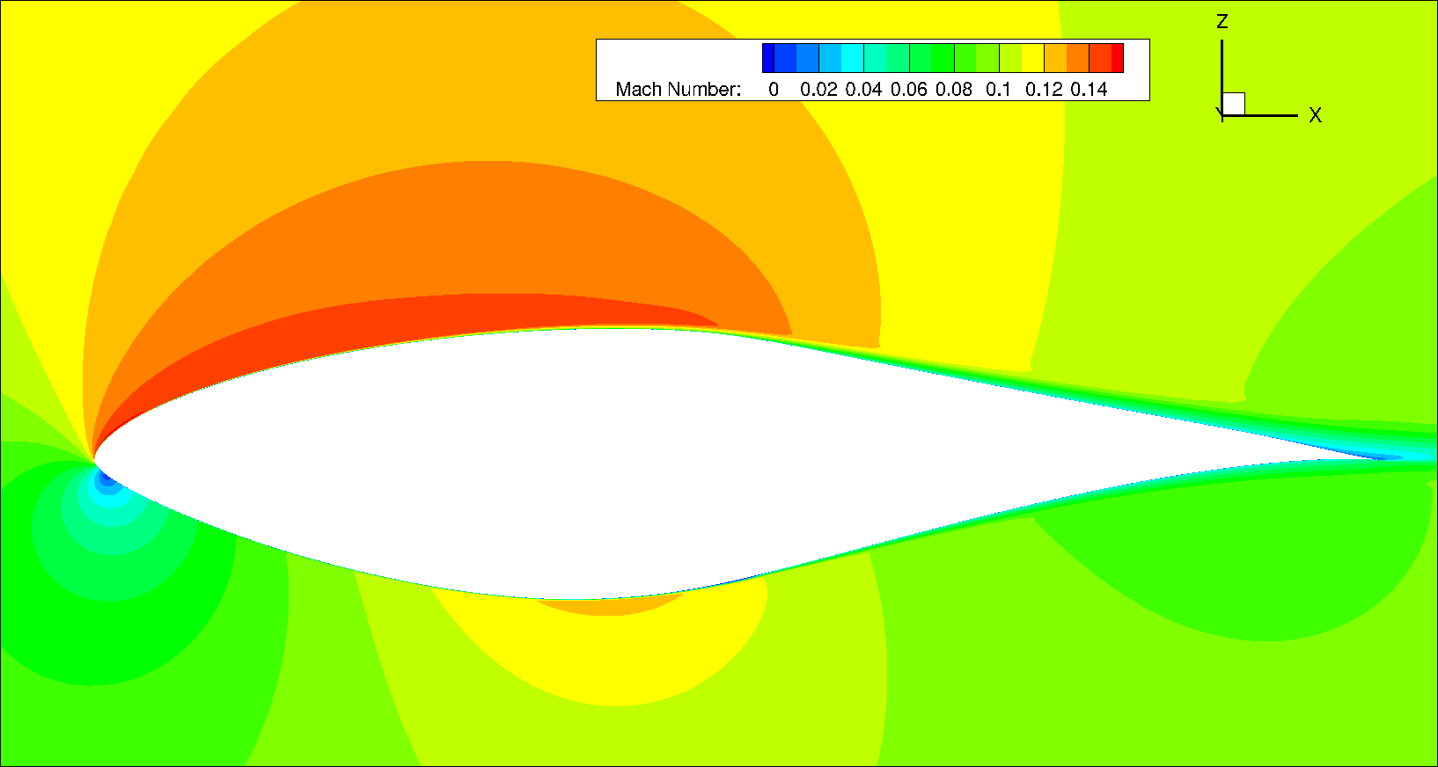
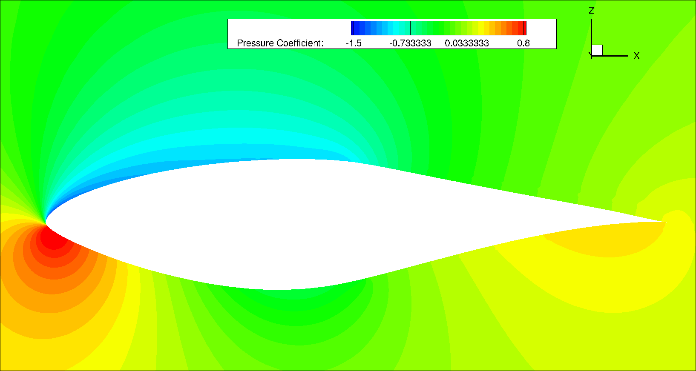
CTM, AoA=5°
Mach & Surface Pressure
Mach Contour Slice
Laminar separation bubble
Cp Contour Slice
AoA=5°

Slide 23




Visualizing the Skin Friction
Peak & Valley, AoA=+5°
TBP Grid System
CTM Grid System
Streamtraces & Vorticity
Grid & Vorticity
Streamtraces & Vorticity
Grid & Vorticity

Slide 24

Skin Friction Coefficient, CF
AoA=5°
Upper surface Cf with transition modeling > fully turbulent between, seems suspect
AoA=5°
WT measured transition sensitivity to AoA
CFD errors in this sensitive
More refinement needed?
Error in WT AoA data?
Skin Friction Coefficient, Cf
Area of Interest,
on next slide
Streamwise location, X/C

Slide 25

Skin Friction Coefficient, CF
AoA=5°
AoA=5°
(Zoomed in View)
Skin Friction Coefficient, Cf
Streamwise location, X/C

Slide 26

Surface Pressure Comparison
Wind Tunnel vs. CFD, AoA=+5°
Refined grid better captures the CP drop, but does not compare perfectly with WT data
  Could leading edge spacing refinement could improve suction Cp comparisons?
AoA=5°
Area of Interest,
on next slide
WT transition line data measured when:
AoA=5.4° for upper surface
AoA=5.1° for lower surface

Slide 27

Surface Pressure Comparison
Wind Tunnel vs. CFD, AoA=+5°
WT determined laminar separation and reattachment compares reasonably well
AoA=5°

Slide 28

Coefficient of Drag Predictions
AoA=+5°
Drag over-predicted by ≈ 40-50 drag counts if ran turbulent vs. with transition modeled

Slide 29




TBP Errors Offset, AoA=5
Upper Surface
Skin Friction Coefficient, Cf
Lower Surface
Upper Surface
Lower Surface

Slide 30
Conclusions
Boundary transition is sensitive to streamwise and viscous spacing
  Highly recommend conducting grid refinement if using BL transition model
Rigid best practices not obtained, but discovered a number of sensitivities
Grids developed using turbulent best practices may give OK looking answers
  But they do not properly capture the physics
Assessment of current transition modeling capabilities in OVERFLOW:
  Good but still needs improvement
  Interested in building additional body of validation data
Grid refinement study took considerable effort
  Using Near-Body Adaptive Mesh Refinement about Cf is likely wise

Slide 31
Future Work
Far field boundary distance grid refinement
  Expected to resolve upper surface early transition based on input from Dr. Jim Coder
Near body adaptive mesh refinement
  Refining on different flow values to determine best practices / sensitivities
Solver setting investigations:
  Sensitivity to turbulence intensity
  Impact of LHS, RHS Schemes & limiters
  Can solutions be run steady-state?
Application to fixed-wing aircraft airfoils

Slide 32


AMRDEC Web Site
www.amrdec.army.mil
Facebook
www.facebook.com/rdecom.amrdec
YouTube
www.youtube.com/user/AMRDEC
Twitter
@usarmyamrdec
Public Affairs
AMRDEC-PAO@amrdec.army.mil

Slide 33
BACKUP

Slide 34

Surface Pressure Comparison
Wind Tunnel vs. CFD, AoA=+1°
Refined grid better captures both CP drops, but does not compare perfectly with WT data
  Transition improves upper surface acceleration region comparison with WT data
Area of Interest,
on next slide

Slide 35

Surface Pressure Comparison
Wind Tunnel vs. CFD, AoA=+1°
Converged Turbulent Model (CTM) predictions compare best vs WT data for the Cp drop
  Minor Cp overshoot still exists, as well as “early” Cp drop

Slide 36

Skin Friction Coefficient, CF
AoA=1°
AoA=1°
Skin Friction Coefficient, Cf
Area of Interest,
on next slide
Streamwise location, X/C

Slide 37

Skin Friction Coefficient, CF
AoA=1°
(Zoomed in View)
Skin Friction Coefficient, Cf
Streamwise location, X/C

Slide 38


Visualizing the Skin Friction
Peak & Valley, AoA=+1°
CTM Grid System
Streamtraces & Vorticity
Grid & Vorticity

