Slide 1


13th Symposium on Overset Composite Grids and Solution Technology
Mukilteo, WA
October 18, 2016
Application of Strand Grid Framework to Rotorcraft Simulations
Approved for public release; distribution unlimited.
Review completed by the AMRDEC Public Affairs Office (PR2263, 23 May 2016)
Jayanarayanan Sitaraman, Parallel Geometric Alg. LLC
Andrew Wissink, US Army Aviation Development Directorate
Vinod Lakshminarayan
Science & Technology Corporation
NASA Ames Research Center
Moffett Field, CA
DISCLAIMER: Reference herein to any specific commercial, private or public products, process, or service by trade name, trademark, manufacturer, or otherwise, does not constitute or imply its endorsement, recommendation, or favoring by the United States Government. The viewing of the presentation by the Government shall not be used as a basis of advertising.

Slide 2
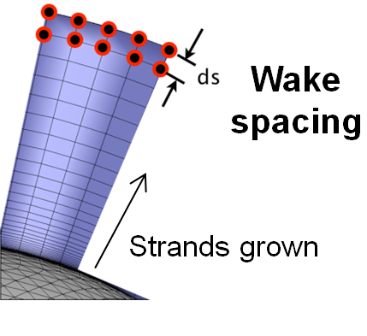
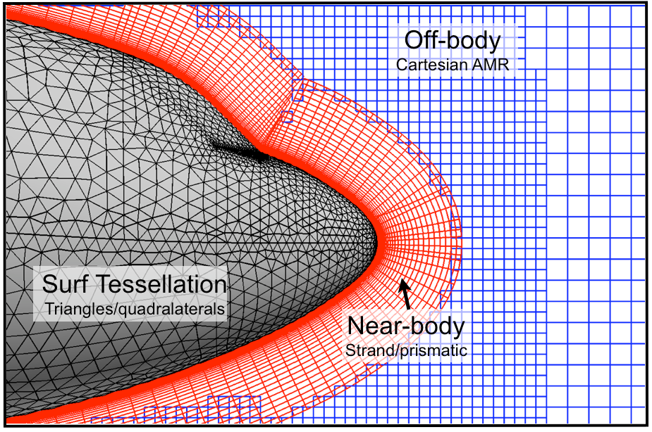
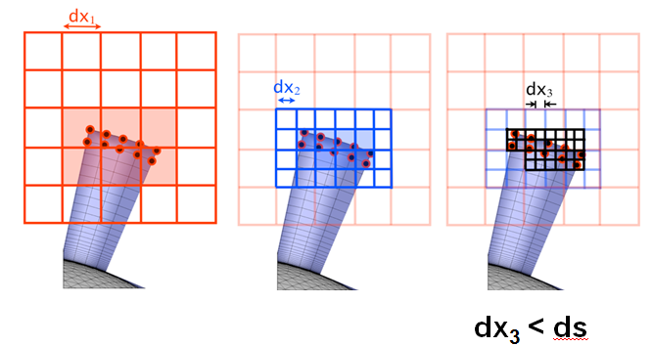
Strand Grid Framework
Introduced by Meakin et al, 2007
“Strand” near-body grid
  Straight line segments grown directly from surface tessellation
  Extrudes a short distance
  Transitions from viscous spacing at a specified wake spacing
  Can self-intersect
Cartesian AMR off-body grid
  Covers rest of the domain
“Strands” grown directly from Surface Tessellation

Slide 3
Strand Grid Framework
Advantages
“Nearly automatic” mesh generation
  Only three inputs : surface tessellation, viscous spacing, wake spacing
  Haimes, 2014 – 2016 → MOSS code
Strands represented with minimal information
  Mesh can be stored in all processors
  Highly parallel domain connectivity
  Sitaraman et al. 2012 → OSCAR
Facilitate efficient flow solvers
  Line-based solution methodology
  Lakshminarayan et al. 2016 → mStrand
Viscous spacing
Surface Tessellation
Off-body mesh automatically refined to wake spacing
This work
Shows validation of strand grid framework using mStrand for rotorcraft problems

Slide 4
Multi-strand Solver (mStrand)
Developed from Nov 2014 -
Solver Features
2nd order vertex centered FV solver
Surface grid can be quads or/and triangles
General prismatic mesh in normal direction
Robust treatment of multiple strand per surface node
MUSCL reconstruction + Riemann solver along strands as well as in the “r-s” plane → Spurious oscillation prevented using gradient-based limiters
2nd order full Navier-Stokes term → Gradients computed using Weighted Least-Squares or Green-Gauss method
1st order implementation of SA turbulence model
Linear solver using preconditioned GMRES
Fully parallel

Slide 5

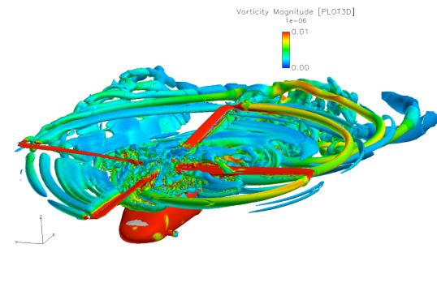
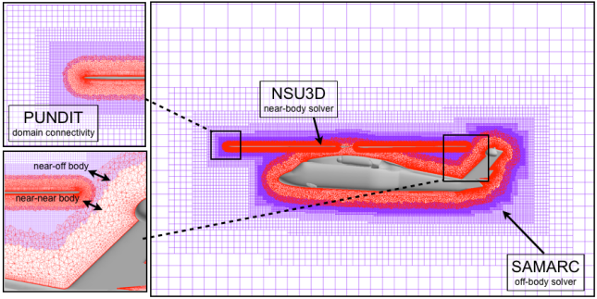
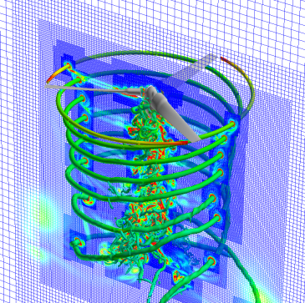
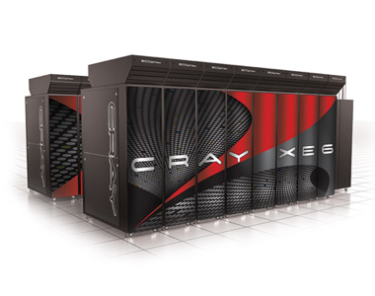
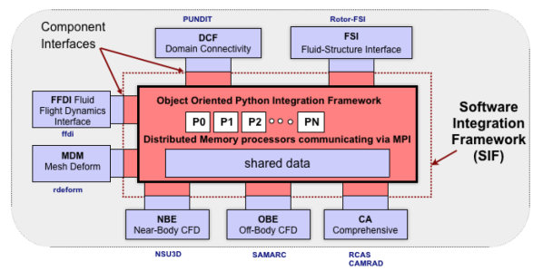
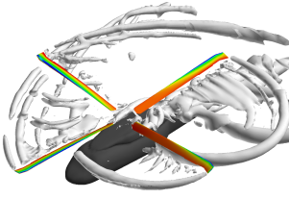
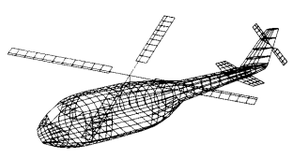
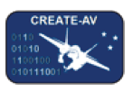

Helios Framework
HPCMP CREATETM AV Helios Helicopter Overset Simulations
Dual Mesh Paradigm
Adaptive Mesh Refinement
Moving Body Overset
mStrand
near-body solver
SAMCART
off-body solver
Near-body
Cartesian off-body
Rotor-Fuselage and Multi-rotor moving mesh support
To resolve wake
CFD/CSD Coupling
Advanced Software Infrastructure
High Performance Computing
RCAS and CAMRAD Structural Dynamics and Trim coupling
Python-based infrastructure readily supports addition of new software
Runs on HPC hardware with focus on parallel scalability
Supports high-fidelity rotary-wing simulation by government and industry
Developed & maintained by a team at Army ADD.

Slide 6
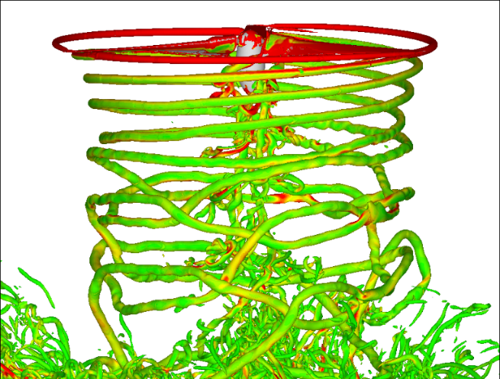
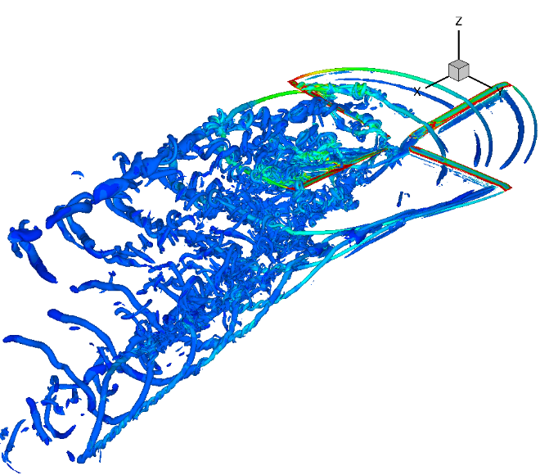
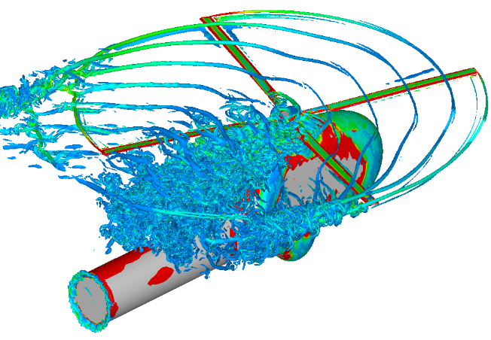
Test Cases
Tram rotor in hover
UH-60A high altitude stalled flight (C9017)
HART II Blade-Vortex Interaction problem

Slide 7
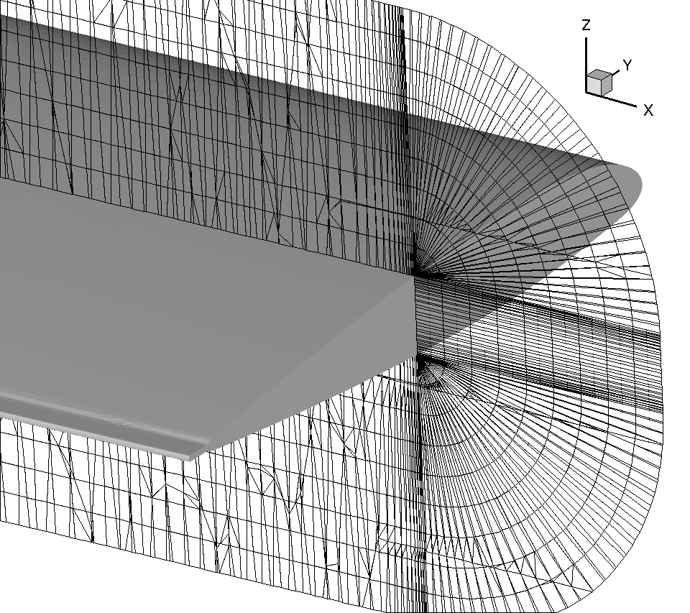
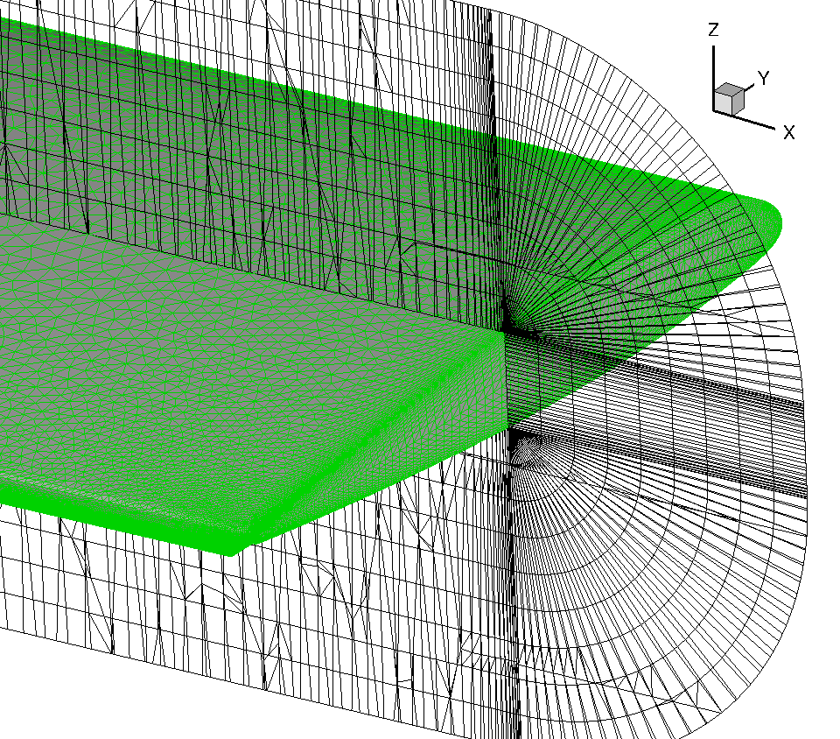
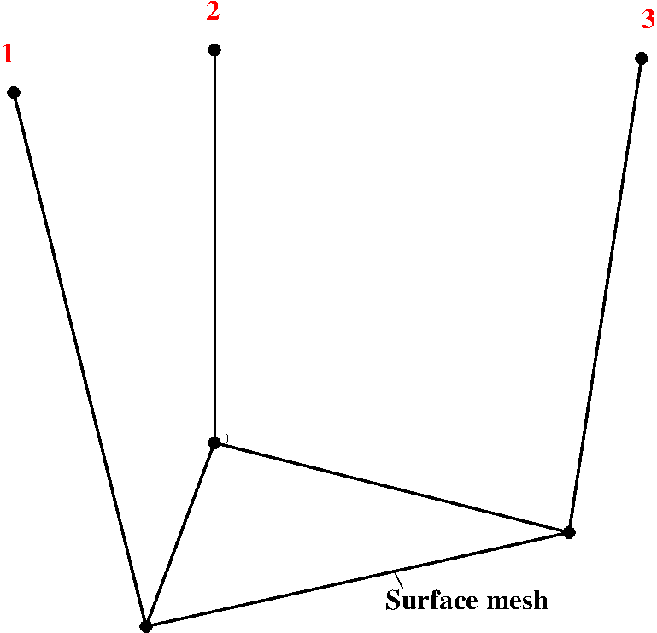
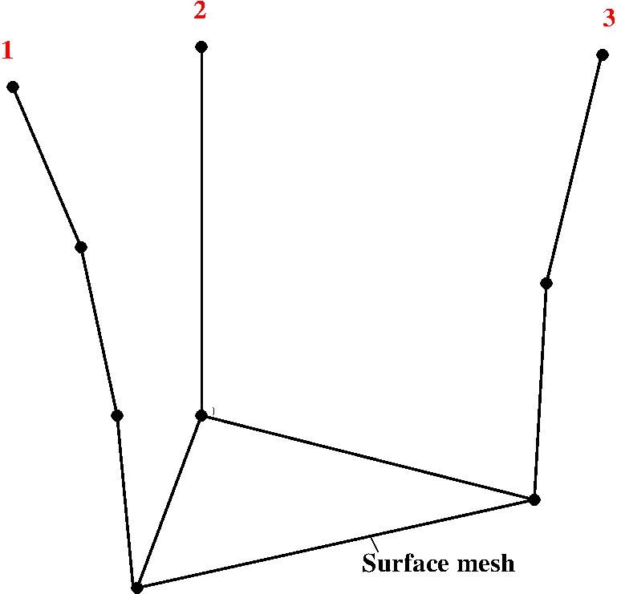

Mesh Generation
MOSS Code by Haimes
Intended to be used directly to generate all meshes
Able to generate meshes for all geometry considered
Generated volume mesh not optimal for CFD calculation
Issue with allowing only straight-line strands
Solution
Relax definition of strands → Strand represented by one or more line-segments
No. of line-segments for each strand could be different
Single line at most locations
Multiple line segments are regions with sharp corners
Compact representation of strand grid still valid
<10% overhead for most problems
Provides better control of grid quality
Strands sub-divided using specified distribution
Problem exacerbated with fine spacing near corners
Strand sub-divided

Slide 8
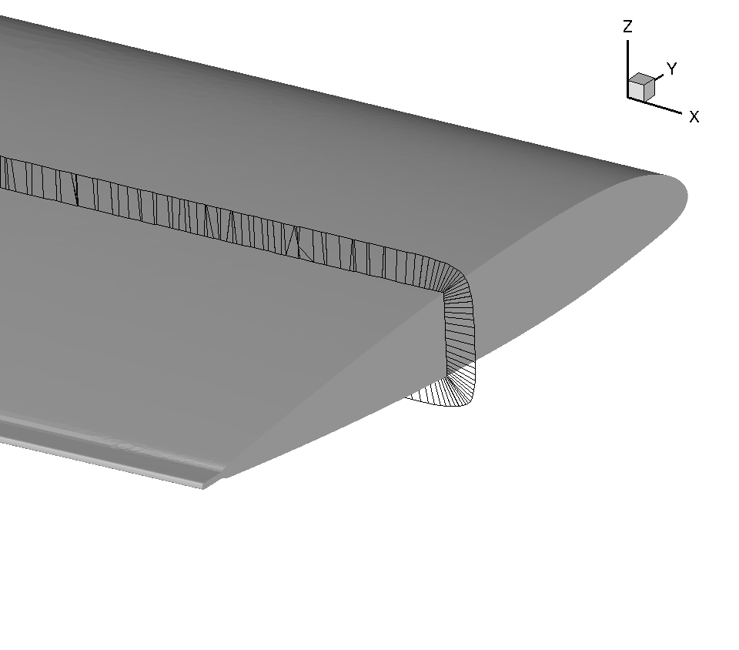
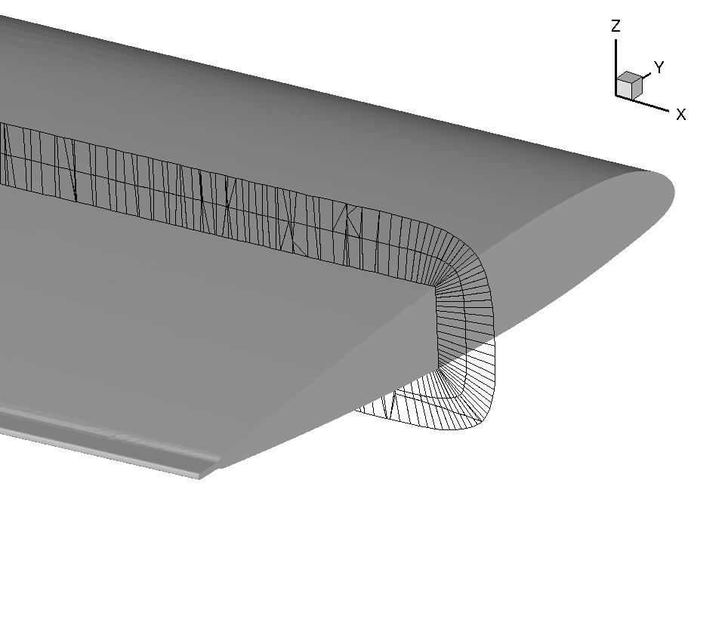

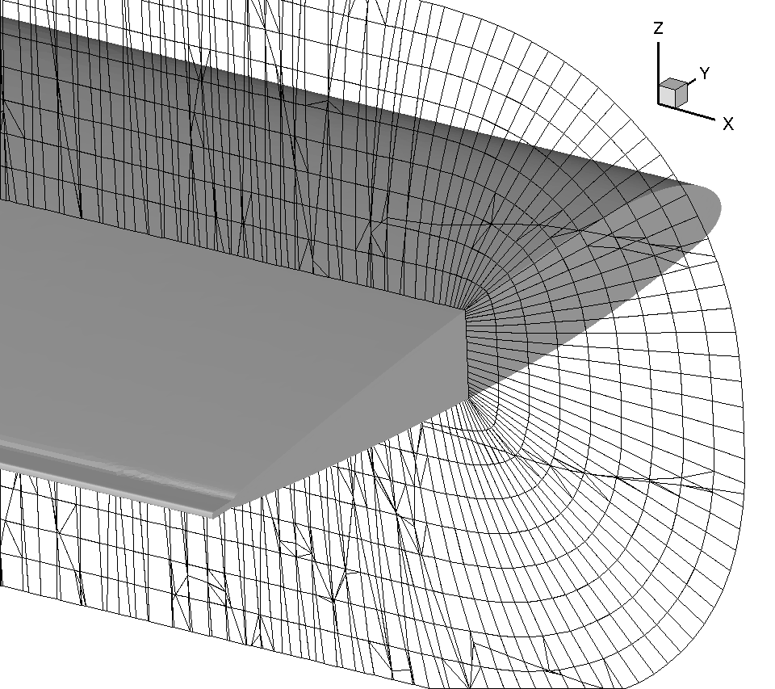
Mesh Generation
Meshes in Current Work
All strands represented with same no. of line-segments
Multi-level strategy
MOSS for the first level → Multi-stranded mesh
Outer boundary of a level used as starting point for next
Levels grown using simple normal smoothing strategy
<10 levels required for good CFD meshes
Working on robust algorithm to grow levels
Single-level mesh from MOSS
Next-level starts at outer-boundary of first-level
First level using MOSS
Mesh using 9 levels

Slide 9
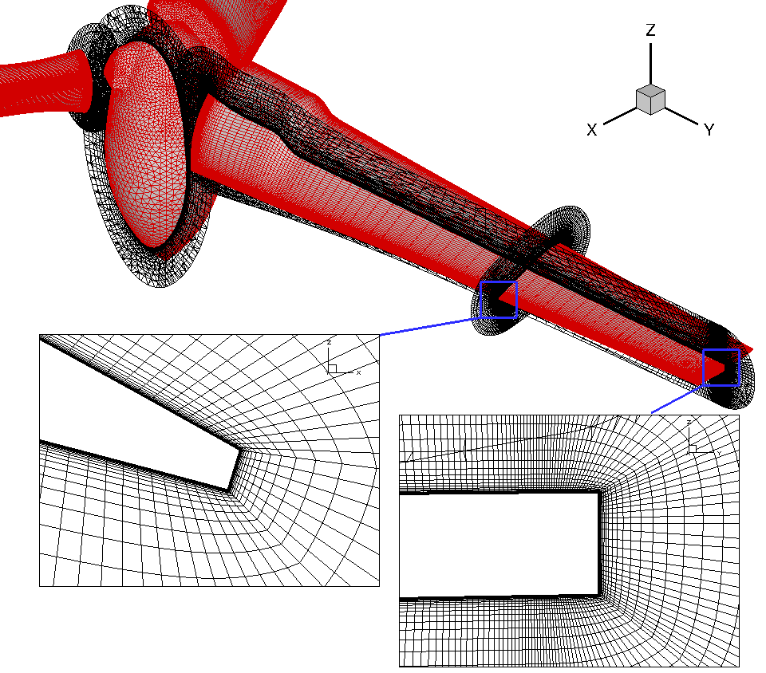
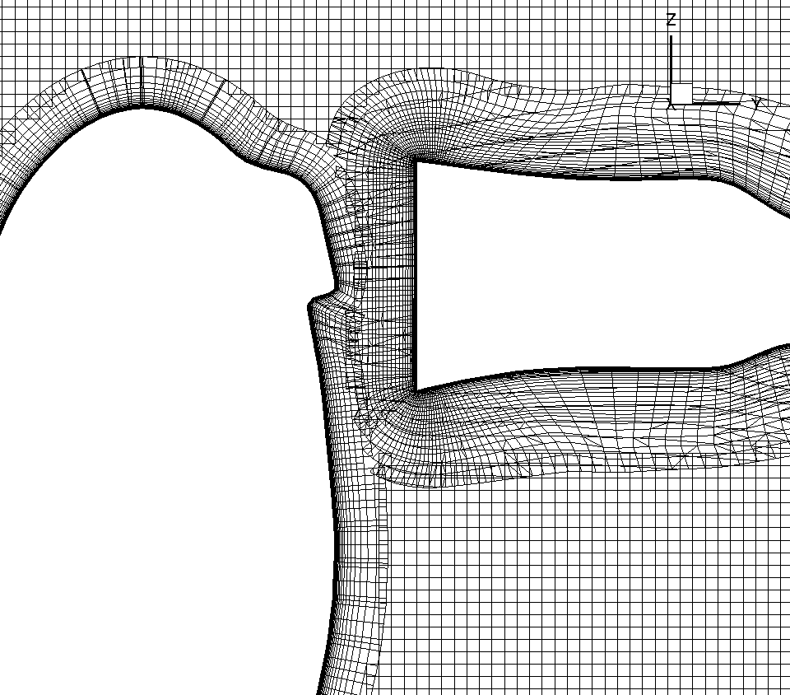
Tram Rotor in Hover
Test developed by NASA and U.S. Army
Aspect ratio ➔ 10.36
Tip Mach ➔ 0.62
Tip Re number ➔ 2.1 million
Collective ➔ 6º - 16º
Grid
Single stranded mesh
Quad + Tri surface mesh
Each body meshed separately
~6.7 million NB (51 strand layers)
Calculations run for 8 revs – 11,520 steps with a rotor step of 0.25º.
Off-body mesh adapted every 10 steps
2 days on 1024 procs
Quarter-scale V22
Interface between blade, hub and Cartesian mesh

Slide 10
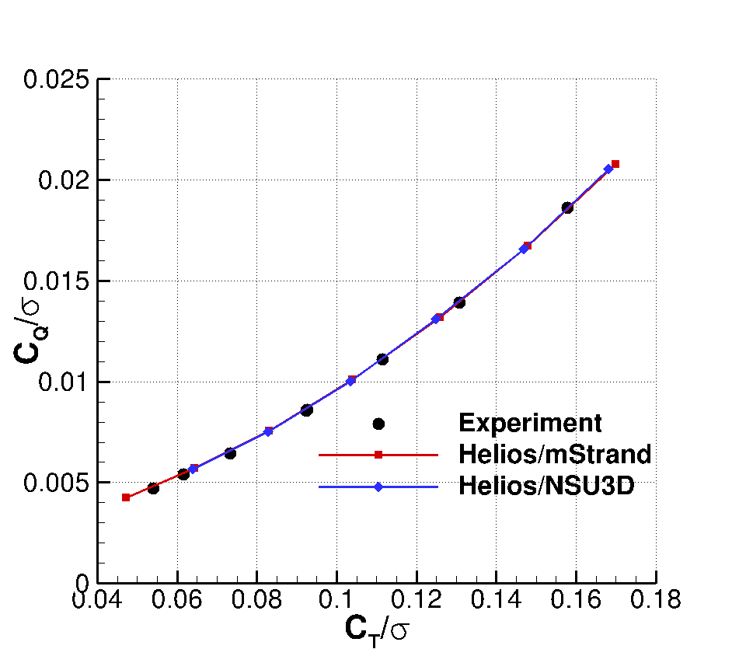
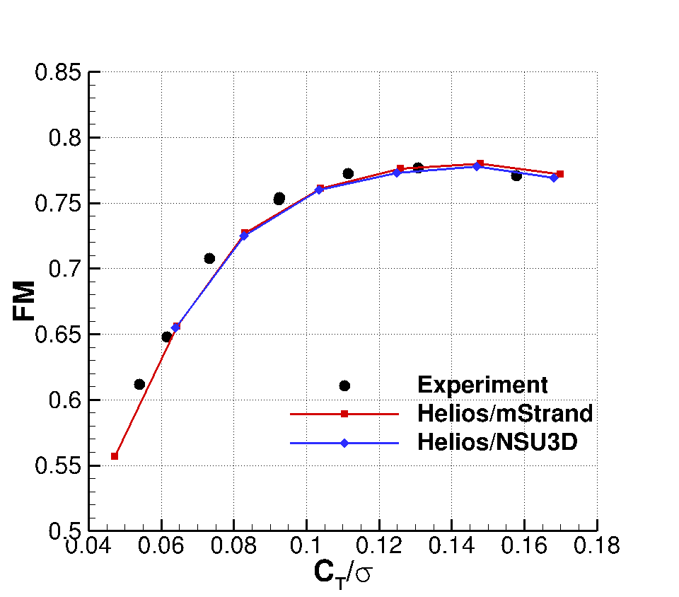
Tram Rotor in Hover
Power vs Thrust
Figure of Merit vs Thrust
Helios/NSU3D provides benchmark best available results from Helios
Excellent performance prediction

Slide 11
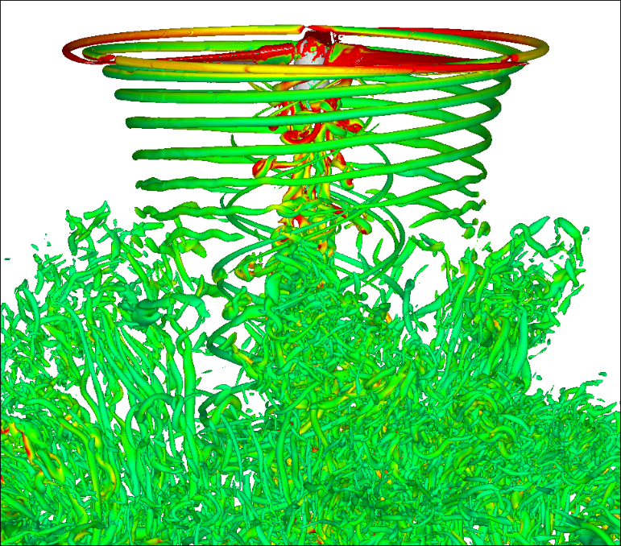
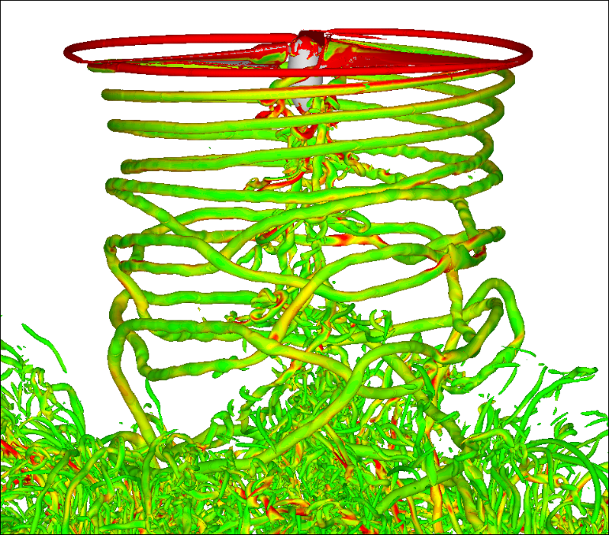
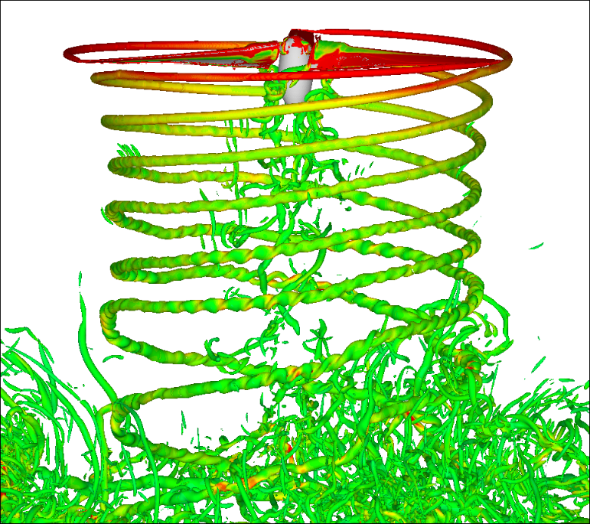
Tram Rotor in Hover
Θ = 6º
Θ = 10º
Θ = 14º
Iso-surface of q-criterion with vorticity magnitude
Tip vortices very well resolved ➔ Vortex formation captured well
Twisting of vortices evident
Vortex interactions

Slide 12
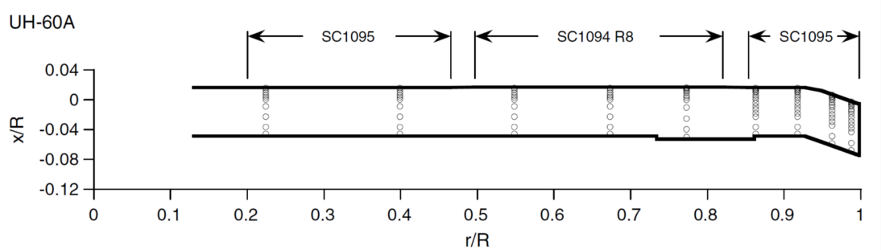
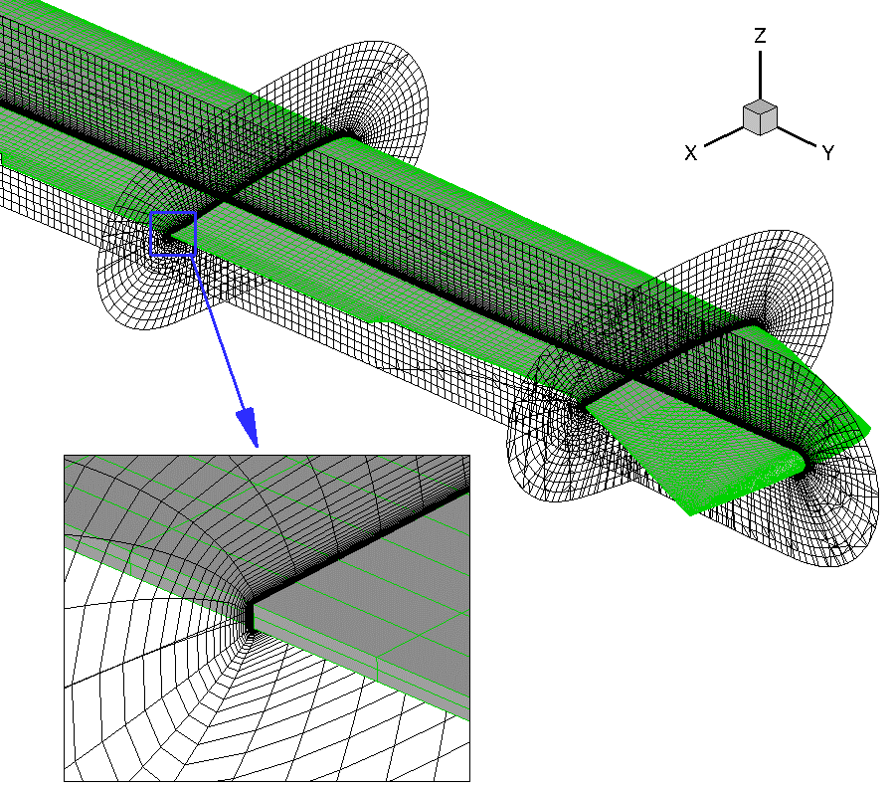
UH60 High-Altitude Stall Flight,
C9017 − μ = 0.24
NASA/U.S. Army UH-60A Airloads Program
4-bladed rotor – 322in radius
Chord at unswept portion – 20.76in
Rotor speed – 258RPM
Strand Grid
Blade-only simulation
1.6M points per blade (61 layers)
Multi-stranded at trailing edge
Extends 0.5 chords
Simulation Setup
Time step 0.25 deg azimuth
8 sub-iterations/time step in near-body
20 sub-iterations/time step in off-body
Spalart-Allmaras turbulence model with rotation correction
Strand grid

Slide 13
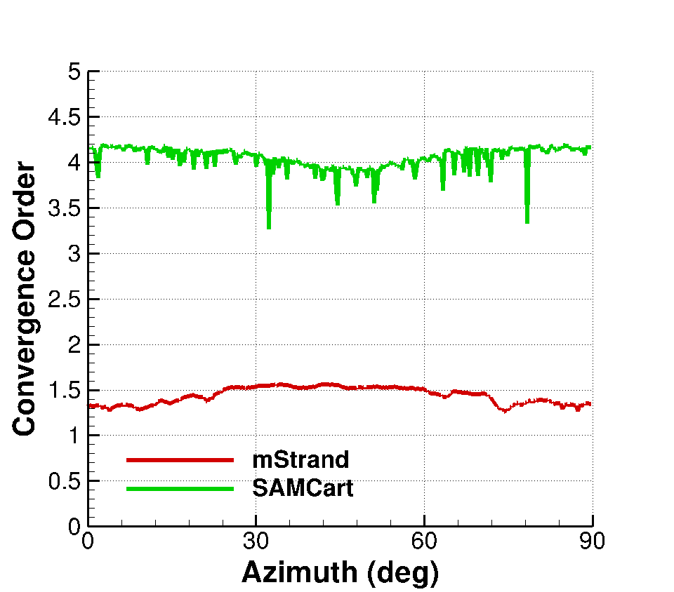
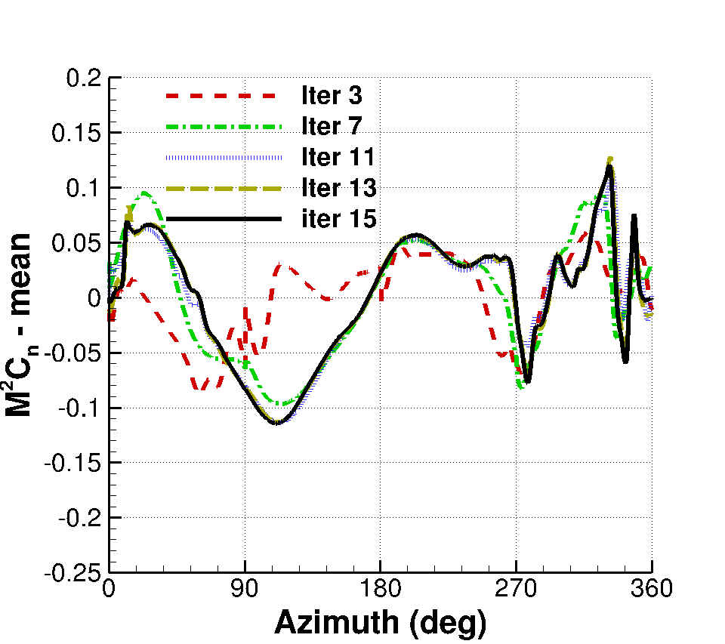
UH60 High-Altitude Stall Flight,
C9017 − μ = 0.24
Fully coupled CFD/CSD simulation → RCAS for structural dynamics and trim
Loose coupling strategy → Forces and deformations over a period
4 rotor revolutions for convergence → 5760 steps and 15 coupling iterations
AMR off-body Cartesian grid → 57M nodes
Less than 2 days on 720 procs
Solver Convergence
Airload Convergence
Satisfactory solver convergence

Slide 14
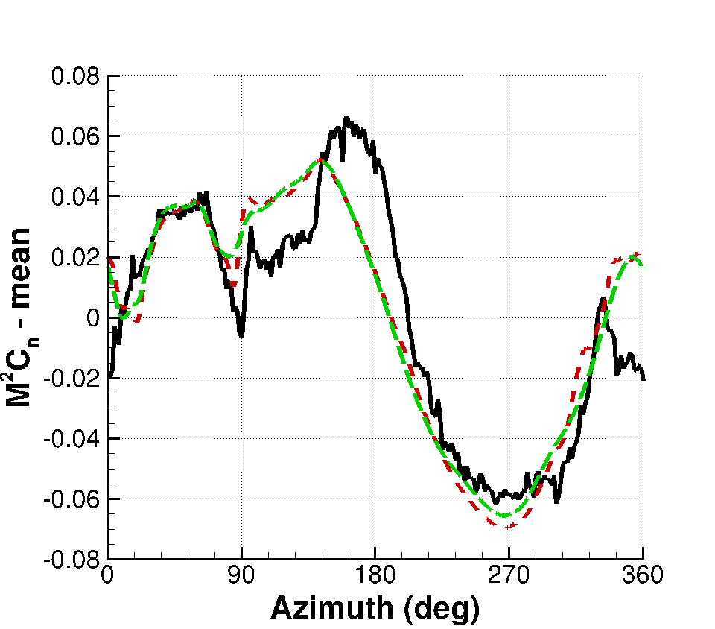
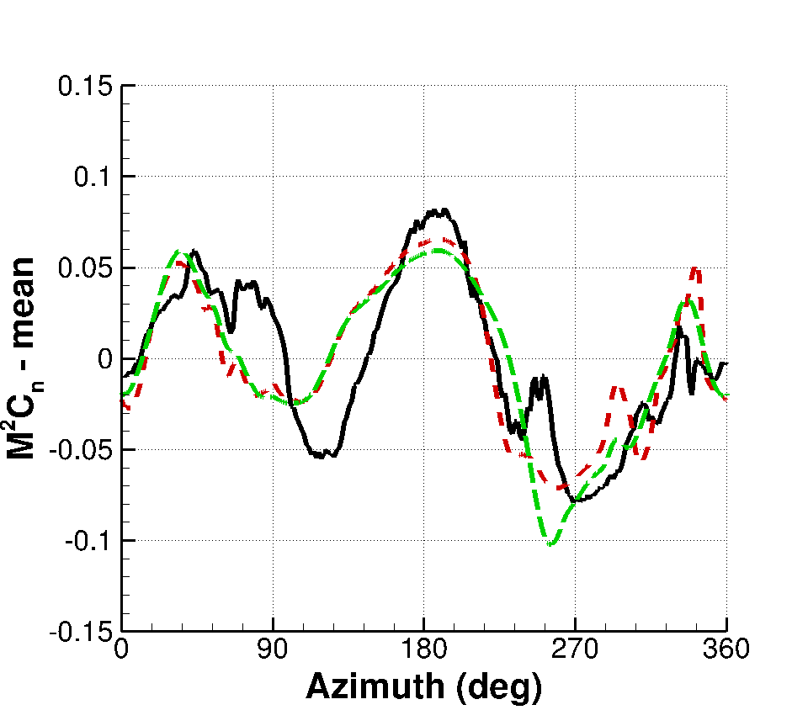
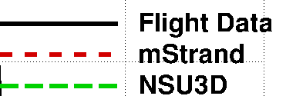
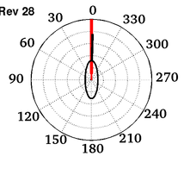
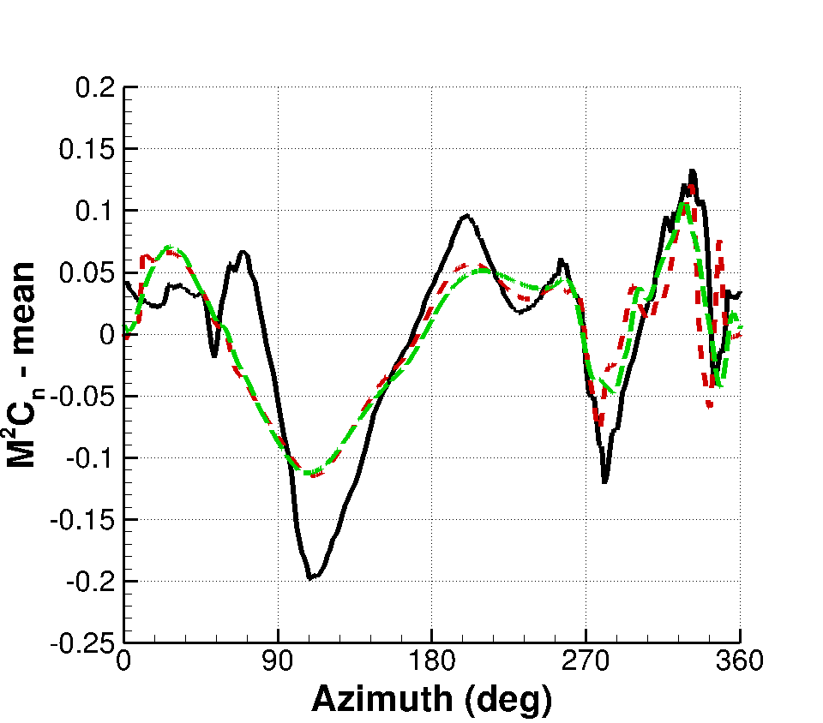
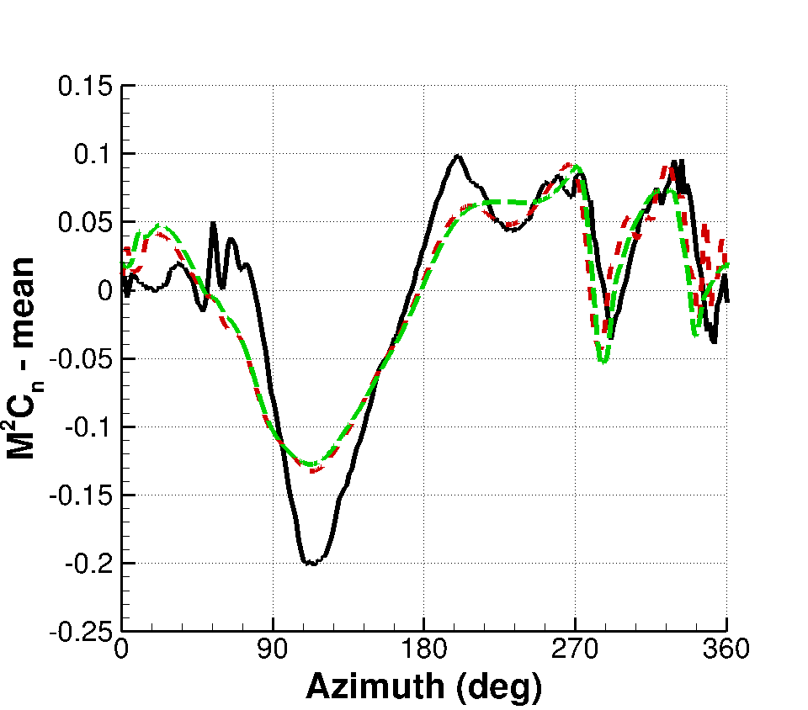
Airloads Comparison (C9017) –
Normal Force
r/R = 0.4
r/R = 0.67
r/R = 0.86
r/R = 0.96

Slide 15
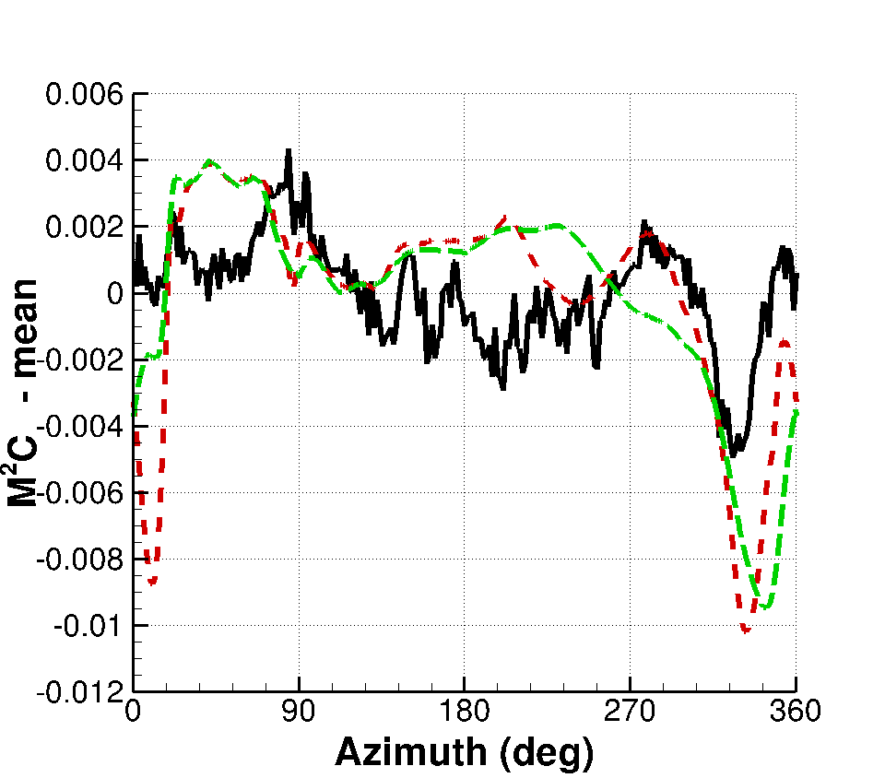
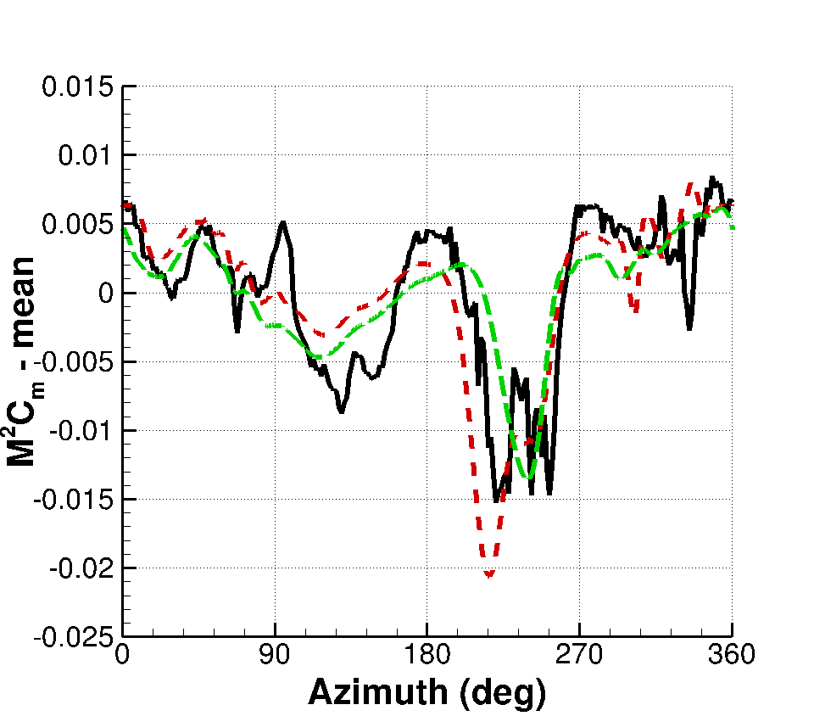
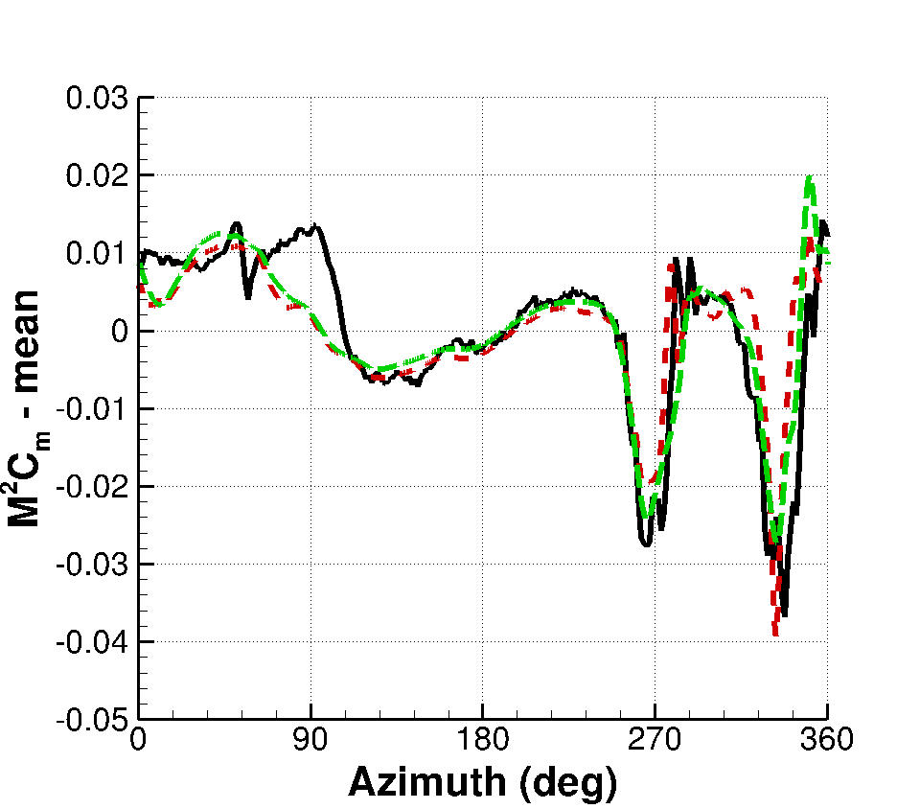
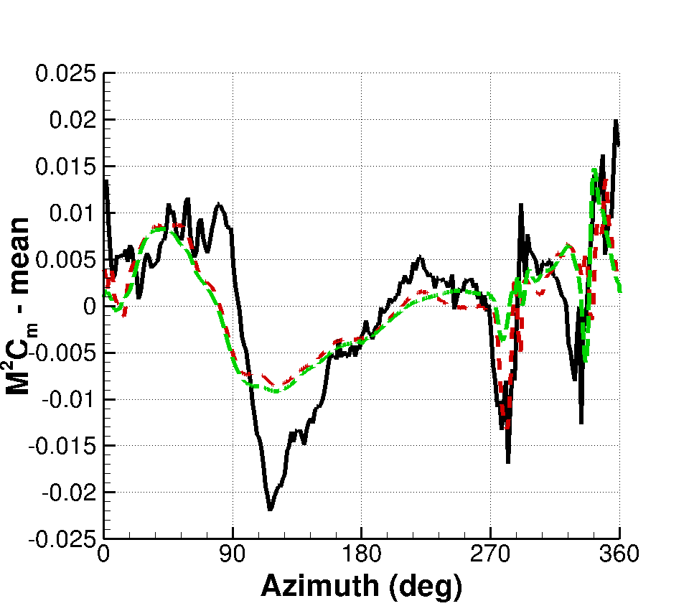
Airloads Comparison (C9017) –
Pitching Moment
r/R = 0.4
r/R = 0.67
r/R = 0.86
r/R = 0.96
Overall good agreement

Slide 16

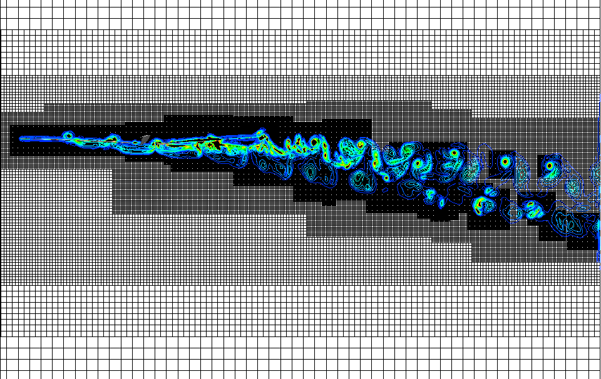
Predicted Wake – C9017
Iso-surface of q-criterion
Wake well captured
Off-body grid has refined based on solution
Unsteadiness in the wake

Slide 17
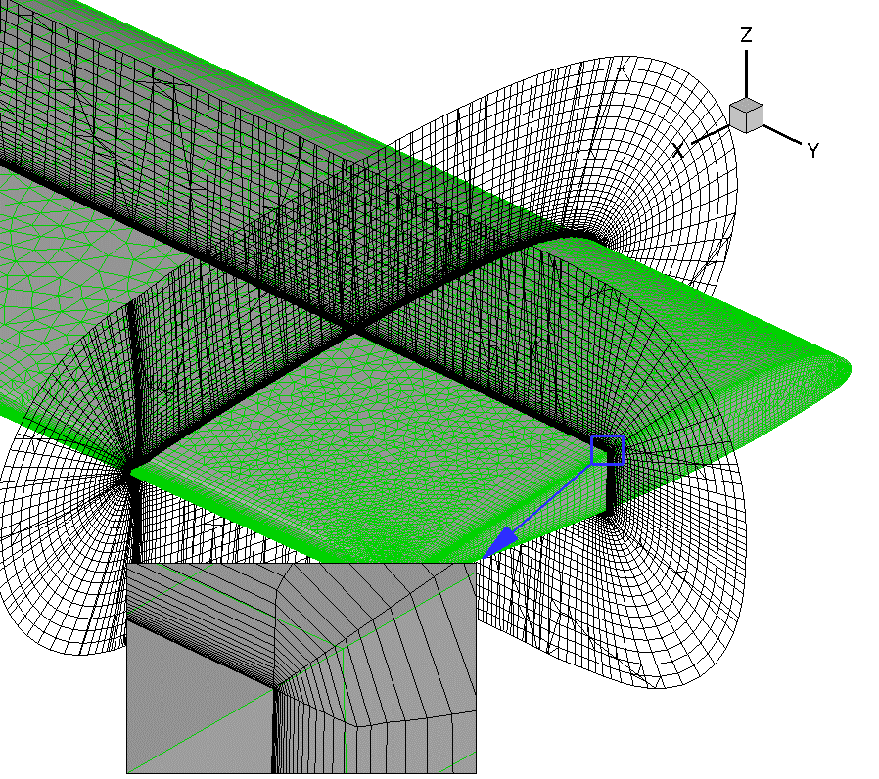
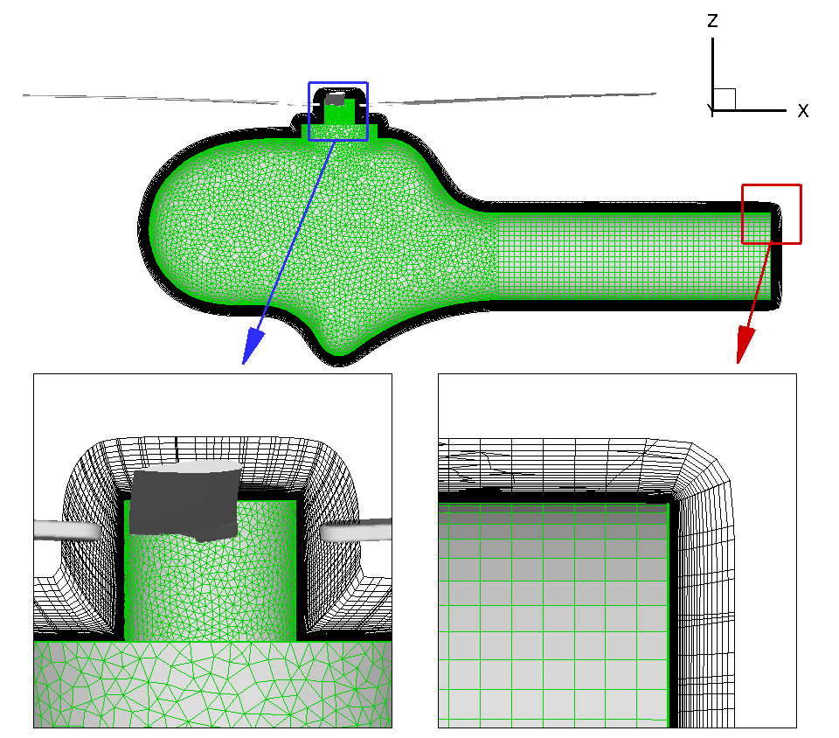
HART II Blade-Vortex Interaction
4-bladed rotor
2m radius and 0.121m chord
Tests conducted at DNW wind tunnel
Descending flight at μ = 0.15
Strand Grid
3.5million per blade
0.67million
Extends 0.3 chords
Multi-stranded at tip

Slide 18
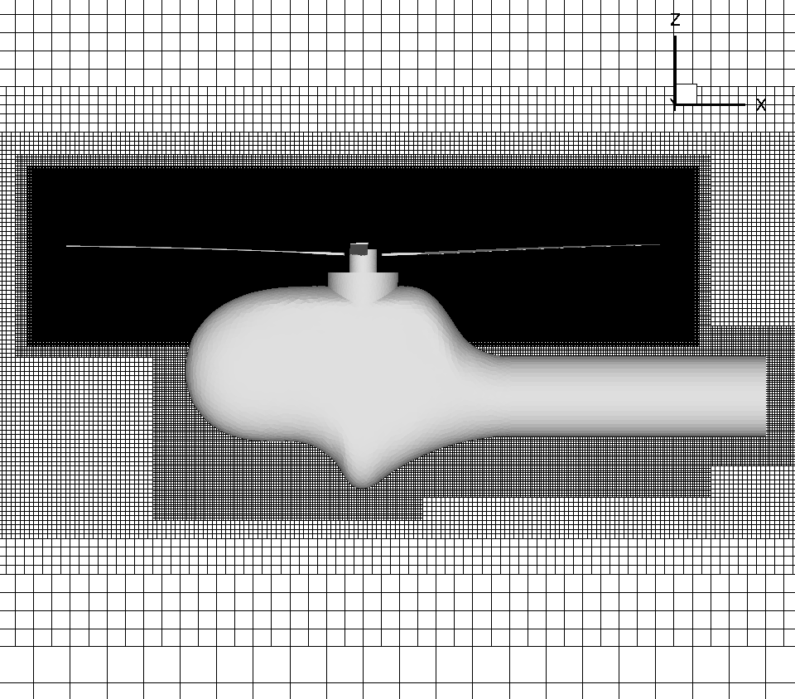
Other CFD Data
Other CFD Data for Comparison → Jayaraman et al. 2016
Blade grid extends to one chord from surface
FUN3D blade grid
  3.5M nodes mixed element grid – Comparable number of nodes in strand mesh
  Refinement in the tip region – Similar surface grid as strand mesh
OVERFLOW blade grid
  5M nodes per blade
  Fine mesh with 2% chord spacing from 80% to tip
Identical off-body grid
FUN3D and OVERFLOW in Helios,
500M off-body grid points

Slide 19
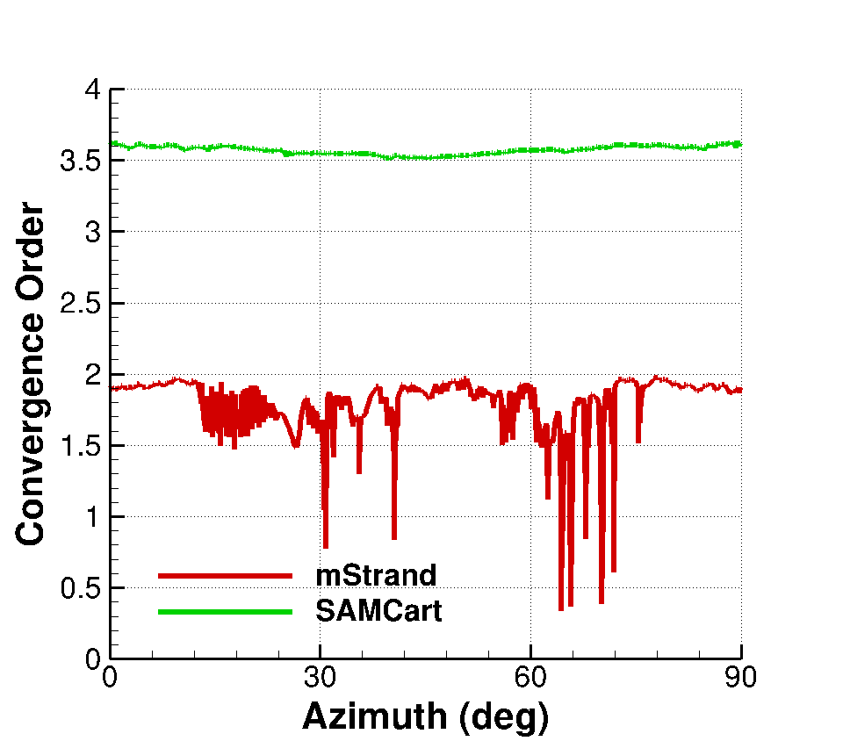
Simulation Parameters
Prescribed blade motions from a previously coupled simulation
Time step 0.1 deg azimuth (3600 time steps/rev)
4 full rotor revolutions for convergence – 14400 steps
8 sub-iterations per time step for near-body
12 sub-iterations per time step for off-body
DES in the off-body
4 days on 3600 procs on HPC
Solver Convergence
Near-body solver → 2 orders
Off-body solver → 3.5 orders

Slide 20
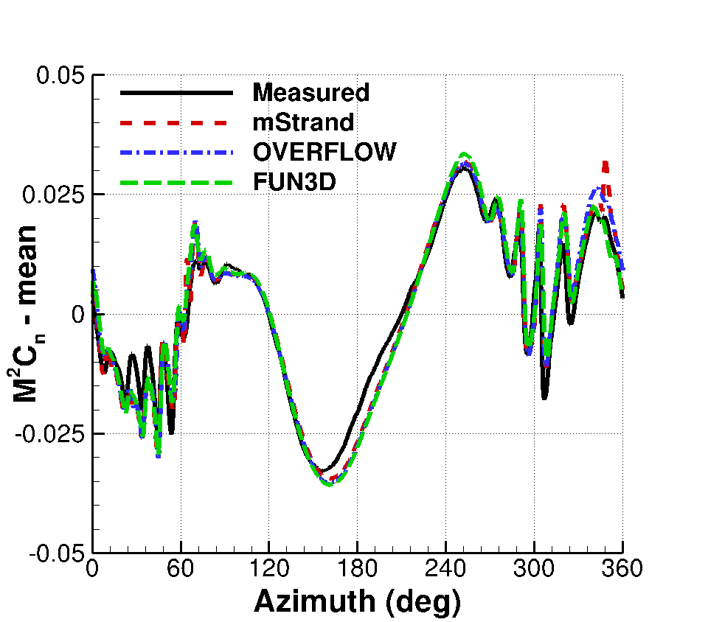
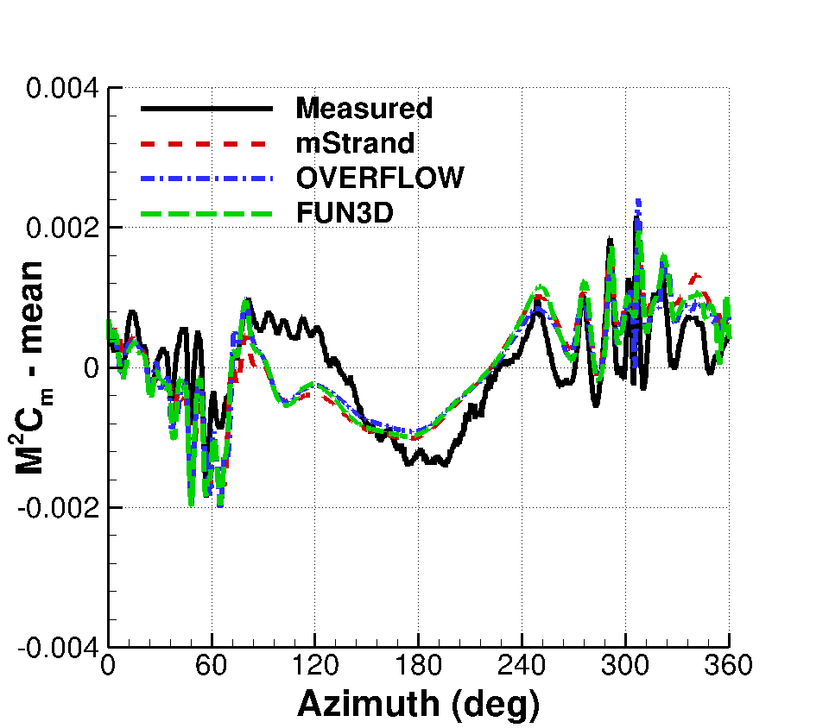
Airloads Comparison
At 87% spanwise station
Strand grid framework results agree well with other CFD
All CFD comparable to experiment
BVI events well captured

Slide 21
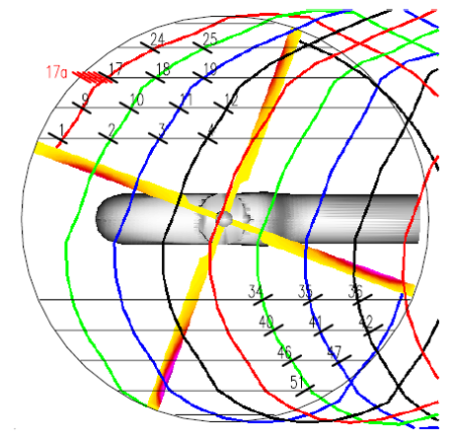

Experimental PIV Location
y/R = 0.7
y/R = 0.7
Ψ = 70º
Ψ = 20º
Vortex Roll-up
Measurement 17a, Ψ = 51º, vortex wake age = 5.3º
Measurement 17b-d, 17, 17e-h, dΨ = 5º, wake age → 10.3º to 45.3º
Vortex Convection
Measurement 17-19, Ψ = 70º, wake age → 25.3º to 205.3º
Measurement 20-23, Ψ = 20º , wake age → 245.3º to 515.3º

Slide 22

Prediction of Vortex Roll-up
Wake age of 5.3º – 45.3º
y/R = 0.7
Measurement 17a, Ψ = 51º
Measurement 17b-d, 17, 17e-h, dΨ = 5º
Vortex strength comparable to FUN3D

Slide 23


Prediction of Vortex Roll-up
Strand grid framework in Helios
OVERFLOW as near-body solver in Helios
Vortex formation and evolution well-captured within strand grid
Solution dissipated when transferred to off-body
Vortex transferred to off-body at younger wake age
Need to exercise AMR in off-body with additional levels

Slide 24

Prediction of Vortex Convection
y/R = 0.7
y/R = 0.7
Measurement 17-19, Ψ = 70º
Measurement 20-23, Ψ = 20º
Ψ = 70º
Ψ = 20º
Vortices well identified

Slide 25


Wake Comparison – Positions 17-23
Vortex Strength
Vortex Position
Vortex position predicted similar to other CFD
Vortex strength at position 17
  Comparable to FUN3D
  Lower than OVERFLOW
Vortex strength at position 18-23
  Comparable or better than OVERFLOW
y/R = 0.7
Ψ = 70º
Ψ = 20º

Slide 26



Predicted Wake
Coarser inboard portion
Returning Vortices
Tip
Tip Vortex
Iso-surface of Q-criterion
Several interaction of vortices with blade
Returning vortex has less chance of re-entering coarser portion of blade grid

Slide 27




Code Performance
Performance for TRAM blade simulation compared with established structured and unstructured solvers
OVERFLOW – NASA structured grid solver
NSU3D – Univ. of Wyoming unstructured grid solver
TRAM case without hub
~6.4 million grid points
mStrand grid
NSU3D grid
OVERFLOW grid

Slide 28



Code Performance
OVERFLOW – Structured grid solver
NSU3D – Unstructured grid solver
Two orders sub-iteration convergence sought
Set max number of sub-iterations
Codes tested on different number of procs
mStrand → best turn-around time at NCPU = 1440

Slide 29

Concluding Remarks
Demonstrated ability to accurately simulate rotorcraft problems with complex physics using strand-grid framework
  mStrand able to handle deforming blades, CFD/CSD coupling
  Airloads and stall well predicted
  Able to predict wake comparable to established solution procedure
Strand technology is promising with the ability to automate solution procedure; at the same time provide good solver efficiency
Future Work
Address meshing challenges for complex geometries
Simulate helicopters with complex fuselage

Slide 30
Acknowledgments
Material presented in this paper is a product of the CREATETM-AV Element of the Computational Research and Engineering for Acquisition Tools and Environment (CREATETM) Program sponsored by the U.S. Department of Defense HPC Modernization Program Office. We also the support of U.S. Army for this work. The authors would like acknowledge Mark Potsdam, Buvana Jayaraman and Beatrice Roget for providing help in setting up various cases.

