Slide 1
Rotor Hub Flow Simulations Using the OVERFLOW Solver
Presented at the 13th Overset Grid Symposium
Mukilteo, WA
October 18, 2016
Dr. Jim Coder
University of Tennessee – Knoxville
Dr. Norman F. Foster and Mr. Warren J. Baker
Penn State Applied Research Laboratory

Slide 2
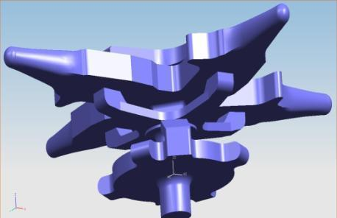
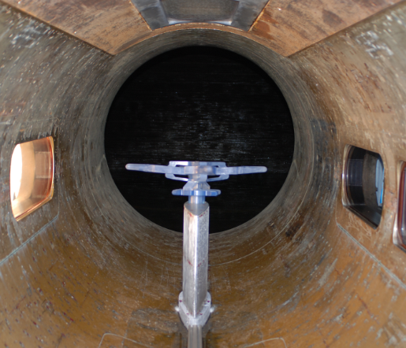
Background and Motivation
Rotor hub accounts for ~30% of the parasite drag for rotorcraft at high speeds
Complex flow physics
Rotating, unsteady
Transitional
Large amounts of separation
Interactional aerodynamics
Ongoing experimental and computational investigations at PSU, UTK, and GIT
Supported through VLC and VLRCOE
Reich et al.

Slide 3
Background and Motivation
1st Rotor Hub Flow Prediction Workshop held at Penn State in June 2016
Assess the state of the art and best practices for predicting rotor hub flows
Simulate an experiment conducted in the 48” Garfield Thomas Water Tunnel at Penn State ARL
Focus on the wake near and long-age wake predictions
Representatives from academia, government and industry
Structured, overset methods are well suited for hub flows
Complex geometries
Structured grids amenable to high-order differencing schemes

Slide 4
Objectives and Strategy
Using OVERFLOW 2.2i with a fully turbulent, hybrid RANS/LES method and higher-order convective fluxes
Structured, overset solver
Density-based, compressible, ideal gas
Hybrid RANS/LES methods prevent excessive turbulent dissipation in wakes
Higher-order fluxes beneficial for vortex-dominated flow fields and helps preserve key flow structures
Test cases considered for simulations
μ = 0.20, Re = 4.6 x 10⁶ – current focus
μ = 0.20, Re = 2.3 x 10⁶

Slide 5
Approach

Slide 6
Preliminary Grid System
Simplified geometry
99 total grids, 17 million cells
Not sublayer resolved (y⁺ >> 1)
Includes pylon and test-section walls
Used to verify solution strategies

Slide 7
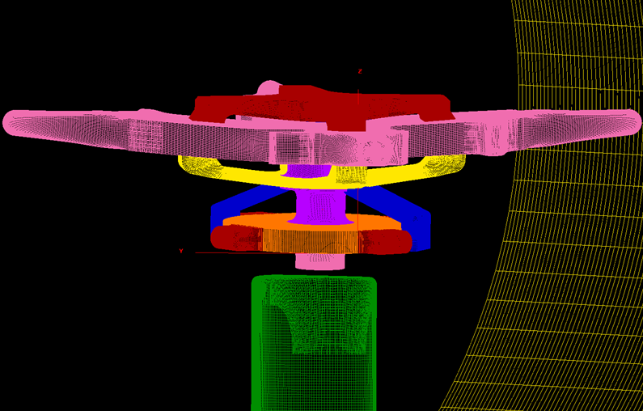
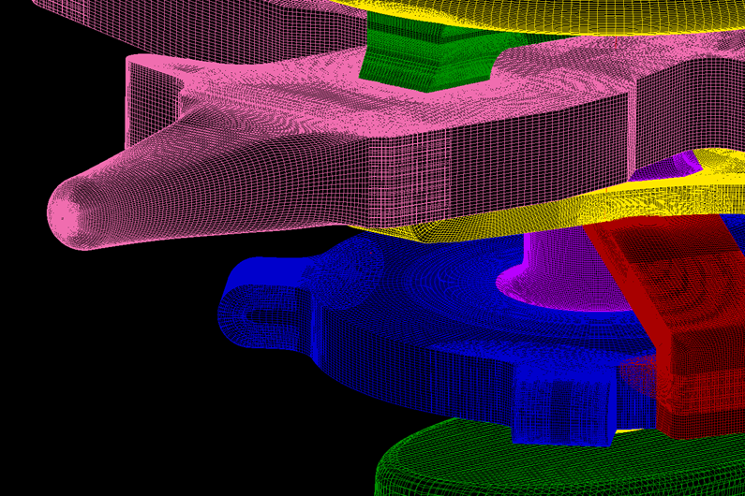
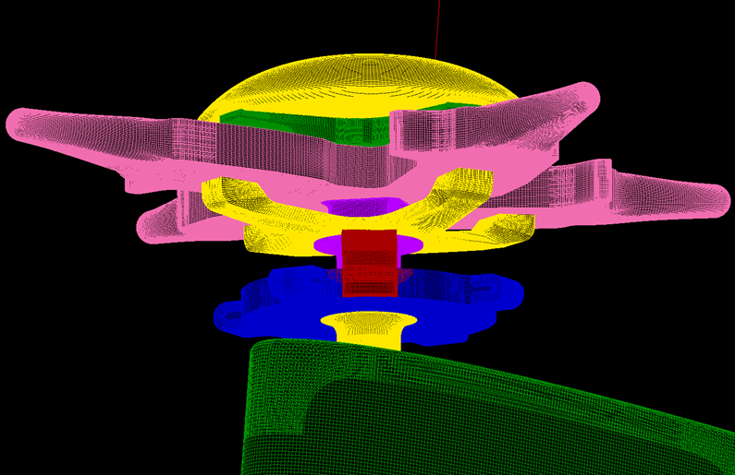
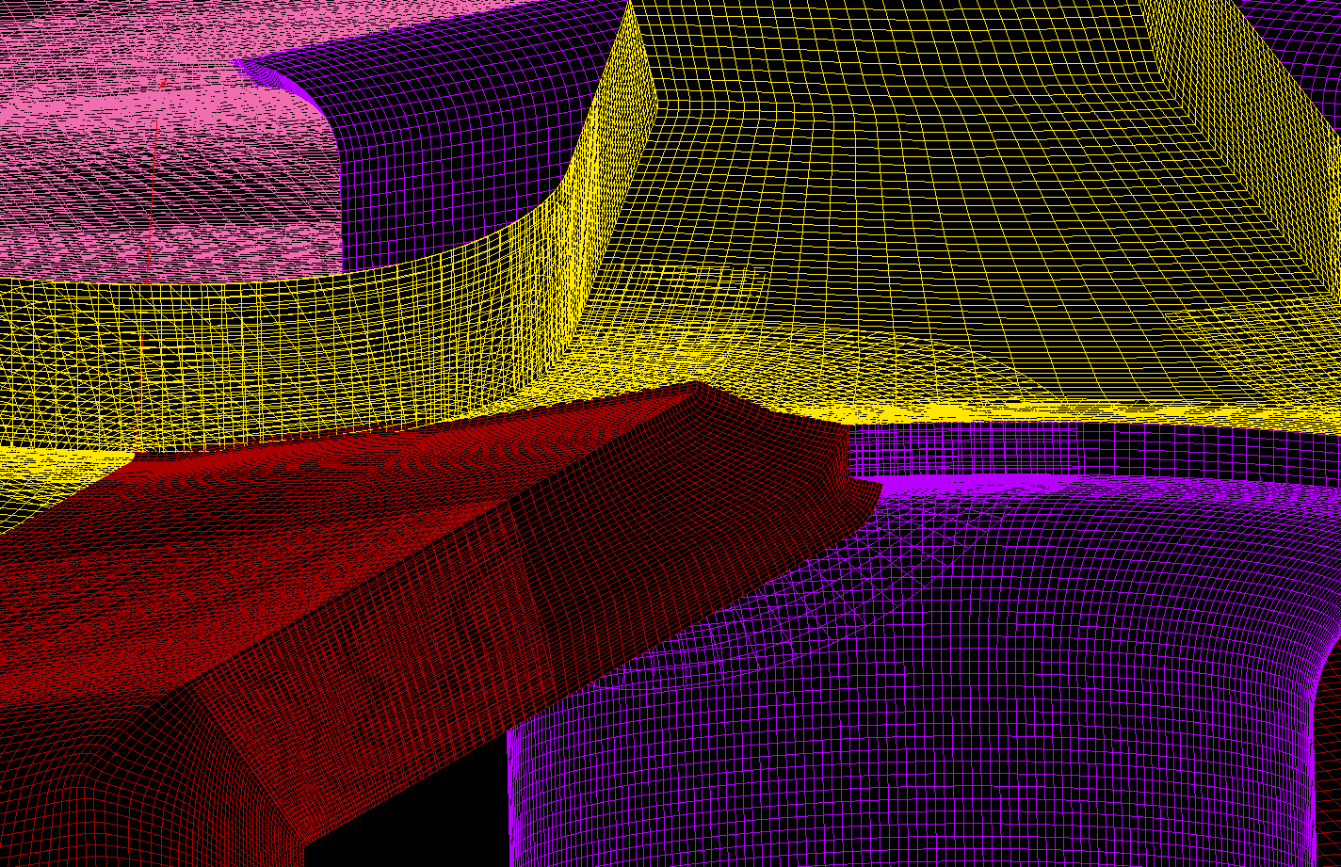
Revised Grid System

Slide 8
Revised Grid System
Structured, overset mesh generated by ARL-PSU
138 total grids
10 stationary
128 rotating
Includes pylon and test-section walls
48.3 million total grid points
Sublayer resolved mesh
Δy ≈ 0.0001”
Except tunnel walls

Slide 9
Turbulence Modeling
Spalart-Allmaras model with DDES
One-equation turbulence model
DDES provides hybrid RANS/LES-like behavior in separated regions and wakes
d is the distance to the nearest solid wall
f_{d} is a blending function to switch between RANS and LES branches
Δ is the local grid spacing
C_{DES} is detached-eddy-simulation calibration coefficient

Slide 10
Numerical Methodology
‘Free-stream’ inlet/outlet conditions
M∞ = 0.1
Re = 191667 in⁻¹ (Re = 4.6 x 10⁶) and 95833 in⁻¹ (Re = 2.3 x 10⁶)
μ_{t}/μ = 0.1
Characteristic BC used for both inlet and outlet
Viscous, no-slip walls used for all solid surfaces
Pressure extrapolation
Hub motion prescribed using Config and Scenario XML files
μ = 0.2 based on full rotor radius (R_{hub} = 0.15R_{rotor})
ω = 0.0625 rad/s*

Slide 11
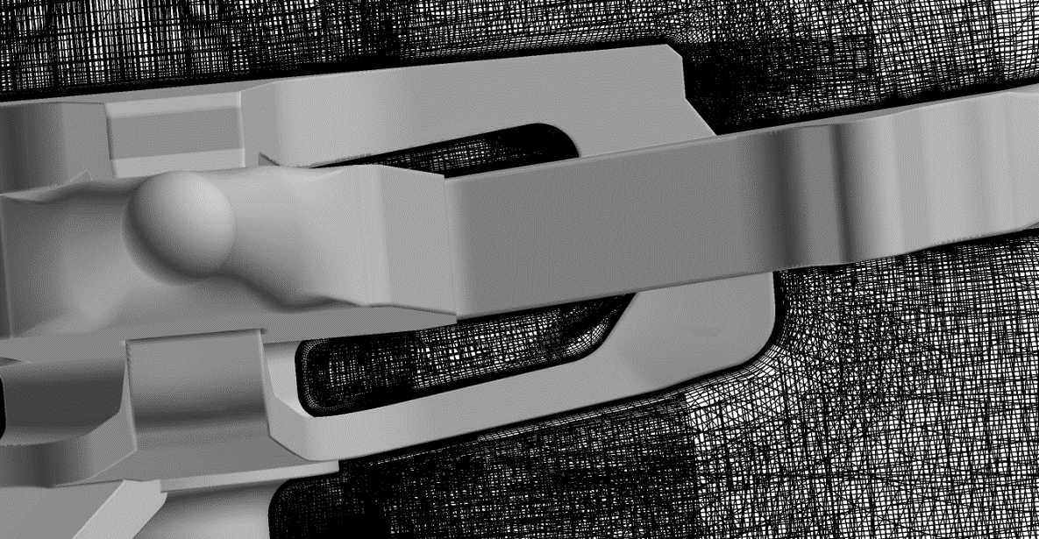
Numerical Methodology
XRAY hole cutting and OVERFLOW internal DCFCRT routines
XRAYs defined using Chimera Grid Tools
Three fringe layers to accommodate 5th-order upwind scheme
Viscous stencil repair used within 18 points of the wall
Result: 30 orphans

Slide 12
Numerical Methodology
Time-accurate solution settings
Implicit BDF2 integration
5th-order-accurate WENO right-hand side
WENO5M limiter
No artificial dissipation
No low-Mach preconditioning
D3ADI left-hand side
SSOR solver too slow, and difficulty stabilizing ARC3D scalar-pentadiagonal scheme for specified RHS
SA-RC-DDES
Δt set to give 0.25° per step
Newton subiteration used to converge unsteady residual 3 orders of magnitude
Maximum of 50 specified, 16-28 generally required

Slide 13
Numerical Methodology
Solutions initialized with 5000 non-time-accurate iterations
Goal is to get bulk, large-scale flow features set up
DDES active to prevent excessive turbulence
3rd-order Roe RHS, ARC3D scalar-pentadiagonal LHS
2nd/4th non-linear artificial dissipation with 10.0 and 0.1, respectively
Low-Mach preconditioning
Switch to time-accurate
Four complete rotations (5760 iterations) without data sampling
Approx. 2.5 test-section lengths simulated
Four more complete rotations with data sampling
Solutions saved every 2° (8 iterations)

Slide 14
HPC Performance
XRAYs and DCF hole cutting debugged on local machine
35 minutes per manual iteration
AFRL HPC Lightning (Cray XC30) used for calculations
8 nodes, 24 cores per node (192 cores total)
42.3 seconds (average) per iteration
Flow solver: 34.00 seconds/iteration (average)
DCF: 1.21 seconds/iteration
File I/O: 12.03 seconds per save
Solver diagnostics estimated a 185.5x speedup (97% efficiency)

Slide 15
Results

Slide 16
Streamwise Velocity Profiles, Re = 4.6 x 10⁶

Slide 17
Streamwise Velocity Profiles, Re = 4.6 x 10⁶

Slide 18
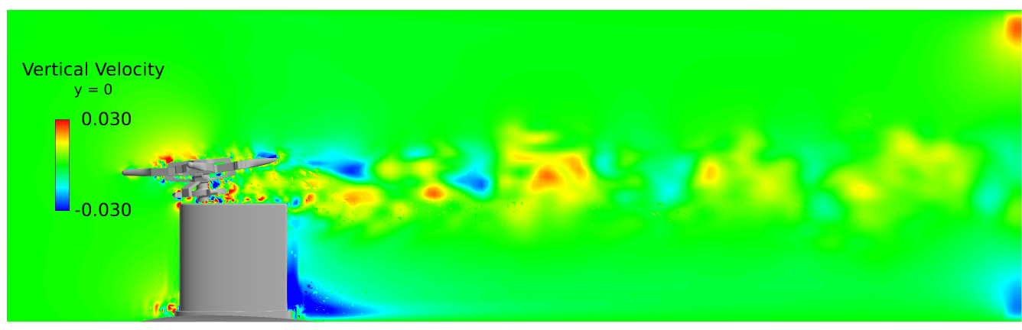
Wake Velocities, Re = 4.6 x 10⁶

Slide 19
Near-Wake, Re = 4.6 x 10⁶

Slide 20
Mid-Wake, Re = 4.6 x 10⁶

Slide 21
Far-Wake, Re = 4.6 x 10⁶

Slide 22
Wake Behavior, Re = 4.6 x 10⁶

Slide 23
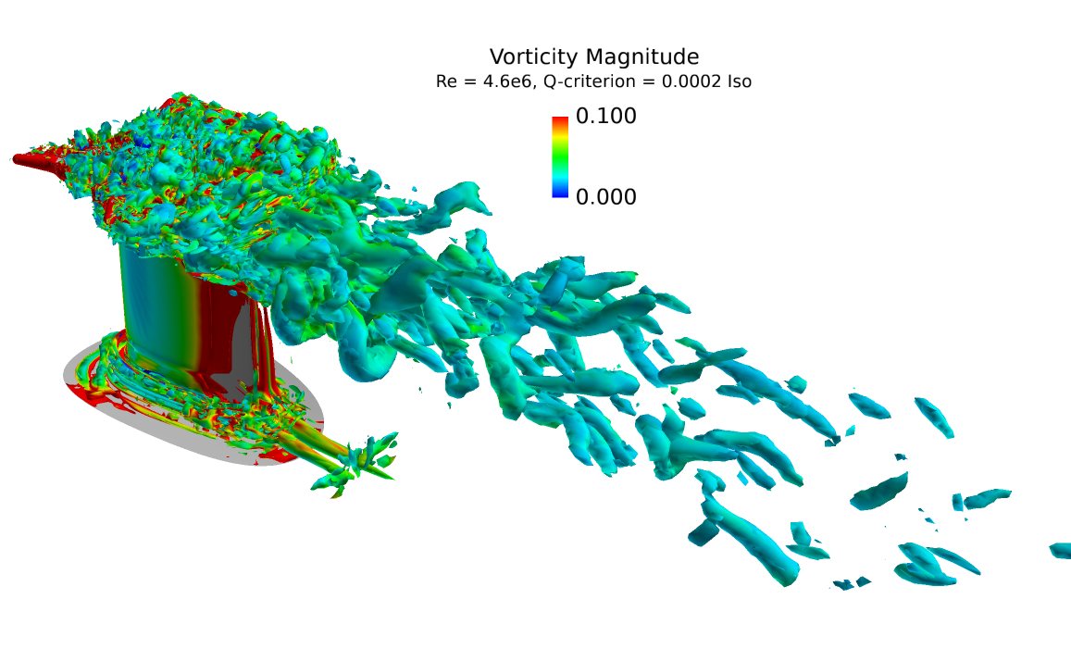
Wake Behavior, Re = 4.6 x 10⁶

Slide 24
Outlet-Induced Pressure Behaviors
2R
4R
7R
Undesirable behavior of outlet boundary condition
Expected cleaner outflow behavior
Wave accumulation affecting upstream behavior

Slide 25
Intermediate Observations
Wake refinement region too coarse
Large jump in cell size from body-fitted grids
Unintended cell anisotropy – 0.5” x 0.5” x 1”
Blockage effects not well modeled
Density-based solver requires total conditions on inlet boundary
More appropriate to specify a mass-flow rate, but unsteady effects make this difficult
Outlet boundary exhibiting unexpected pressure behavior
Likely due to characteristic boundary condition and/or higher-order differencing in convective fluxes
May be contaminating upstream wake development
Sponge layer may improve solution quality

Slide 26
Improved Simulations (Ongoing)

Slide 27
New Off-Body Grid System
Grid Enhancements
Enlarged wake-refinement region
Isotropic, 0.25-inch cells in wake-refinement region
Slight refinement of tunnel background mesh
Reduced y⁺ value, still not sublayer resolved
Addition of upstream and downstream coarse “sponge” layers
New size: 57.5M nodes
Modified BCs
Characteristics-based nozzle inflow
Constant pressure outflow, P/P∞ = 1
Inviscid walls upstream of test section
Viscous walls downstream of test section

Slide 28
New Off-Body Grid System

Slide 29
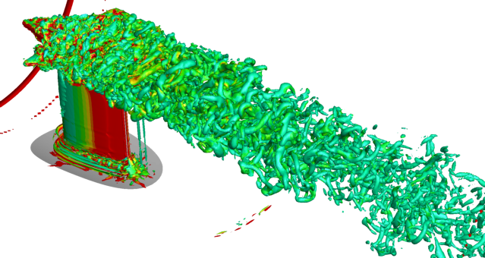
Sample Wake Behavior
Identical numerical method as previous simulation
Implicit BDF2, 0.25° timestep, 5th-order WENO RHS, D3ADI LHS, SA-RC-DDES, Newton subiterations with 3-order convergence

Slide 30
Conclusions and Future Work

Slide 31
Conclusions
Enhanced grid system greatly improved solution quality
Better matching of body-fitted and background grids
Turbulent wake content better resolved and preserved downstream
Changing the inlet/outlet boundary conditions helped
Still not perfect, approx. 5% error in effective Reynolds number
Specified mass-flow condition preferred, but difficult to enforce in unsteady flow
Mid- and long-age wake characteristics appear to show sensitivity to axial pressure gradient
Under continuing investigation

Slide 32
Future Work
Explore the impact of physical modeling
Laminar-turbulent transition
QCR
Scale-adaptive simulation
Assess the influence of the tunnel wall boundary layer on the wake behavior
Water tunnel has constant-diameter test section with non-negligible buoyancy correction
Could be the difference between a favorable and an adverse axial pressure gradient

Slide 33
Acknowledgments
The authors are grateful to the US Army’s National Rotorcraft Technology Center program and Dr. Louis Centolanza for funding this research. Effort This effort was sponsored by the US Government under Other Transaction number W15QKN-10-9-0003 between Vertical Lift Consortium, Inc. and the Government, project NRTC-FY15-R-01. The US Government is authorized to reproduce and distribute reprints for Governmental purposes notwithstanding any copyright notation thereon. The views and conclusions contained herein are those of the authors and should not be interpreted as necessarily representing the official policies or endorsements, either expressed or implied, of the US Government.

Slide 34
Questions?

