Slide 1

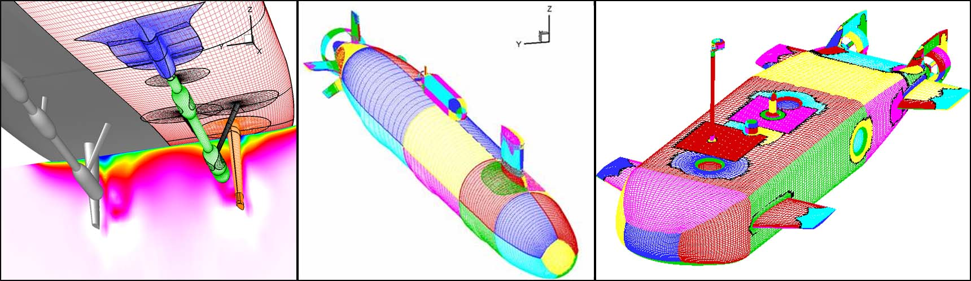

A coupled overset mesh and hybridizable discontinuous galerkin algorithm
2016 Overset Grid Symposium
Justin Kauffman
Engineering Science and Mechanics Department
Advised by Dr. Jonathan Pitt
Funded by ARL Walker Fellowship
October 18, 2016
INFANTE autonomous underwater vehicle, courtesy of Penn State ARL website; Boger and Dreyer, 2006

Slide 2
Outline
Motivation/Problem Statement
Overset focus
Hybridizable discontinuous Galerkin (HDG) discretization
Overset HDG
  Method of Manufactured Solutions (MMS)
  Convection-diffusion verification
  Elastostatics verification
  Navier-Stokes verification
Future Work
  Arbitrary – Lagrangian Eulerian (ALE) formulation
  Fluid – Structure Interaction
2

Slide 3
Motivation
Motivating Factor
Reduce the global degrees of freedom (DoFs) while maintaining the benefits from discontinuous Galerkin Chimera¹ schemes, i.e. optimal order of accuracy with respect to the basis functions and arbitrary overlap.
Scope
Derive and implement the essential communication infrastructure between meshes for an overset HDG formulation. Integrate existing methods for hole cutting and dynamic meshing at a later time, when necessary for more complex problems.
M. C. Galbraith, P. D. Orkwis, Discontinuous Galerkin Scheme Applied to Chimera Overset Viscous Meshes on Curved Geometries, in: 42nd AIAA Fluid Dynamics Conference and Exhibit, June 2012
3
Image courtesy of Penn State ARL website

Slide 4
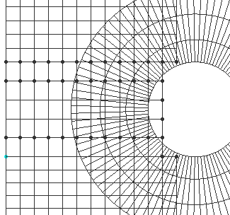
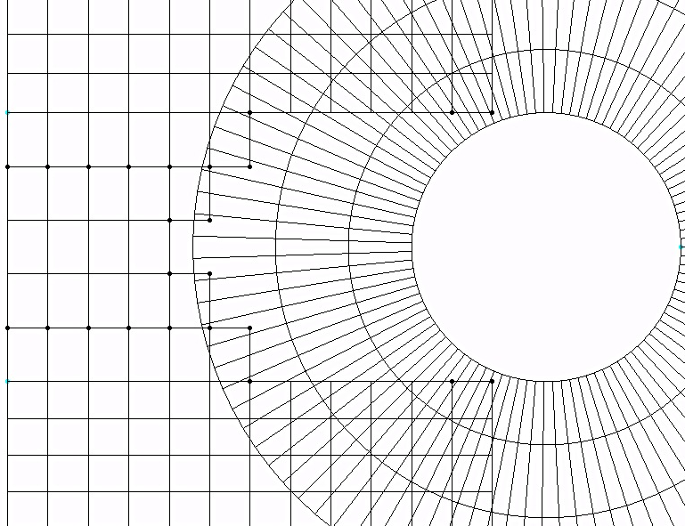
Overset Meshing
Communication between meshes
Orphan points
Blue cell donates information to Red node – How?
Holes
This is the focus of the coupled overset HDG algorithm!
4

Slide 5
Why HDG?
Continuous Galerkin (CG):
Hybridizable Discontinuous Galerkin (HDG):
Discontinuous Galerkin (DG):
Advantages:
Traditional Finite elements
Commercial software
Advantages:
Locally conservative between elements
Handles irregular meshes and hanging nodes
Arbitrarily high order accurate
Advantages:
Naturally handles Elliptic operators
Highly parallelizable
Reduces global DoFs
Arbitrarily high order accurate
Disadvantages:
Not locally conservative
Not robust for high order elements
Disadvantages:
Difficulty with Elliptic operators
Large number of global DoFs
Disadvantages:
Software/
Implementation
5

Slide 6
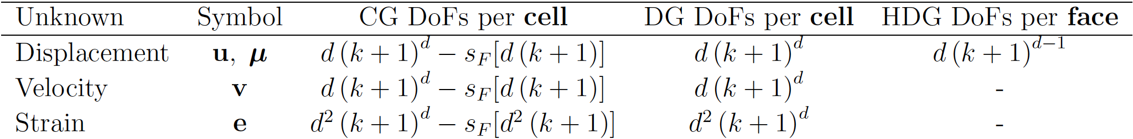
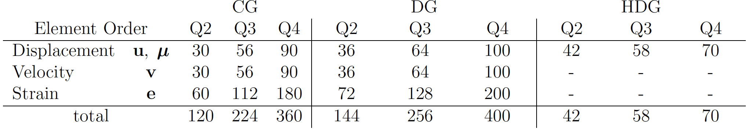
Global DoF Comparison
CG
DG
HDG
Variables: u, v, e - 8 local comps per ( , )
μ - 2 global comps per ( )
- Global DOFs
- Local DOFs
6

Slide 7
HDG Discretization
CG
DG
HDG
Local solution
Global solution trace
Global boundary
Global DOFs
Local DOFs
Example: 2D 1x2 quadratic elements
Variables: u, v, e - 8 global comps per ( )
CG: 120 global DOFs
DG: 144 global DOFs
Variables: u, v, e - 8 local comps per ( , )
μ - 2 global comps per ( )
HDG: 42 global DOFs + 144 local DOFs
7

Slide 8
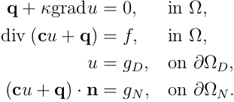
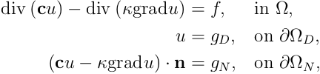
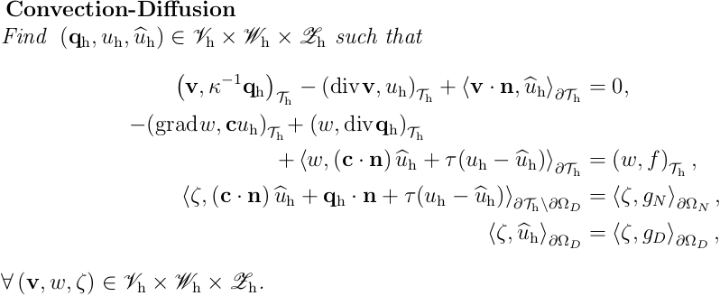
HDG Derivation
Strong Form of Convection-Diffusion:
First order system
Multiply by test functions
and integrate by parts
Weak Form of Convection-Diffusion:
Continuity of numerical trace
7

Slide 9

Overset HDG
= global DoFs
Communication occurs
between the global DoF from the red cell
at this location and a new corresponding local DoF from the blue cell at this location.
If this location was not an overset boundary the resulting term would be included in
since there would be a neighboring cell to communicate with.
Instead
8

Slide 10
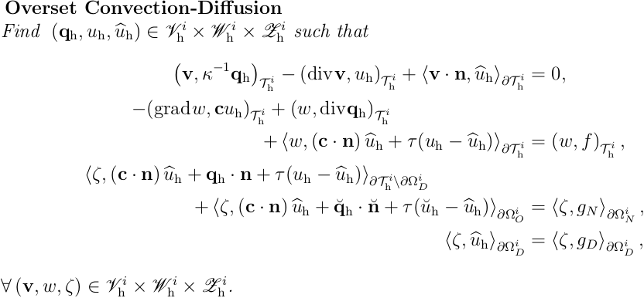
Convection-Diffusion
9

Slide 11
Outline
Motivation/Problem Statement
Overset focus
Hybridizable discontinuous Galerkin (HDG) discretization
Overset HDG
  Method of Manufactured Solutions (MMS)
  Convection-diffusion verification
  Elastostatics verification & validation
  Navier-Stokes verification
Future Work
  Arbitrary – Lagrangian Eulerian (ALE) formulation
  Fluid – Structure Interaction
10

Slide 12
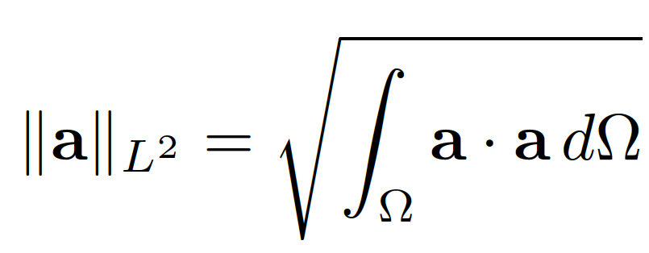
MMS
The method of manufactured solutions provides code verification for each problem being solved.
Produce source terms and boundary conditions
Calculate errors and obtain convergence rates through grid refinement study
Choose solution
Error Metrics
Optimal order convergence achieved?
Fix bugs
Yes
No
11

Slide 13

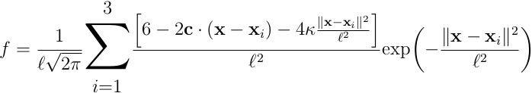
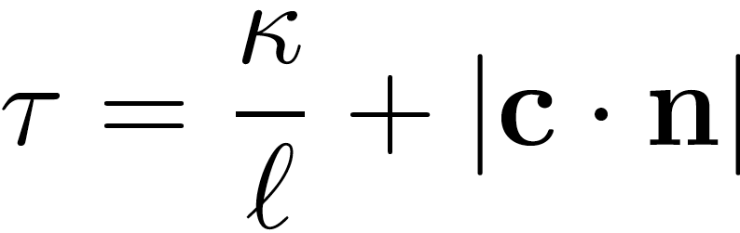
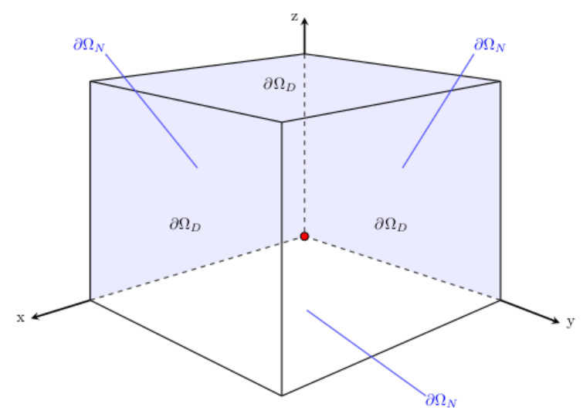
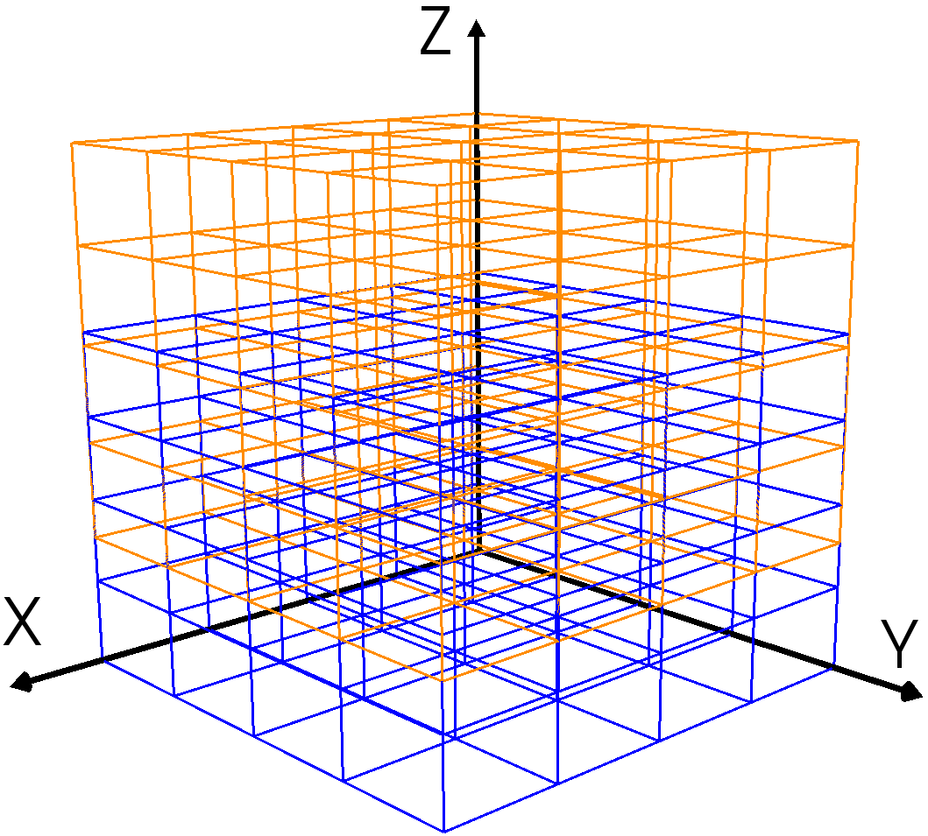
Verification
12

Slide 14
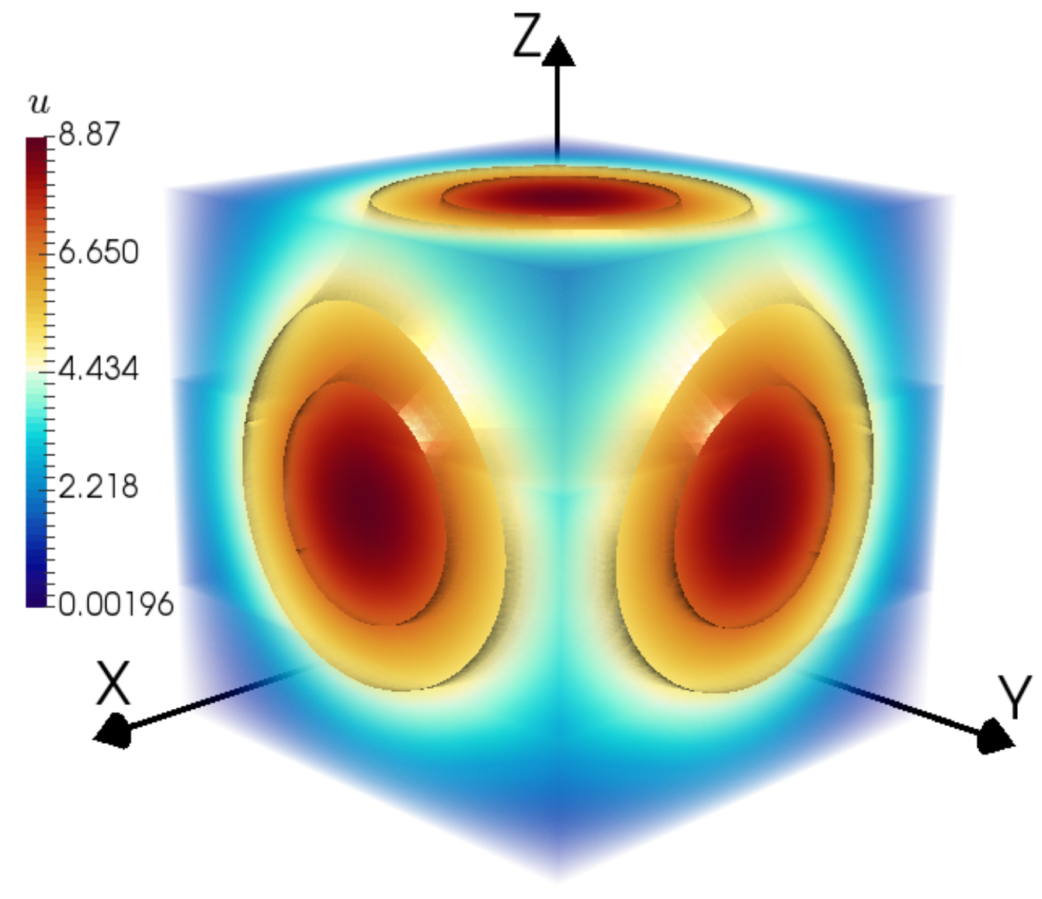
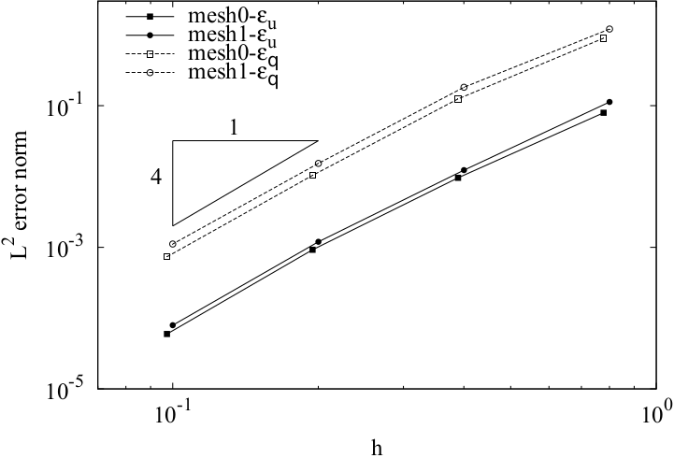
Solution and Convergence
Convergence data for Q3 elements
Overset Solution
13

Slide 15
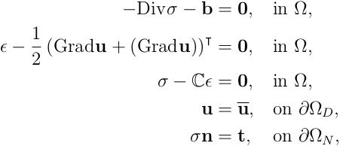
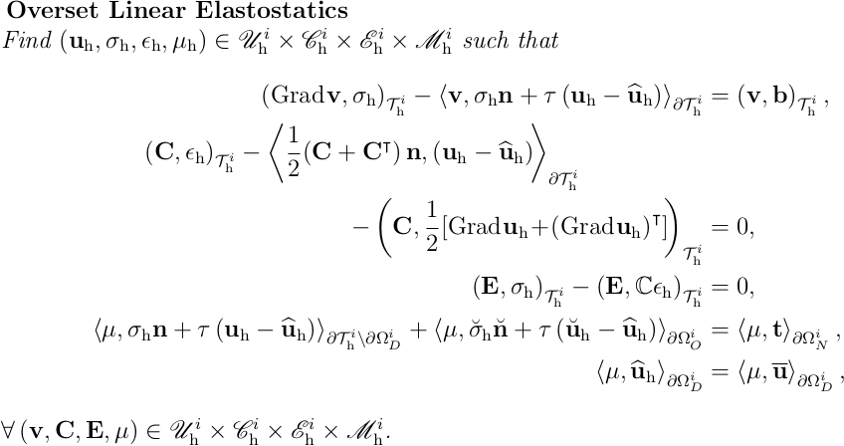
Elastostatics
Strong Form of Elastostatics:
Weak Form of Elastostatics:
14

Slide 16
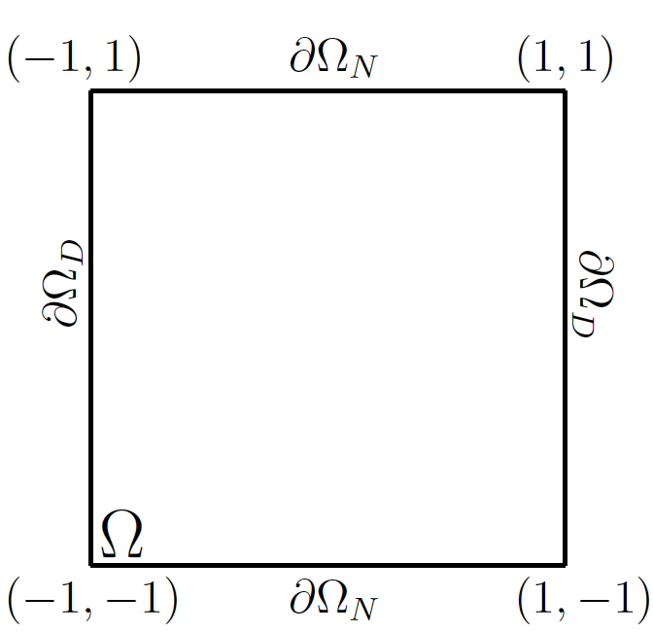
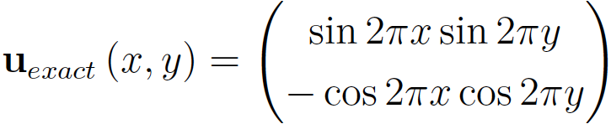
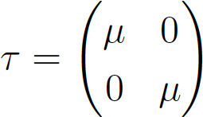
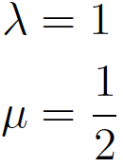
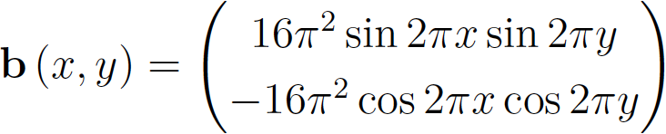
Verification
Strong Form of Elastostatics:
15

Slide 17
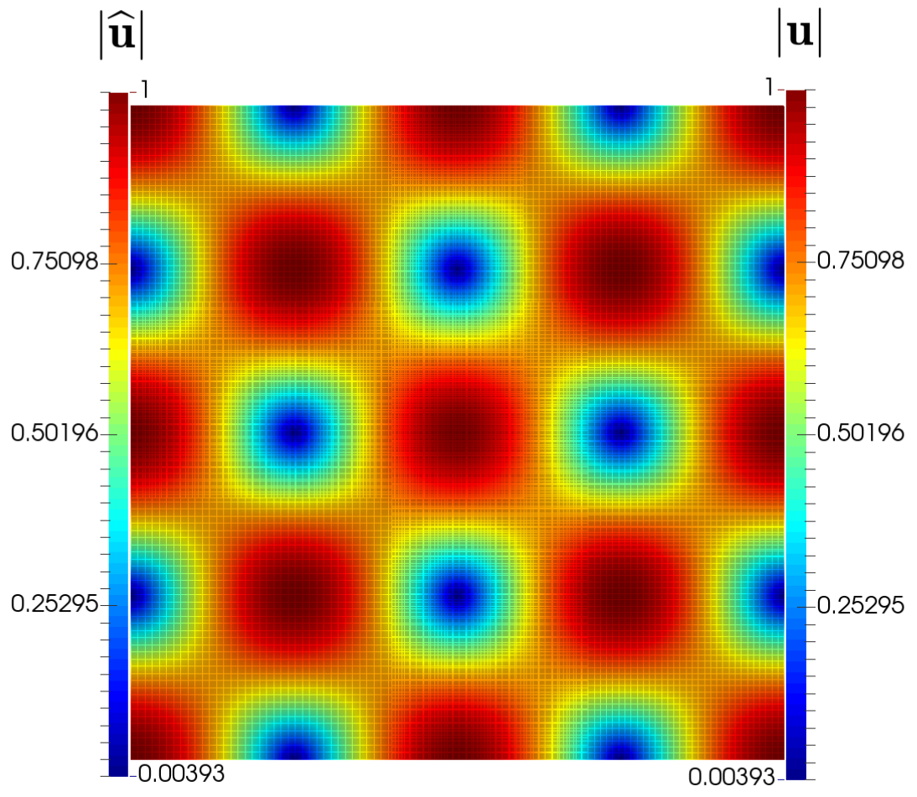
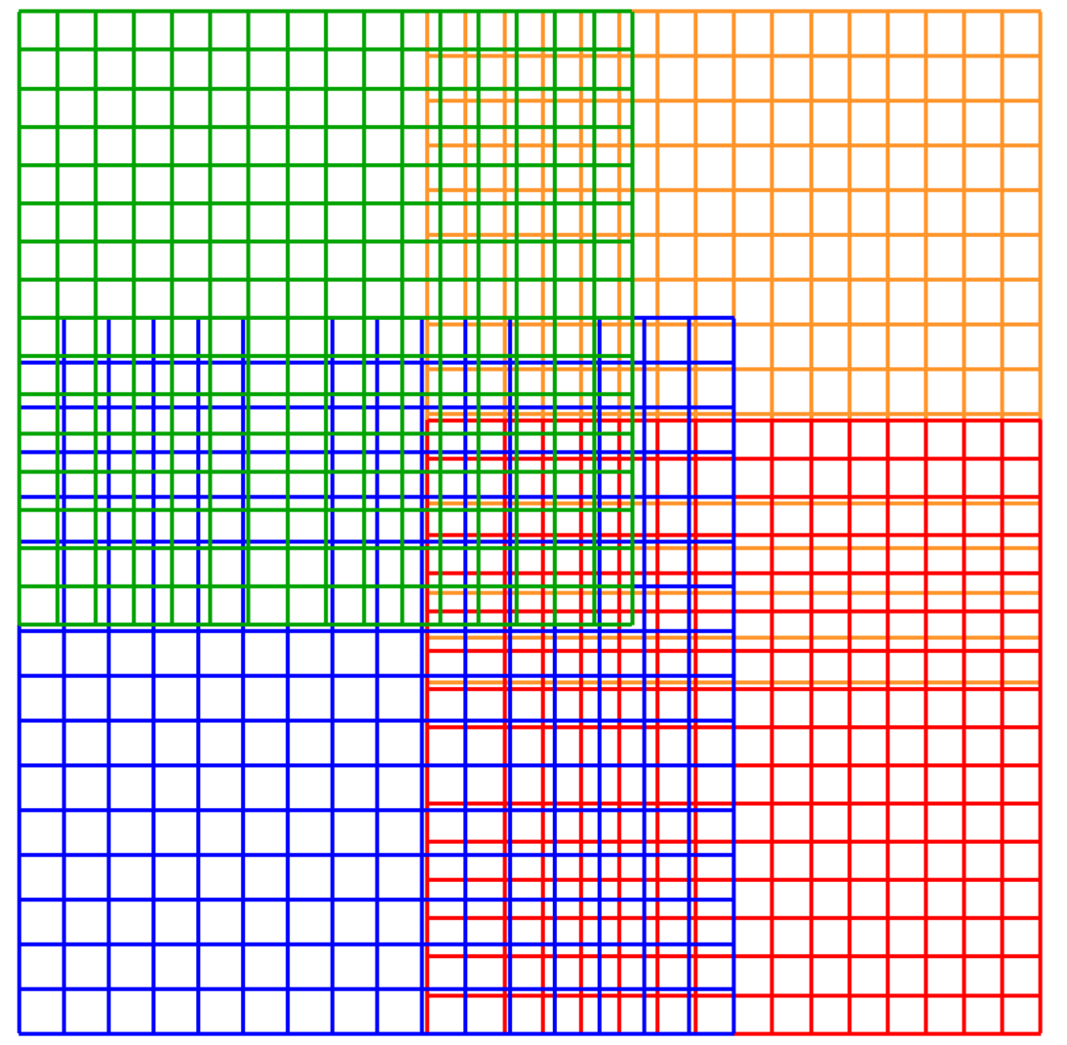
Solution
Q4 elements on a four overset mesh configuration
16

Slide 18
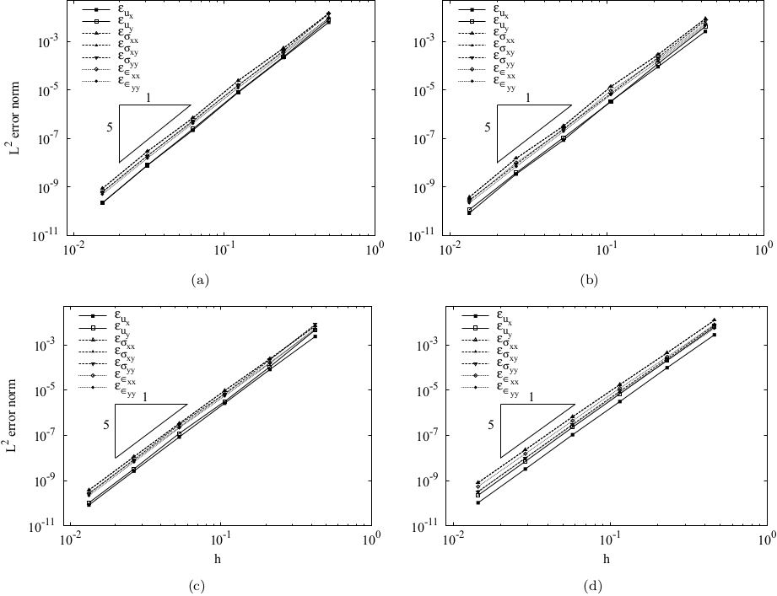
Convergence Plots
17

Slide 19
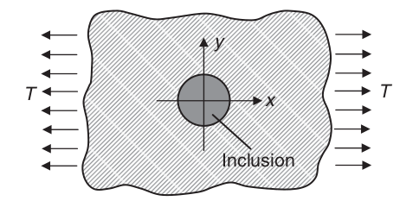

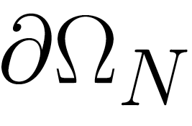





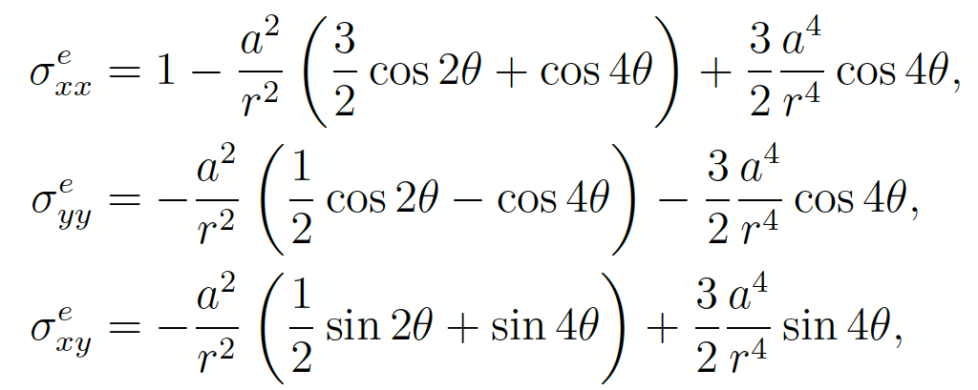



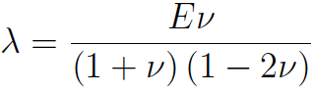

Validation
Compared to an analytical solution
Hole
18

Slide 20
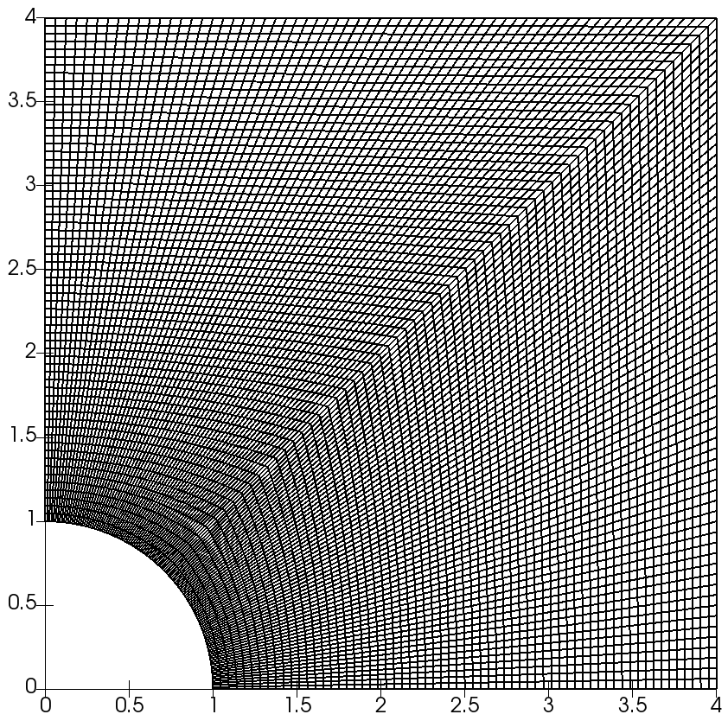
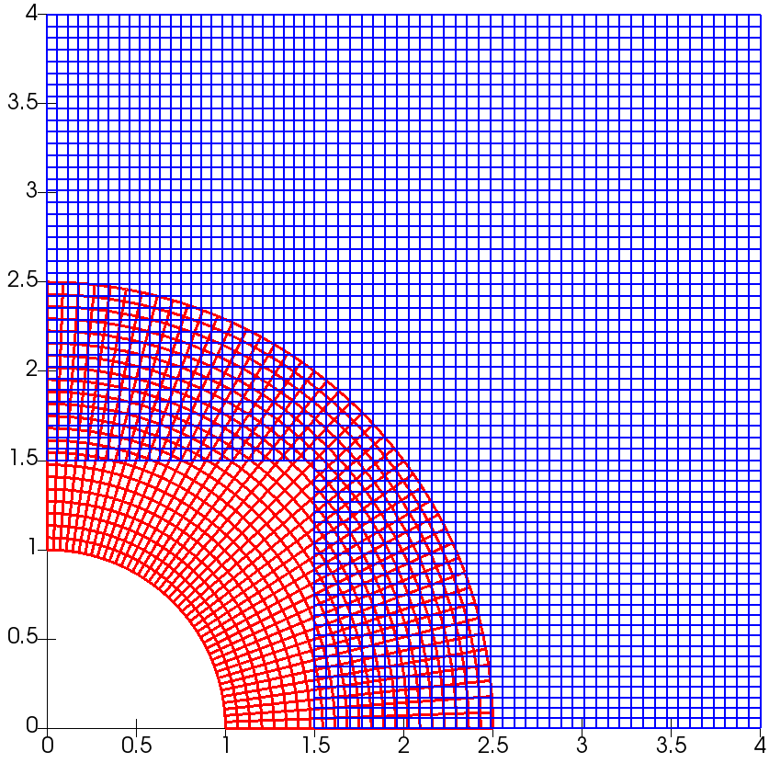
Meshes
Single Mesh
Overset Mesh
10,752 Cells
198,912 global DoFs
5,485 total Cells
107,640 total global DoFs
48.99% Cell reduction
45.89% global DoFs reduction
Q5 elements
19

Slide 21
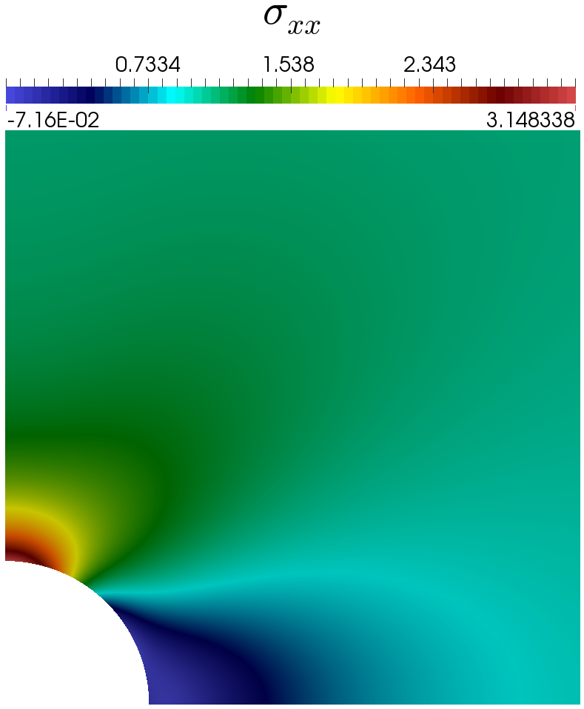
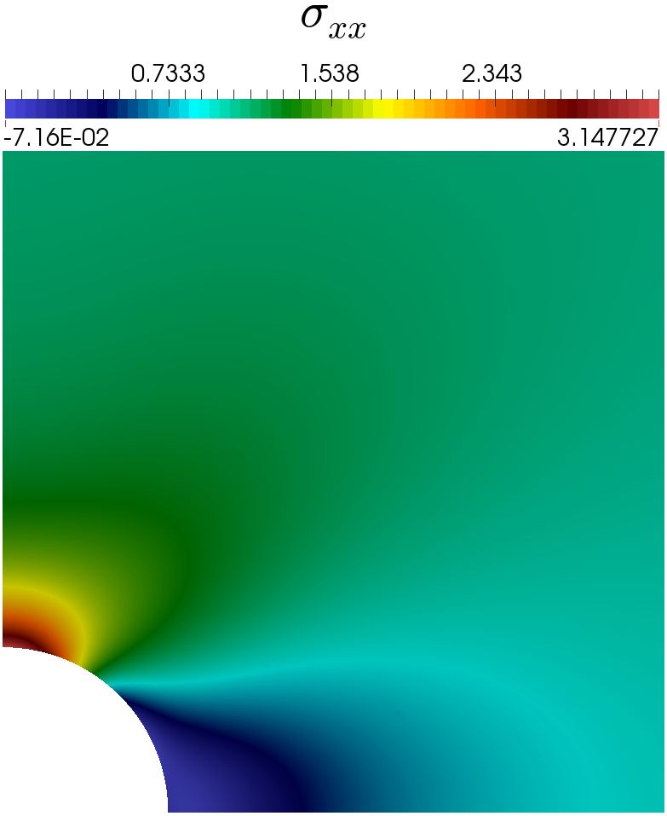
Solution
Single Mesh
Overset Mesh
20

Slide 22
Comparison Plots
21

Slide 23
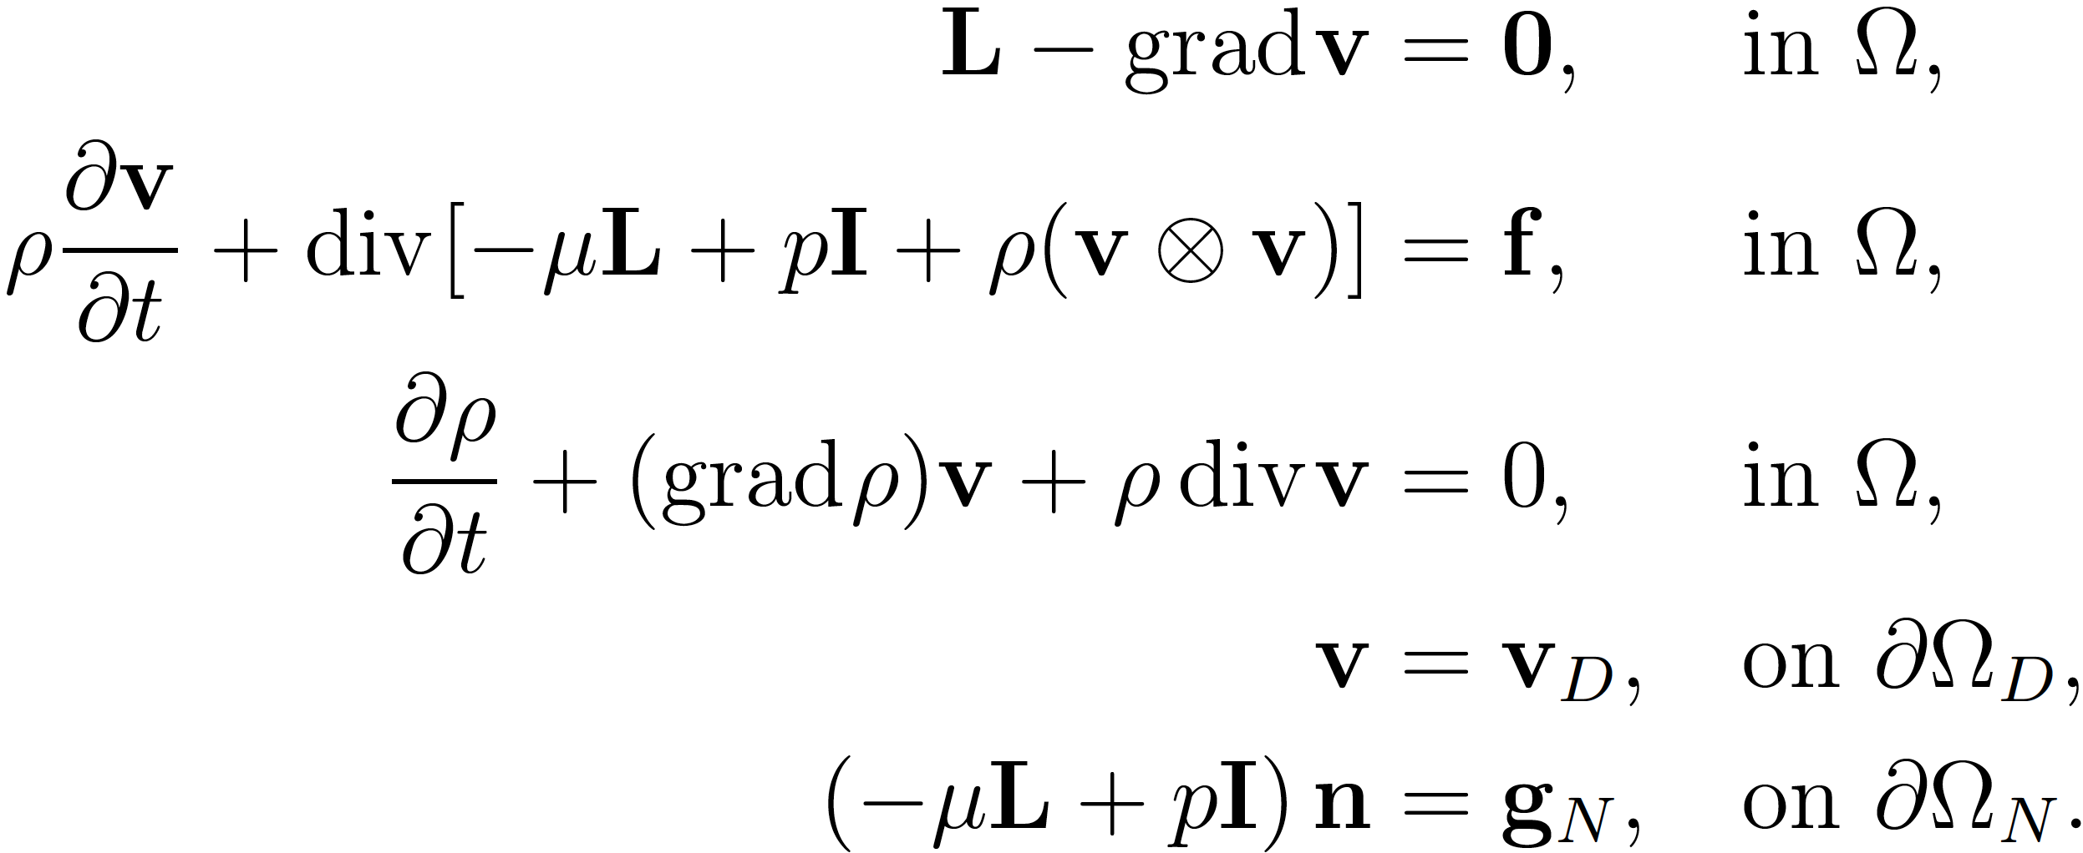
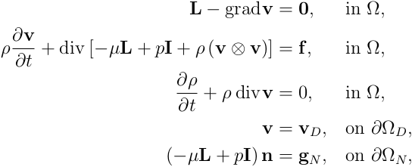

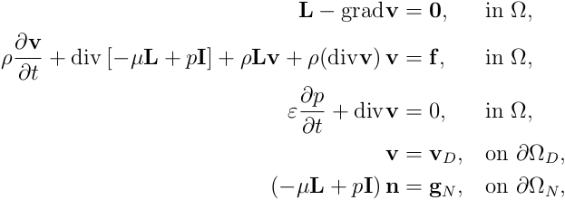
Navier-Stokes
Strong Form of Navier-Stokes:
Assume density is constant spatially
Assume entropy is constant²
Strong Form of Pseudo-Compressible Navier-Stokes:
Changes from an incompressible formulation
M. Inagaki, O. Murata, T. Kondoh, Numerical prediction of fluid-resonant oscillation at low Mach number, 2002
22

Slide 24
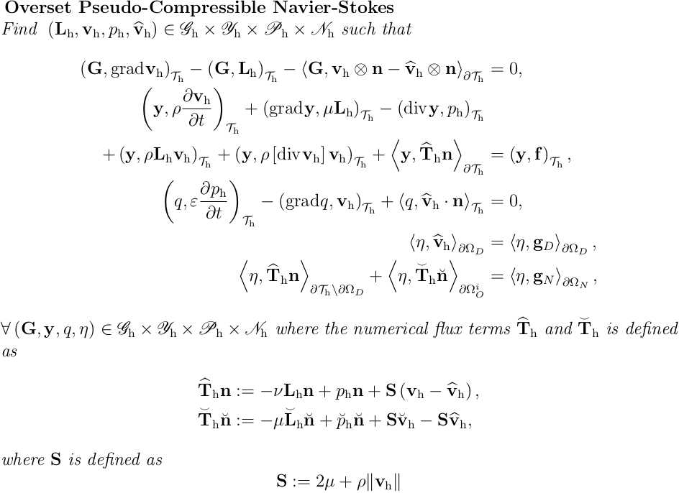
Navier-Stokes
Weak Form of Pseudo-Compressible Navier-Stokes:
23

Slide 25
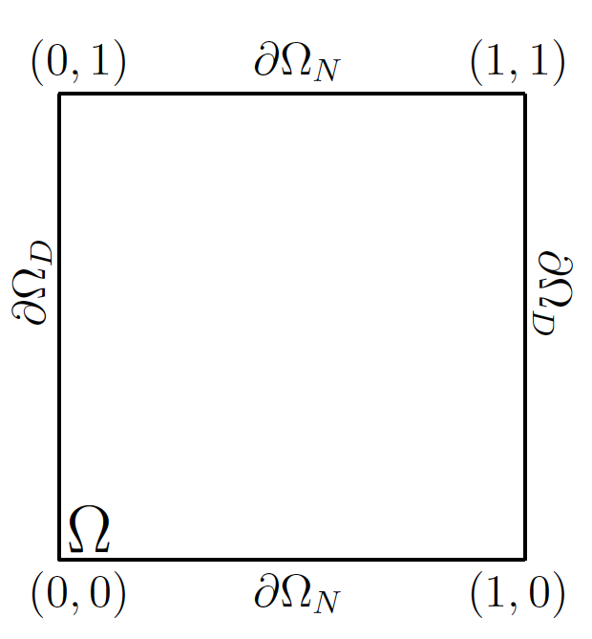
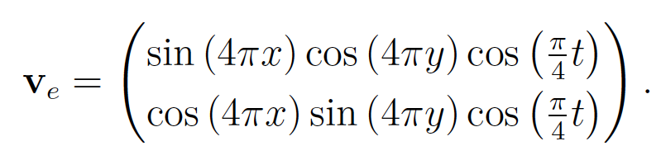



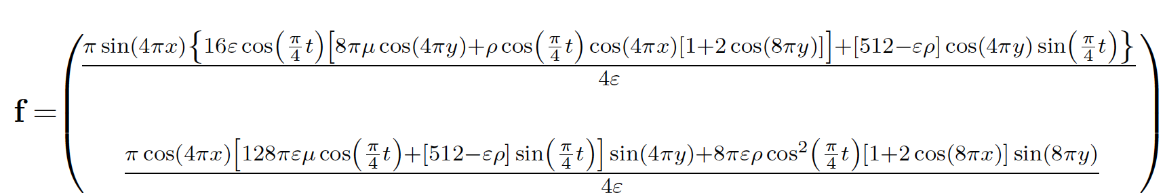
Verification
Strong Form of Pseudo-Compressible Navier-Stokes:
24

Slide 26
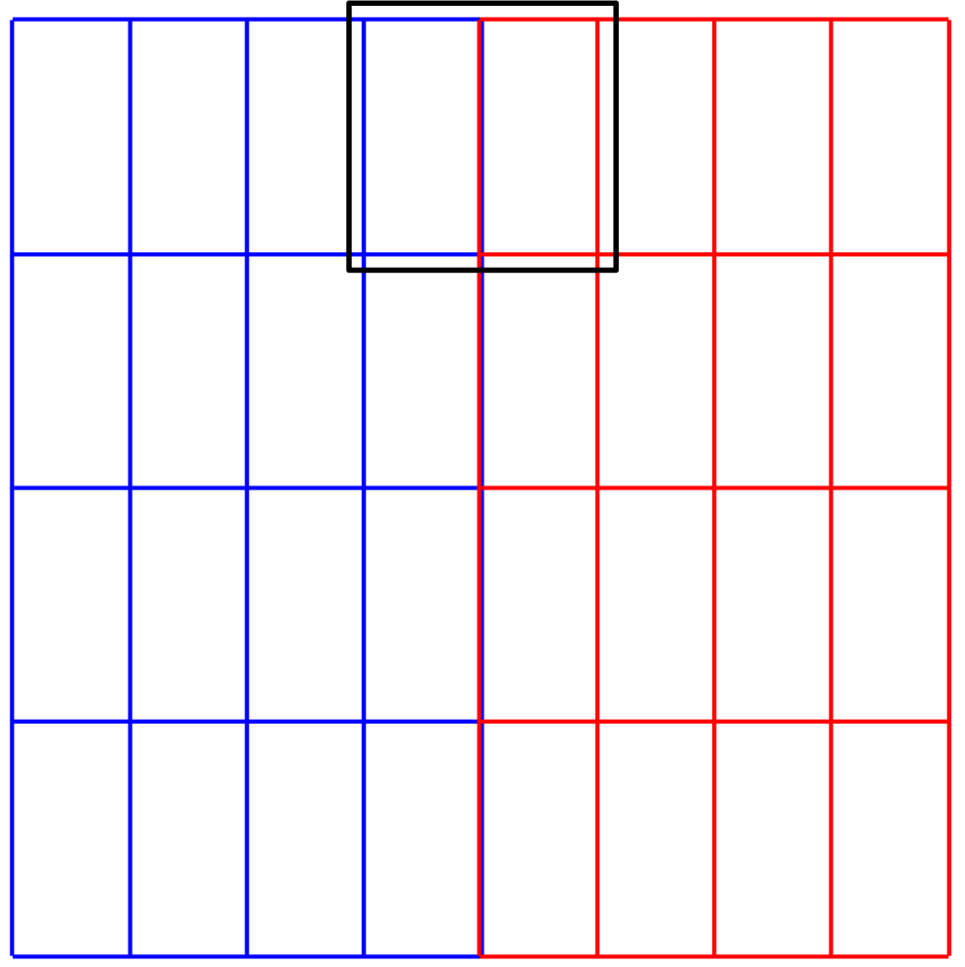

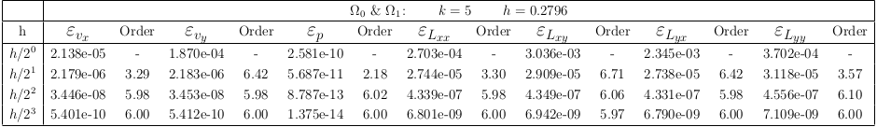
Convergence Data
Q5 elements
25

Slide 27
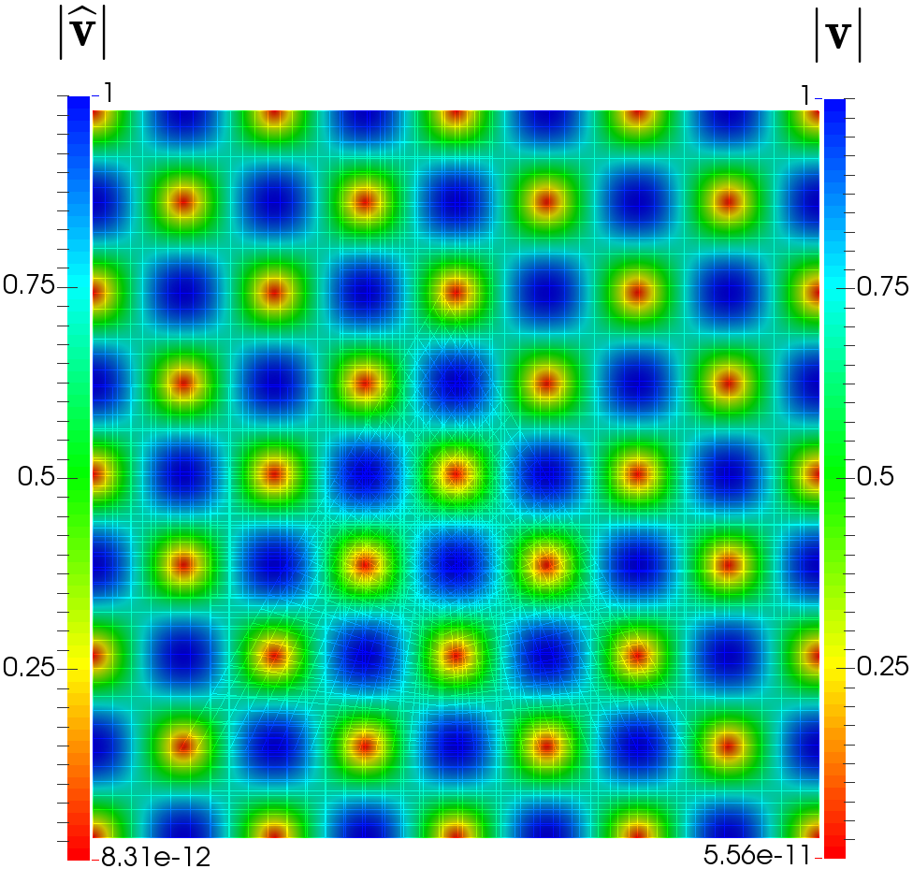
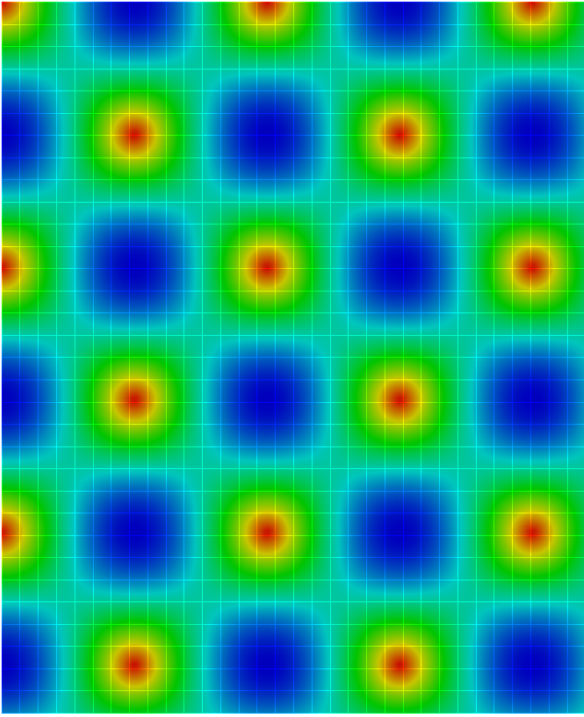
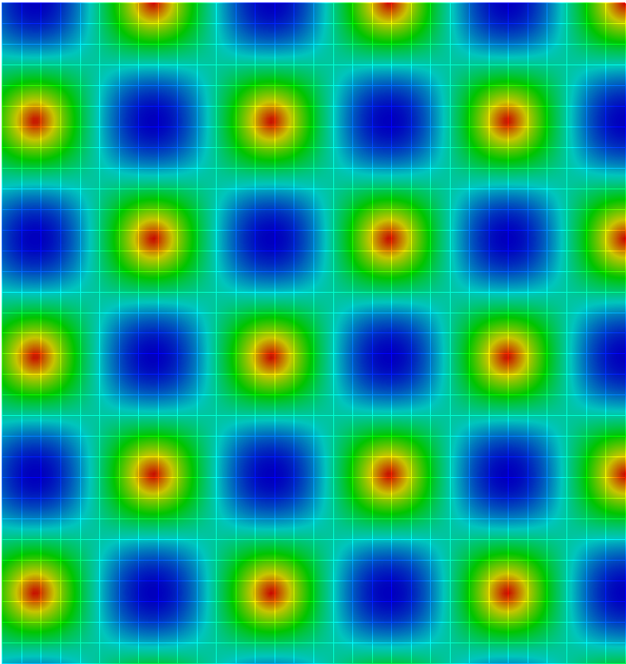
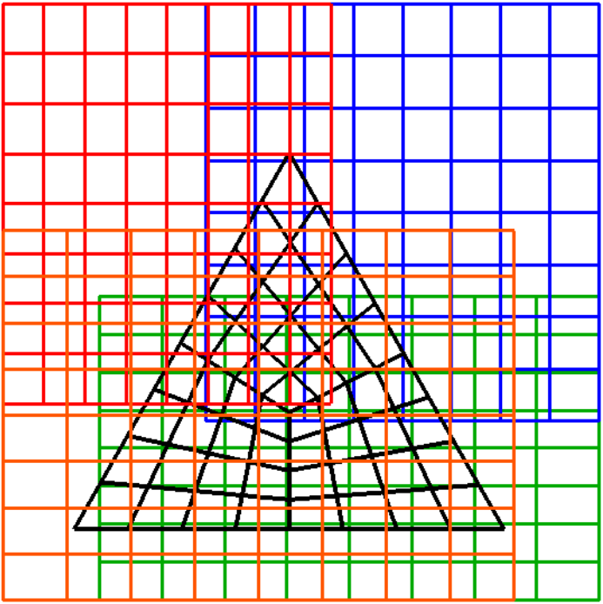
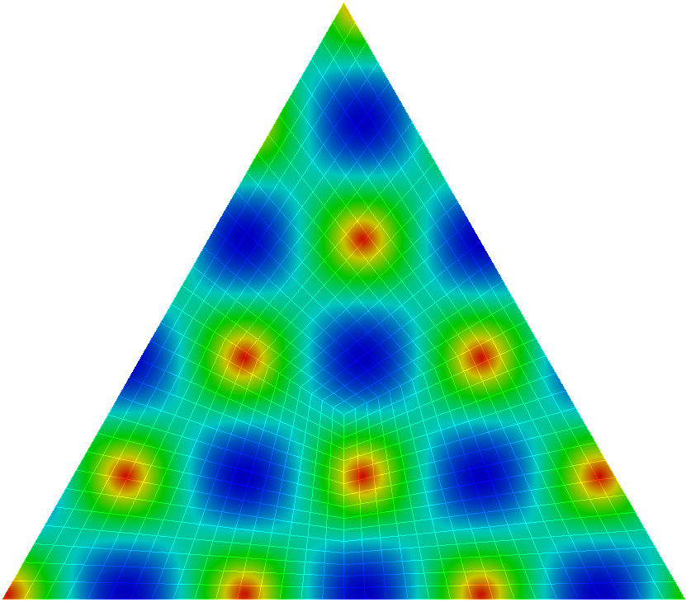
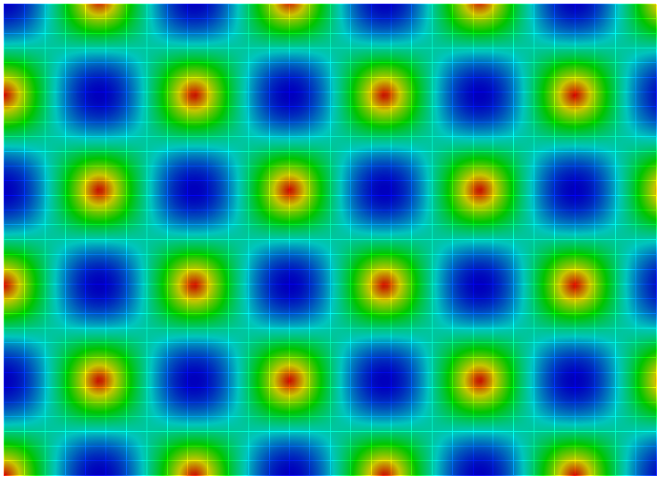
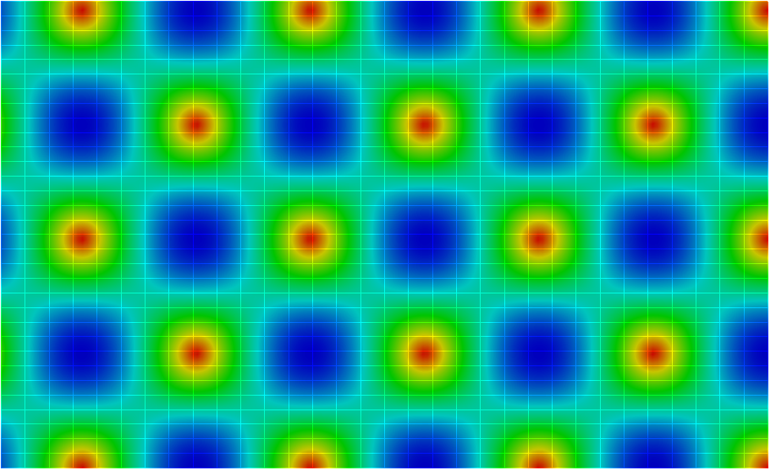
Solution
Q5 elements on a five overset mesh configuration
26

Slide 28







Convergence Plots
27

Slide 29





Preliminary Results
Flow around a cylinder using Q2 elements with Implicit Backward Euler
2.2
0.21
U_{max}=1.5
No-Slip
p=0
0.41
0.2
0.2
S. Turek, Efficient Solvers for Incompressible Flow Problems: An Algorithmic and Computational Approach, vol. 6. Springer Science & Business Media, 1999.
28

Slide 30



Preliminary Results
29

Slide 31
Outline
Motivation/Problem Statement
Overset focus
Hybridizable discontinuous Galerkin (HDG) discretization
Overset HDG
  Method of Manufactured Solutions (MMS)
  Convection-diffusion verification
  Elastostatics verification & validation
  Navier-Stokes verification
Future Work
  Arbitrary – Lagrangian Eulerian (ALE) formulation
  Fluid – Structure Interaction
30

Slide 32






ALE Formulation
Necessary transformations and definitions
Spatial
Configuration
Material
Configuration
Reference
Configuration
31

Slide 33


ALE Formulation
Preliminary
32

Slide 34
ALE Results
33

Slide 35




Potential Validation
⁴
Flow around a self-oscillating cylinder
⁴
Abe Lee, Fluid-Structure Interaction of Large Amplitude Structure Vibrations and Moderately High Reynolds Number Turbulent Flows, Ph.D. Dissertation, The Pennsylvania State University, 2014
Dynamic airfoil pitching
⁵
⁵
S. Wang, D. Ingham, L. Ma, M. Pourkashanian, Z. Tao, Numerical investigations on dynamic stall of low Reynolds number flow around oscillating airfoils, 2010
33

Slide 36
HDG FSI Formulation
Monolithic Coupling
Jason P. Sheldon, Scott T. Miller, Jonathan S. Pitt, A hybridizable discontinuous Galerkin method for modeling fluid–structure interaction, Journal of Computational Physics, Volume 326, 1 December 2016, Pages 91-114, http://dx.doi.org/10.1016/j.jcp.2016.08.037
34

Slide 37

HDG FSI Formulation
35

Slide 38



Turek-Hron FSI Benchmark
S. Turek and J. Hron. Fluid-Structure Interaction, volume 53 of Lecture Notes in Computational Science and Engineering. 2006.
Jason P. Sheldon, Scott T. Miller, Jonathan S. Pitt, A hybridizable discontinuous Galerkin method for modeling fluid–structure interaction, Journal of Computational Physics, Volume 326, 1 December 2016, Pages 91-114, http://dx.doi.org/10.1016/j.jcp.2016.08.037
37

Slide 39
Summary
Essential building-blocks for FSI problems have been verified, and optimal order convergence is maintained for an arbitrary amount of overlap.
An abutting HDG-FSI framework has already been developed!
Future Research
V&V of overset-HDG ALE
Formulation of fully coupled oveset-HDG FSI
Implementation will require
  Dynamic meshes and Hole cutting
Efficiency Improvements
38

Slide 40
Acknowledgements
Applied Research Laboratory at The Pennsylvania State University for funding through the Graduate Walker Assistantship
Dr. Scott Miller and Dr. Jason Sheldon for their advice and contributions.
Thank you
Questions?
39

