Slide 1
A General Purpose, Open-Source Overset Library for Caelus based on Suggar++
Dr. Chris Sideroff
Dr. Darrin Stephens

Slide 2
Overset with OpenFOAM
Previous library/solver efforts:
foamedOver (Boger et al, PSU-ARL)
naoeFOAM-os-SJTU (Shen at al, Shanghai Jiao Tong University)
Others?
Previous OGA efforts:
OperaFOAM (Chandar et al IHPC Singapore)
Bellerophon (Groß, Univ. of Rostock)
Others?
None have been publicly released or available for purchase (to our knowledge)

Slide 3
Library
Caelus (OpenFOAM derivative) is collection of libraries
Goals:
Hide overset-specific details
Minimal changes to existing library and top-level applications
Use existing linear solvers
Minimal changes to existing workflow
Use Suggar++ for OGA
Features
Static, prescribed and dynamic motions
6-DoF ODE solver w/ constraints, restraints and loads
No restriction on parallel decomposition
static/dynamic, single-phase/VOF solvers

Slide 4
Implementation
oversetFvMesh: derived from fvMesh class
Important because (almost) all existing top-level functionality uses fvMesh
Inherits all non-overset functionality
Handle overset specific duties with virtual and overloaded functions
class oversetFvMesh : public fvMesh
{
…
}

Slide 5
Low Level Changes
Few changes required to main Caelus library to support oversetFvMesh library. E.g.
Dummy equation and matrix manipulation functions for non-overset
Small matrix support for 6 DoF ODE functionality
Find functions for mesh primitives required virtualization
primitiveMesh
polyMesh
fvMesh
oversetFvMesh

Slide 6
Implementation
Manipulate matrix and field values of fringe cells
Templated matrix (momentum, pressure) and field (volume fraction) update functions
Calls DiRTlib and libSuggar++ to update fringe
fvVectorMatrix Ueqn
(
fvm::ddt(U) +
fvm::div(phi, U) –
fvm::laplacian(nu, U)
==
- fvc::grad(p)
);

Slide 7
Implementation
Manipulate matrix and field values of fringe cells
Templated matrix (momentum, pressure) and field (volume fraction) update functions
Calls DiRTlib and libSuggar++ to update fringe
// Update matrix implicitly
mesh.updateFvMatrix<vector>(UEqn);
UEqn.solve();
// Update matrix implicitly
mesh.updateFvMatrix<vector>(UEqn);
// Update field value explicitly
mesh.updateFvField<scalar>(alpha1);

Slide 8
Usual Workflow
Generate Mesh
Setup Case (BCs, etc)
Assemble Matrix
Solve Eqns
Solve Matrix
Post Process

Slide 9
Overset Workflow
Generate Mesh
Run Suggar++
Setup Case (BCs, etc)
Assemble Matrix
DCI /
libSuggar++
Solve Eqns
Modify Matrix
Solve Matrix
Post Process

Slide 10
Case Structure
├── 0
│ ├── U
│ ├── p
│ ├── k
│ ├── omega
│ └── nut
├── 1
│ ├── U
│ ├── ...
│ ├── polyMesh
│ └── uniform
│ │ └── sixDoFRigidBodyState
├── constant
│ └── polyMesh
├── suggar
│ ├── DCI
│ ├── Grids
│ │ ├── background
│ │ └── sphere
│ ├── Input
│ └── Work
└── system
├── controlDict
├── fvSchemes
└── fvSolution
FoamFile
{
version 2.0;
format ascii;
class dictionary;
location "0/uniform";
object sixDoFRigidBodyState;
}
centreOfRotation ( 4.099396 0 1.650153 );
principalOrientation ( 1 0 0 0 1 0 0 0 1 );
velocity ( 1.0e+01 0.0 0.0 );
acceleration ( 0.0 0.0 0.0 );
angularMomentum ( 0.0 0.0 0.0 );
torque ( 0.0 0.0 0.0 );

Slide 11
Features
Suggar++ for OGA:
DCI files (DiRTlib)
DCI files or in memory (libSuggar++)
Static (DiRTlib)
Prescribed
Single body, rotation or translation (DiRTlib)
Multi body, more complex prescribed motions (libSuggar++)
Dynamic
Multi body
Hierarchical body arrangement (mimics Suggar++ input)
6 degree of freedom solver (w/ constraints, restraints, loads)

Slide 12
Orphan Points
LSQ nearest neighbor averaging
“Neighborhood” user selectable: radius and levels
Remediation fully parallel
Same approach used for changing iblank (dynamic)
oversetFvMeshCoeffs
{
DiRTlibNumberOfVariables 3;
dciFilePrefix "output";
searchRadiusFactor 3.4;
maxCellCellRows 4;
nOrphanIterations 50;
tolOrphanIterations 0.05;
...
}

Slide 13
libSuggar++
More complex prescribed and dynamic motions need libSuggar++
oversetFvMeshCoeffs
{
...
writeComponentCellSets false;
writeDynBodiesCellSets false;
useLibSuggar++ true;
// Only libSuggar++
DCIMemoryTransfer true;
nSuggarRanks 1;
motionMemoryTransfer true;
motionFileOutput true;
motionOutputDCIFile false;
}

Slide 14
6 Degrees of Freedom
Available integrators
Symplectic
Newmark
Crank-Nicholson
Constraints: point, axis, line, plane, orientation
Restraints: linear spring, linear and angular damper
Loads: external force and moment
Selectable gravity, buoyancy and hydrodynamic forces

Slide 15
Body Hierarchy
No limit on number of bodies or levels
Only limit: no 6DoF-in-6DoF
multiOversetBodyMotionFvMeshCoeffs
{
helicopter
{
oversetBodyMotionFunction linearMotion;
linearMotionCoeffs
{
}
main-rotor
{
oversetBodyMotionFunction rotatingMotion;
rotatingMotionCoeffs
{
}
blade1
{
oversetBodyMotionFunction oscillatingRotatingMotion;
oscillatingRotatingMotionCoeffs
{
}
}
}
}
}

Slide 16
Parallel
Solver
Usual decomposition methods available
No restriction on how or where mesh is decomposed
Overset (libSuggar++) currently runs in parallel on solver ranks
No MPI_COMM splitting (yet)
No DC groups (yet)
Caelus
Suggar++
Caelus
Suggar++
Suggar++ DC groups
Caelus

Slide 17
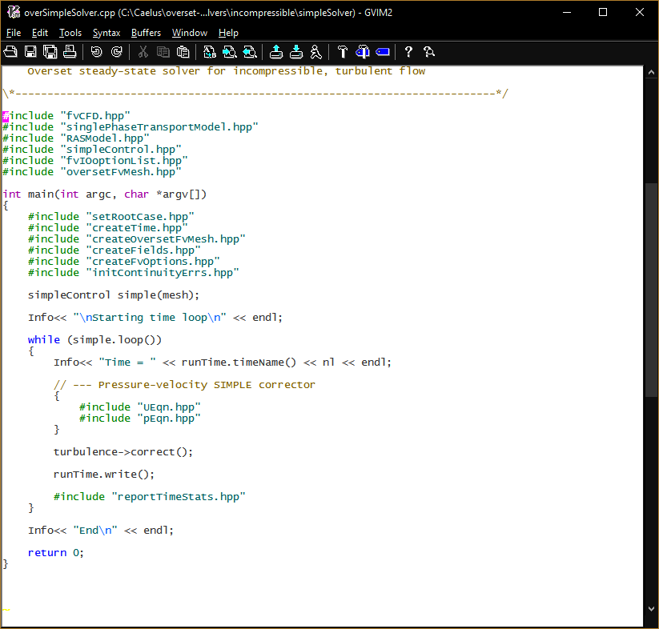
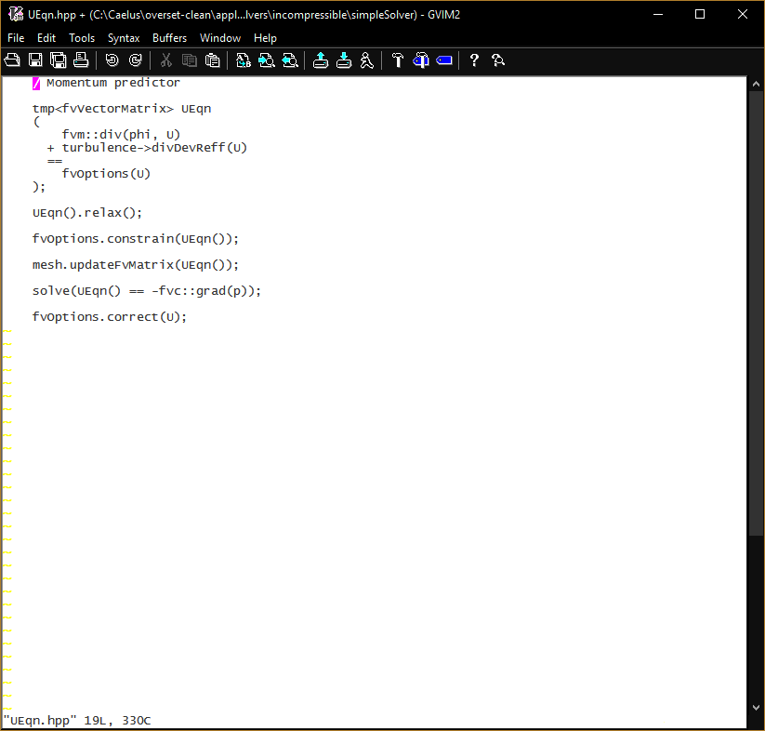
Solvers
Will initially provide:
Single phase: static and dynamic
Multi-phase (VOF): static and dynamic
Adding solvers “should” be trivial

Slide 18
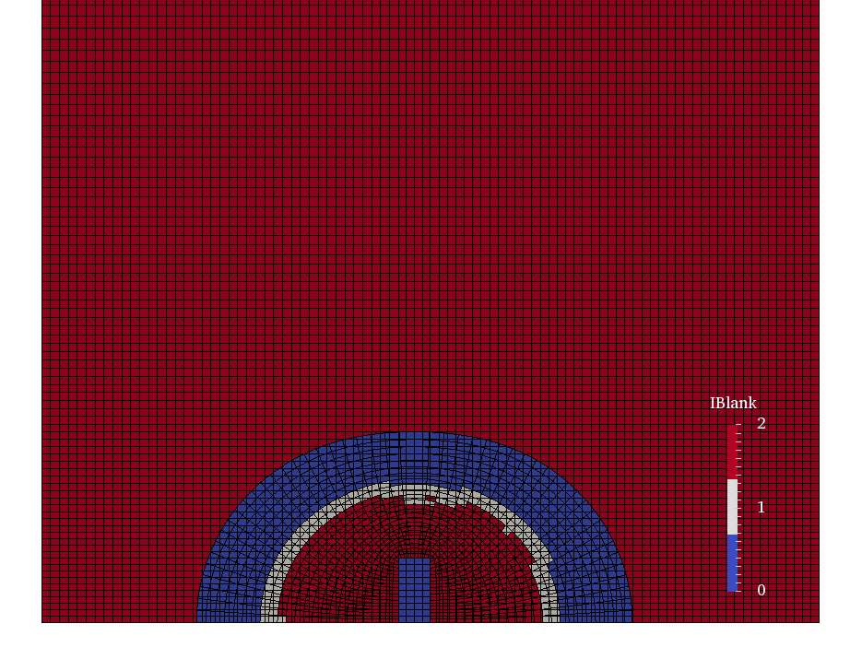
Utilities
Move component grids with:
Prescribed motion (DCI files)
motion.xml
Create overset data: iblank, component ids
Compute mass and moment of inertial properties of bodies

Slide 19
Static Validation

Slide 20
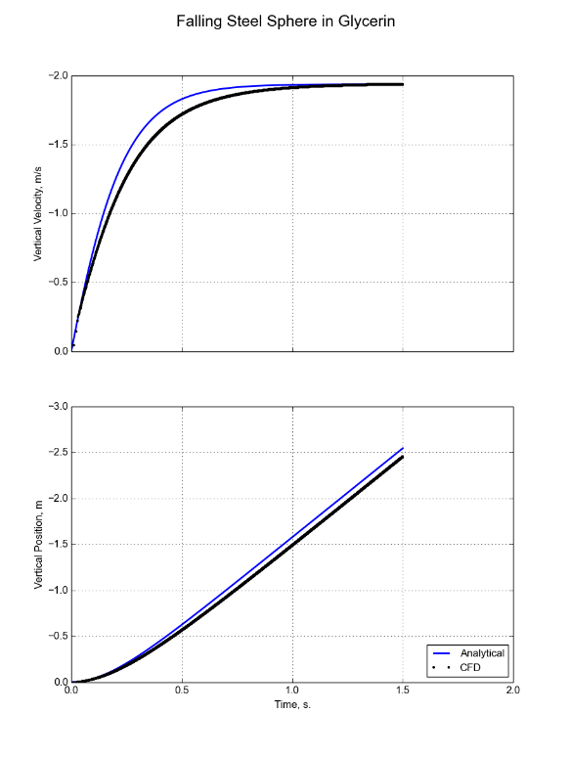
6 DoF Validation

Slide 21
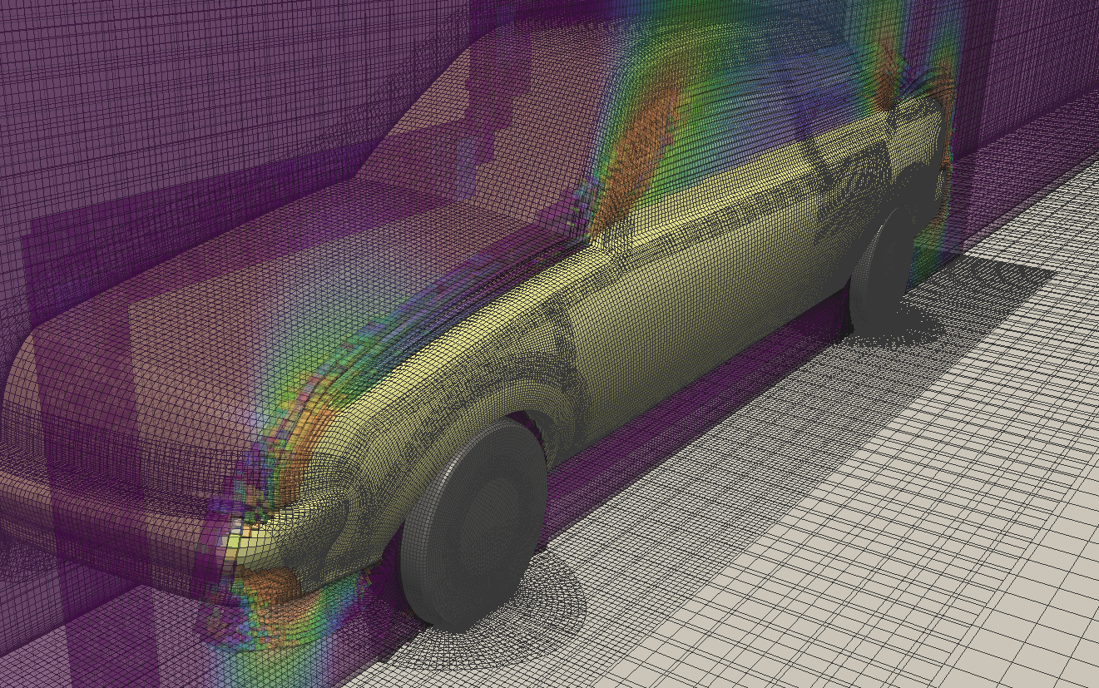
Availability
Yes
Open-source but not free (as in beer)

Slide 22
What is ?
Caelus is a derivative of OpenFOAM
Open and free (as in beer): www.caelus-cml.com
Supports multiple platforms (Windows, Linux and Mac)
Robust compilation: Scons
Easy to install
Verified schemes and Validated solvers and turbulence models
Documentation and validation cases
Improved algorithmic robustness on non-”perfect” meshes
Improved accuracy on non-”perfect” meshes
Swak, Python wrapping, etc
New compressible solvers and turbulence models
New VLES turbulence model class
Stable, predictable API

Slide 23
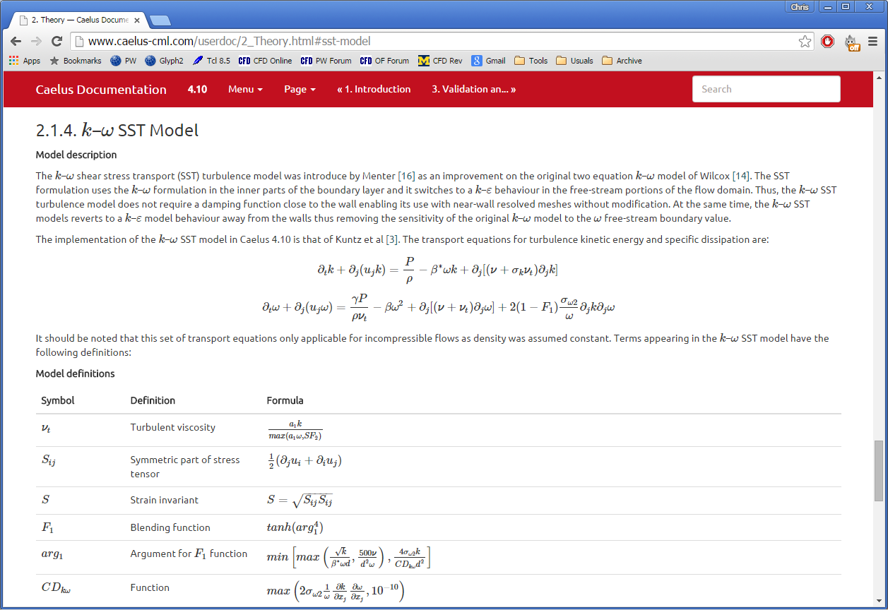
What is Caelus?
Documentation and validation cases
Easy installation with minimal dependencies (Python and MPI)

Slide 24
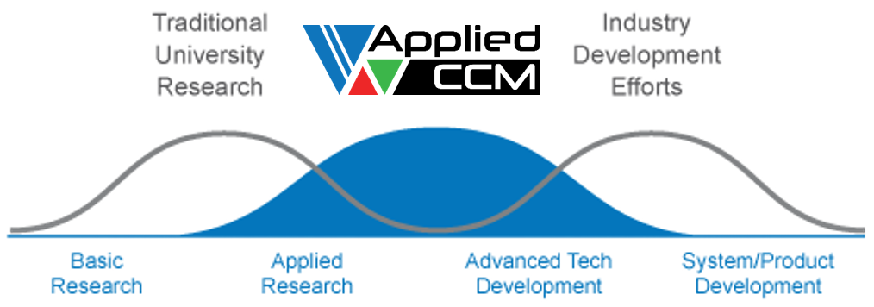
What we do
Specialise in the application, support and development of open source computational mechanics
Provides customer value by conducting industry-relevant TRL 2-6 R&D
Engage with customers as their technology partner
Industry Relevant Research

Slide 25
Technology Summary
Solvers
Highly efficient incompressible/compressible fractional-step solvers (AIAA Scitech 2015)
Combustion
Arrhenius finite-rate chemistry models (GTP 2015)
Thermo-acoustic instability solvers (JPP 2015)
Sensitivity, Optimization and Uncertainty (SOU)
Adjoint (SAE 2014)
Tangent
Uncertainty and error propagation
Turbulence modelling
VLES (APISAT 2015)
Acoustics solvers (JPP 2015)
Linearized Euler
Linearized Perturbed Compressible Equations (LPCE)
Overset

Slide 26
Current Research Projects
Multi-scale multiphase solver
Employ adjoint, tangent, polynomial chaos to:
Optimize for acoustic phenomena
Investigate uncertainty and error propagation of turbulence parameters and quantities (e.g. empirical coefficients)
Automated vertically integrated CFD workflows:
Meshing → Solving → Post-pro → SOU → Meshing …
Development of generic overset framework (solver agnostic) to enable:
Higher quality meshes
Multiple, nested dynamic body motions

Slide 27
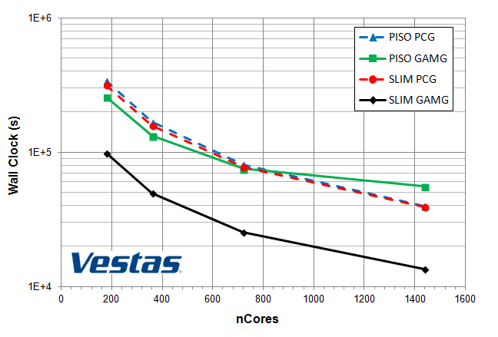
Semi Linear Implicit Method - SLIM
Fast, low dissipation fractional step solver based on projection method
Significantly better scalability than traditional implicit transient solvers
4X
Industrial parallel performance study of 50 million cell ABL simulation

Slide 28
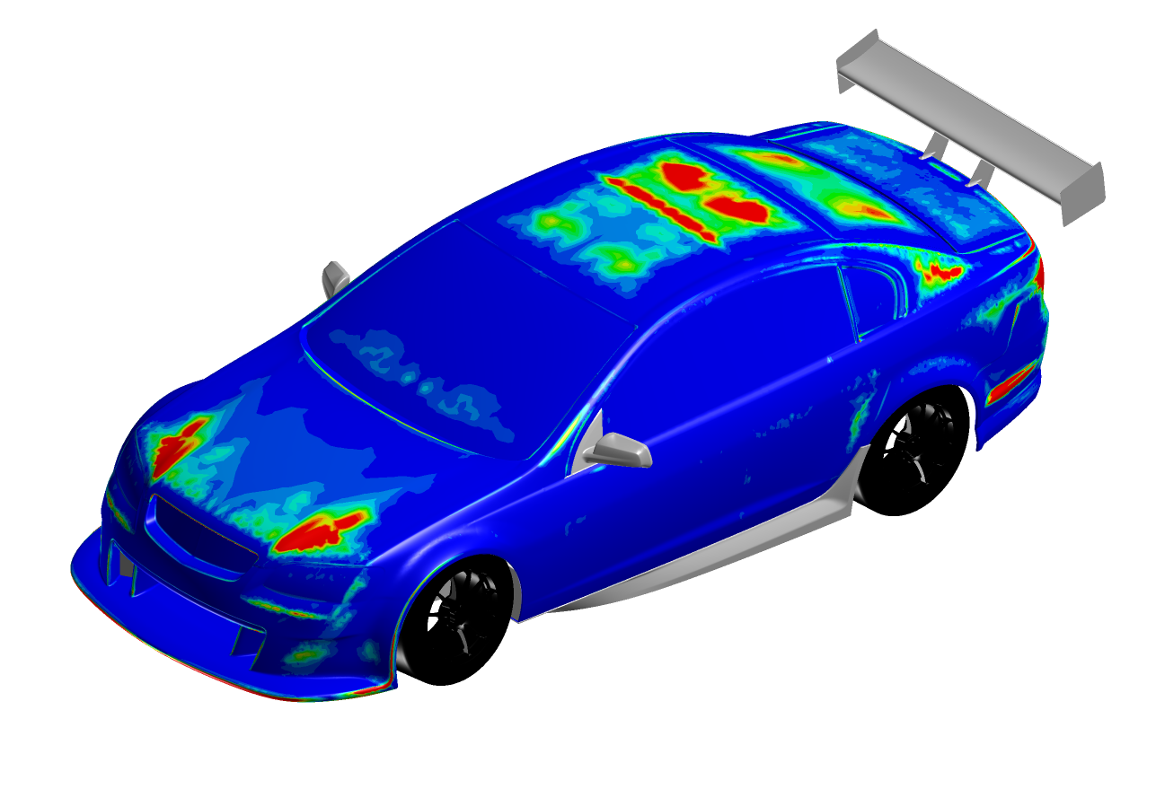
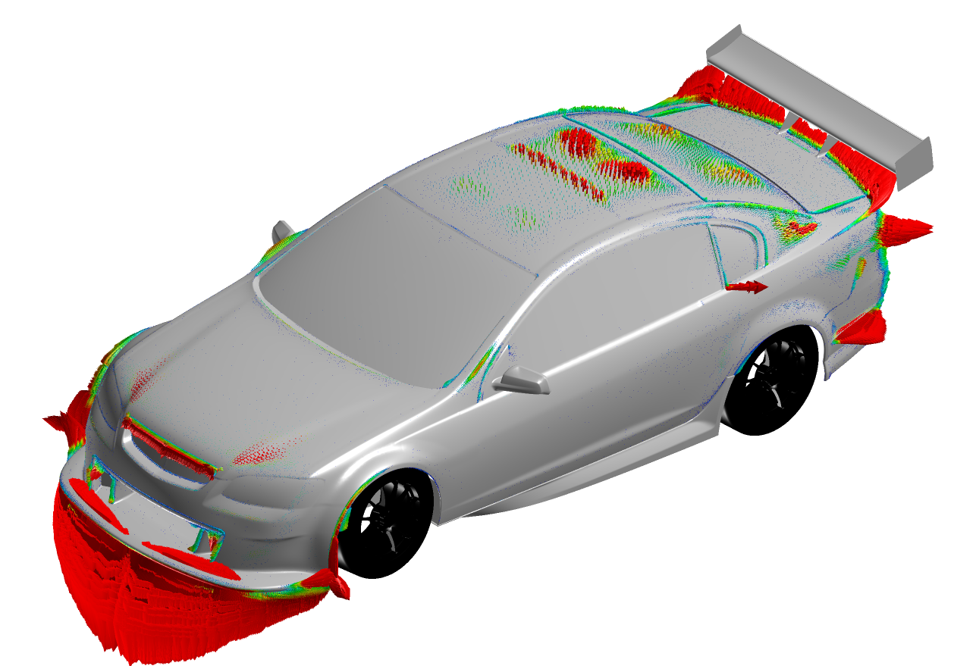
Adjoint
Time-symmetry preserving semi-discrete surface adjoint:
Provides both direction and magnitude
Tested on meshes up to 60M cells without limitation
Used to redesign front air dam on V8 supercar

Slide 29
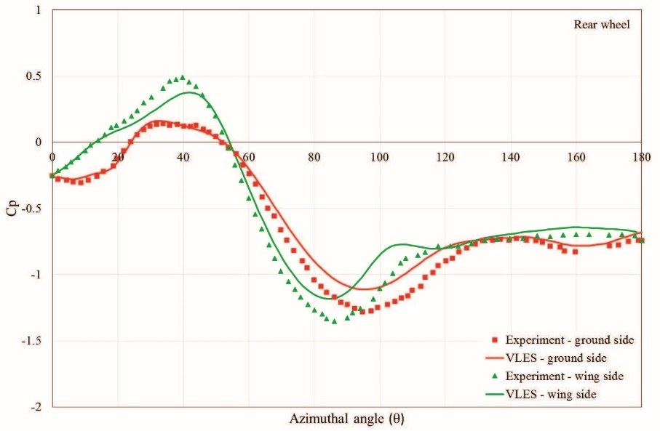
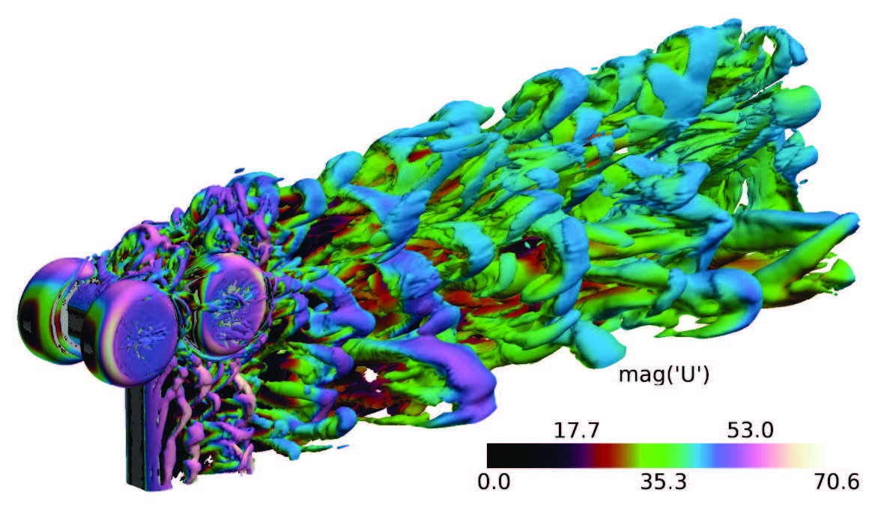
VLES: Hybrid RANS/DES Turbulence Model
Based off of Speziale, C. G. (1998) “Turbulence modeling for time-dependent RANS and VLES: A review”, AIAA J., 36, pp. 173–184.
Use resolution function, F_{r}, off body to blend RANS and LES
Rear wheel pressure coefficient
Rudimentary Landing Gear , AIAA Aeroacoustics Workshop

Slide 30
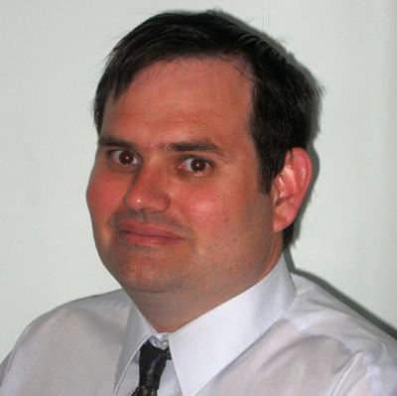
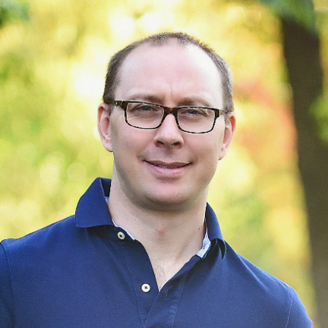
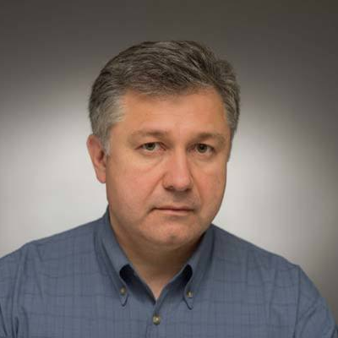
Who we are
Darrin Stephens
has an extensive background in modeling a range of complex reacting multiphase flows and led the development of CFD models for a number of industrial unit processes allowing re-design and optimization, improving throughput and efficiencies. He is the managing director and principle research engineer at Applied CCM Pty Ltd., a company providing development, technical support and training for the open source CFD software OpenFOAM. His professional interests include multi-phase algorithms, optimization algorithms, population balance modeling, coupled solvers and the development of next-generation hybrid and multi-physics models. He earned his Ph.D. degrees in mechanical engineering from James Cook University in Townsville, Australia.
Chris Sideroff
is the managing director and principle research engineer at Applied CCM Canada, a company providing development, technical support and training for open source based CFD software such as Caelus and OpenFOAM. His current research interests are automation methods for mesh generation, more robust discretization schemes for highly anisotropic and skewed meshes for finite volume based CFD solvers, work flow automation (pre, solve, post) with interpreted programming languages such as Python, and overset grid technologies. He earned his Ph.D. degree in mechanical and aerospace engineering from Syracuse University in Syracuse, USA.
Aleks Jemcov
has 20 years of experience in computational fluid dynamics and turbomachinery related flows. His research interests include development of numerical algorithms for fluid mechanics, solid-fluid interactions, efficient solver methodologies applicable to both compressible and incompressible flows, thermo-acoustics, turbulence modeling, and linear algebra. Prior experience includes work in the Combustion Dept. at Pratt & Whitney Canada, Development Dept. at Fluent Inc., and the Development Department and Fluids Business Unit at ANSYS, Inc. He currently serves as Associate Director for Computational Sciences at the Notre Dame Turbomachinery Laboratory and is a Research Assistant Professor in the Aerospace and Mechanical Engineering Department at the University of Notre Dame. He earned his Ph.D. in Aerospace Engineering from the University of Belgrade.

Slide 31
Questions
Applied CCM Inc
Dr Chris Sideroff
Phone: +1 613 276 7472
Email: c.sideroff@appliedccm.ca
Web: www.appliedccm.com
Applied CCM Pty Ltd
Dr Darrin Stephens
Phone: +61 03 8376 6962
Email: d.stephens@appliedccm.com.au
Web: www.appliedccm.com
www.caelus-cml.com

